Slide 1
SBIRT Training
Tiffany Lee-Parker, PhD
Denise Bowen, MA, PA-C
Stephen Craig, PhD

Slide 2
SBIRT Training
What is SBIRT and why use it?
Screening for Substance Use Disorders (SUDs)
Essential Motivational Interviewing (MI) Skills
Brief Intervention
Referral to Treatment

Slide 3
What Is SBIRT?
An intervention based on “motivational interviewing” strategies
Screening: Universal screening for quickly assessing use and severity of alcohol; illicit drugs; and prescription drug use, misuse, and abuse
Brief Intervention: Brief motivational and awareness-raising intervention given to risky or problematic substance users
Referral to Treatment: Referrals to specialty care for clients/patients with substance use disorders
Treatment may consist of brief treatment or specialty AOD (alcohol and other drugs) treatment.

Slide 4
Why Is SBIRT Important?
Unhealthy and unsafe alcohol and drug use are major preventable public health problems resulting in more than 100,000 deaths each year.
The costs to society are more than $600 billion annually.
Effects of unhealthy and unsafe alcohol and drug use have far-reaching implications for the individual, family, workplace, community, and the health care system.

Slide 5
Health Impacts of Problematic Substance Use
Hypertension, heart disease
Liver disease, gastritis, pancreatitis
Depression, anxiety, sleep dysfunction
Risk for breast, colon, esophageal, head, and neck cancers
HIV/AIDS, other STIs, and other infectious diseases
Trauma, disability

Slide 6
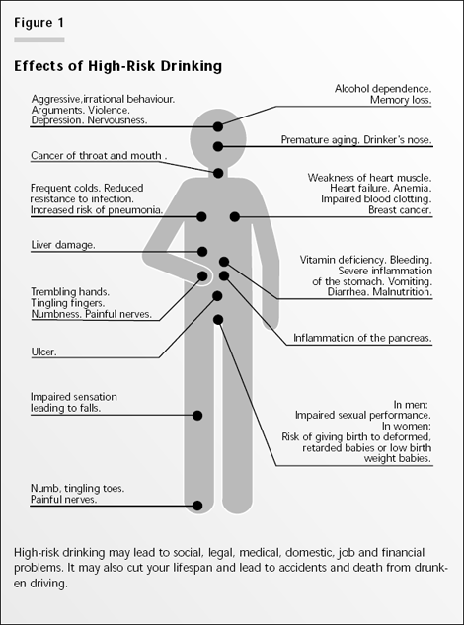
Medical and Psychiatric Harm of High-Risk Drinking

Slide 7
SCREENING

Slide 8
Prevalence of Substance Use
Substance | Female | Male
Tobacco | 23.9% | 37.8%
Alcohol (current drinkers) | 64.1% | 69.2%
Illicit Drugs | 13.7% | 19.8%
Misuse of Prescriptions | 5.2% | 6.1%
Notes:
Try to find updated statistics

Slide 9
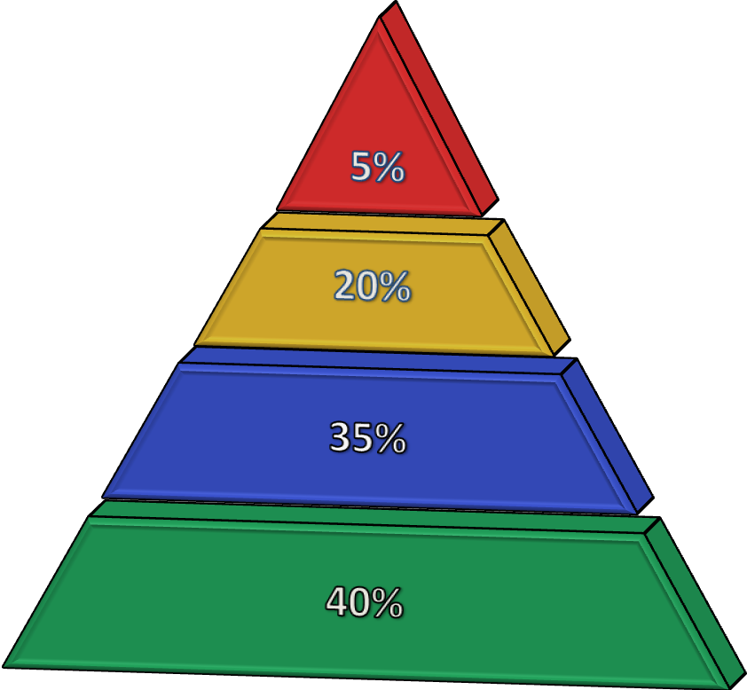
Based on Findings of Screening
Dependent Use
Harmful Use
At-Risk Use
Low Risk

Slide 10
Screening Tools
Screening
Utilized to detect and stratify at-risk substance use
Combines the interpersonal inquiry and the application of inventories
AUDIT
DAST (10)
CAGE-AID
CRAFFT
Sets the stage for effective intervention
See handouts in your binder

Slide 11
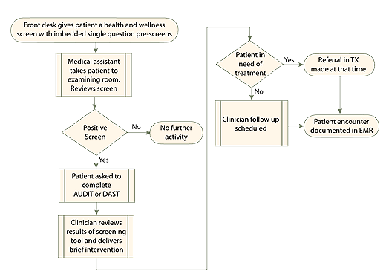
Screening in a Practice Setting
Most practices use a teaming approach

Slide 12
Alcohol Prescreening
Prescreen: Do you sometimes drink beer, wine, or other alcoholic beverages?
NO
YES
AUDIT C: How often do you have a drink containing alcohol? How many standard drinks containing alcohol do you have on a typical day? 3. How often do you have six or more drinks on one occasion?
Sensitivity/Specificity:
Male: 86%/89%
Female: 73%/91%
Male score of 4 or more, Female score 2 or more, complete full screen.
Source: www.integration.samhsa.gov/images/res/tool_auditc.pdf‎

Slide 13
Prescreening Drinking Limits
Determine the average drinks per day and average drinks per week—ask:
Recommended Limits
Men = 2 per day/14 per week
Women/anyone 65+ = 1 per day or 7 drinks per week
> Regular limits = at-risk drinker
On average, how many days a week do you have an alcoholic drink?
On a typical drinking day, how many drinks do you have? (Daily average)
Weekly average = days X drinks

Slide 14
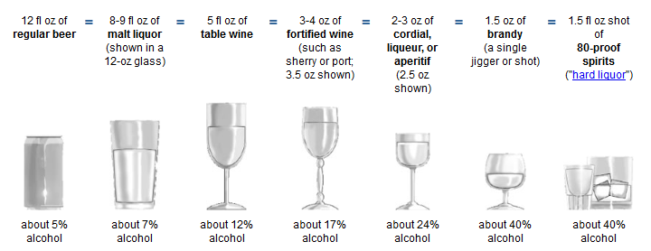
How Much Is “One Drink”?
Equivalent to 14 grams pure alcohol

Slide 15
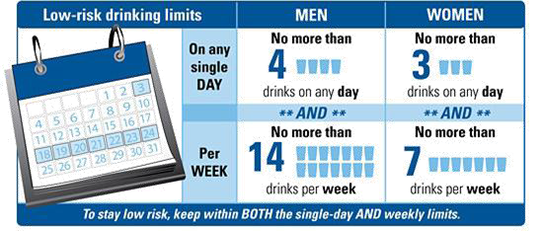
Drinking Limit Recommendations
For healthy adults age 65 and under:
For people over 65, exceeding 3 drinks a day or 7 drinks a week is not recommended.
Women who are pregnant or may become pregnant should not drink.

Slide 16
How Many Drinks Is This?
Take a moment and determine how many drinks for the following:
A 22 oz. Bell’s Two Hearted Ale
What is the ABV?
A 12 oz. Long Island Iced Tea
How many shots?
A 23 oz. Four Loco drink
What is the ABV?

Slide 17
How many drinks?
Two Hearted is 7% ABV
7% is almost twice the ABV for one standard drink
One, 12 oz Two Hearted is almost two standard drinks
A 22 oz. beer is almost double the size of a standard drink.
Therefore, a 22 oz. Two Hearted beer is almost FOUR standard drinks.

Slide 18
How many drinks?
A 12 oz. Long Island Iced Tea
5 different types of liquor
At ½ oz. per shot, it equates to 2.5 drinks
At 5 shots of liquor, it equates to 5 drinks

Slide 19
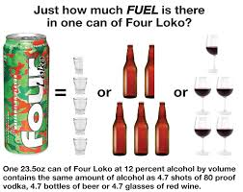

Slide 20
Handouts
Let’s look at the AUDIT, DAST, CAGE-AID, and CRAFFT
Commonly used drugs

Slide 21
Prescreening for Drugs
“How many times in the past year have you used an illegal drug or used a prescription medication for nonmedical reasons?”
(…for instance because of the feeling it caused or experiences you have…)
If response is, “None,” screening is complete.
If response contains suspicious clues, inquire further.
Sensitivity/Specificity: 100%/74%
Source: Smith, P. C., Schmidt, S. M., Allensworth-Davies, D., & Saitz, R. (2010). A single-question screening test for drug use in primary care. Arch Intern Med ,170(13), 1155−1160.

Slide 22
A Positive Drug Screen
ANY positive on the drug prescreen question puts the patient in an “at-risk” category. The followup questions are to assess impact and whether substance use is serious enough to warrant a substance use disorder diagnosis.
Ask which drugs the patient has been using, such as
cocaine, meth, heroin, ecstasy, marijuana, opioids, etc.
Determine frequency and quantity.
Ask about negative impacts.

Slide 23
Key Points for Screening
Screen everyone.
Screen both alcohol and drug use including prescription drug abuse and tobacco.
Use a validated tool.
Prescreening is usually part of another health and wellness survey.
Explore each substance; many patients use more than one.
Follow up positives or "red flags" by assessing details and consequences of use.
Use your MI skills and show nonjudgmental, empathic verbal and nonverbal behaviors during screening.
Notes:
23

Slide 24
Screening Stratifies Risk
Notes:
Joe – Slide Title?
The full alcohol and/or drug screens stratifies patients risk levels into zones of use. These zones inform the type of intervention to be delivered.

Slide 25
Brief Negotiated Interview

Slide 26
What Is Brief Intervention?
Brief Intervention
a brief motivational and awareness-raising intervention given to risky or problematic substance users.
The Brief Negotiated Interview (BNI)
a semistructured interview process based on MI that is a proven evidence-based practice and can be completed in 5−15 minutes.

Slide 27
Refer to Handout
SBIRT Flow Chart

Slide 28
Change Talk

Slide 29
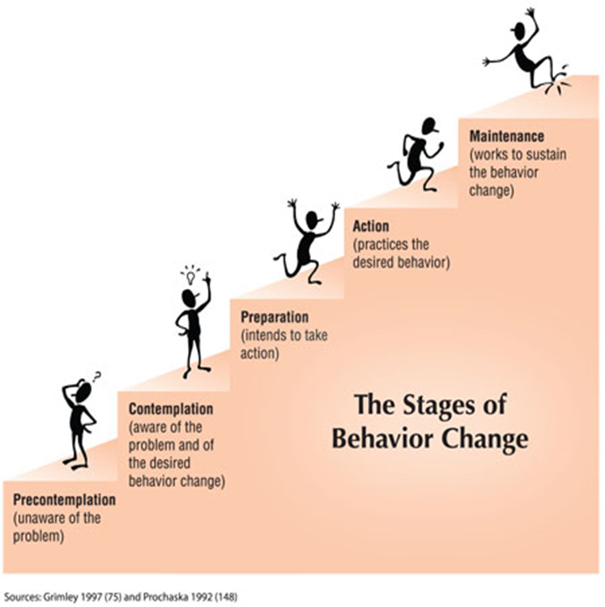

Slide 30
Remember
“Readiness to change”
State of Being
Personality Trait

Slide 31
Increase Change Talk
DARN-CAT
Change talk is at the heart of MI. We want to elicit—
Preparatory change talk
Desire: I want to change.
Ability: I can change.
Reason: It’s important to change.
Need: I should change.
Implementing change talk
Commitment: I will make changes.
Activation: I am ready, prepared, willing to change.
Taking steps: I am taking specific actions to change.
Source: “An Overview of Motivational Interviewing,” Motivational Interviewing website (www.motivationalinterview.org/Documents/1%20A%20MI%20Definition%20Principles%20&%20Approach%20V4%20012911.pdf)

Slide 32
Exercise
What would be some examples of change talk?
Now let’s look at the handouts in your packet

Slide 33
Motivational Interviewing

Slide 34
Definition of Motivational Interviewing
“Motivational interviewing is a client-centered, directive method for enhancing intrinsic motivation to change by exploring and resolving ambivalence.”

Slide 35
Motivational Interviewing
The tasks of MI are to—
Engage, through having sensitive conversations with clients/patients.
Focus on what is important to the client/patient regarding behavior, health, and welfare.
Evoke the client/patient’s personal motivation for change.
Negotiate plans.
Motivating often means resolving conflicting and ambivalent feelings and thoughts

Slide 36
Matt Foley: The Original Motivational Speaker
http://www.hulu.com/watch/4183

Slide 37
What MI Is Not
A way of tricking people into doing what you want them to do
A specific technique
Problem solving or skill building
Just patient-centered therapy
Easy to learn
A panacea for every clinical challenge
Miller, W. R., & Rollnick, S. (2012).

Slide 38
Motivational Interviewing Principles

Slide 39
MI Principles (continued)
MI is founded on four basic principles:
Express empathy.
Develop discrepancy.
Roll with resistance.
Support self-efficacy.

Slide 40
Four Other Guiding MI Principles
Resist the righting reflex.
If a patient is ambivalent about change, and the clinician champions the side of change…

Slide 41
Four Other Guiding MI Principles (continued)
Understand your client’s/patient’s motivations.
With limited consultation time, it is more productive asking clients/patients what their reasons are and why they choose to change, rather than telling them they should.

Slide 42
Four Other Guiding MI Principles (continued)
Listen to your client/patient.
When it comes to behavior change, the answers most likely will lie within the client/patient, and finding answers requires listening.

Slide 43
Four Other Guiding MI Principles (continued)
Empower your client/patient.
A client/patient who is active in the consultation, thinking aloud about the why, what, and how of change, is more likely to do something about it.

Slide 44
MI Steps and Core Skills

Slide 45
Motivational Interviewing Core Skills

Slide 46
Core MI
Open-ended questions
Affirmations
Reflections
Summaries

Slide 47
Open-Ended Questions
Using open-ended questions—
Enables the client/patient to convey more information
Encourages engagement
Opens the door for exploration

Slide 48
Open-Ended Questions (continued)
What are open-ended questions?
Gather broad descriptive information
Require more of a response than a simple yes/no or fill in the blank
Often start with words such as—
“How…”
“What…”
“Tell me about…”
Usually go from general to specific

Slide 49
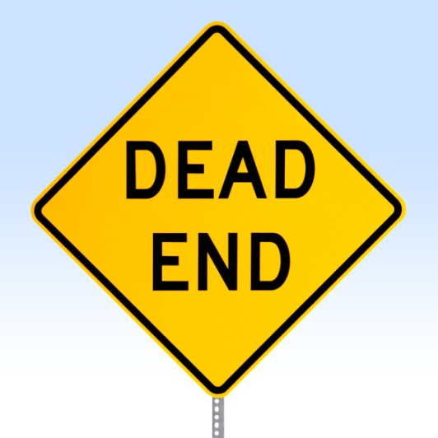
Closed-Ended Questions Present Conversational Dead Ends
Closed-ended questions typically—
Are for gathering very specific information
Tend to solicit yes-or-no answers
Convey impression that the agenda is not focused on the patient

Slide 50
Affirmations
What is an affirmation?
Compliments or statements of appreciation and understanding
Praise positive behaviors
Support the person as they describe difficult situations

Slide 51
Affirmations May Include:
Commenting positively on an attribute
“You are determined to get your health back.”
A statement of appreciation
“I appreciate your efforts despite the discomfort you’re in.”
A compliment
“Thank you for all your hard work today.”

Slide 52
Reflective Listening
Reflective listening is one of the hardest skills to learn.
“Reflective listening is a way of checking rather than assuming that you know what is meant.”
(Miller and Rollnick, 2002)

Slide 53
Reflective Listening (continued)
Involves listening and understanding the meaning of what the client/patient says
Accurate empathy is a predictor of behavior change

Slide 54
Levels of Reflection
Simple Reflection— stays close
Repeating
Rephrasing (substitutes synonyms)
Example:
Client/Patient: I hear what you are saying about my drinking, but I don’t think it’s such a big deal.
Clinician: So, at this moment you are not too concerned about your drinking.

Slide 55
Levels of Reflection (continued)
Complex Reflection— makes a guess
Paraphrasing—major restatement, infers meaning, “continuing the paragraph”
Examples
Client/Patient: “Who are you to be giving me advice? What do you know about drugs? You’ve probably never even smoked a joint!
Clinician: “It’s hard to imagine how I could possibly understand.”
***
Patient: “I just don’t want to take pills. I ought to be able to handle this on my own.”
Clinician: “You don’t want to rely on a drug. It seems to you like a crutch.”

Slide 56
Summaries
Periodically summarize what has occurred in the counseling session.
Summary Usages
Begin a session
End a session
Transition
Purpose of Summaries
Elicits, affirms, and reinforces motivation to change
Helps resolve ambivalence and reinforces motivation

Slide 57
Summaries (continued)
Examples
“So, let me see if I’ve got this right…”
“So, you’re saying… is that correct”
“Make sure I’m understanding exactly what you’ve been trying to tell me…”
Double sided reflections are often highly effective as summaries to illustrate ambivalence.

Slide 58
Motivational Interviewing Strategies

Slide 59
Readiness Rulers: I-C-R
Readiness rulers can address:
Importance
Confidence
Readiness
Notes:
59

Slide 60
Initiating Reflective Discussion
Start the reflective discussion asking permission of our patients to have the conversation.
Example: “Would it be all right with you to spend a few minutes discussing the results of the wellness survey you just completed?”

Slide 61
Providing Feedback
Substance use risk
Based on your AUDIT screening—
Score: 27
You are here
Low Moderate High Very High
0 40
Feedback Process
Ask Permission to Give Information
Discuss Findings
Link Behaviors to Known Consequences
Content to Review
Score
Level of risk
Risk behaviors
Normative behavior

Slide 62
Evoking Personal Meaning
Reflective questions: From your perspective…..
What relationship might there be between your drinking and ____?
What are your concerns regarding use?
What are the important reasons for you to choose to stop or decrease your use?
What are the benefits you can see from stopping or cutting down?

Slide 63
Negotiating Commitment
Developing a plan that is:
Simple
Realistic
Specific
Attainable
Followup time line
Negotiating
a
PLAN

Slide 64
Video and Discussion
Motivational Interviewing Video
The following video is a brief video demonstration of some of the key elements of Motivational Interviewing.

Slide 65
Referral to Treatment

Slide 66
Referral
How often do you think referrals are warranted?
Out of every 100 patients, how many referrals are given?
(a) 5 (b) 10 (c) 20 (d) 25

Slide 67
Referral
Approximately 5 percent of patients screened will require a referral to either brief treatment or specialty treatment.

Slide 68
What Is Treatment?
Treatment may include—
Counseling and other psychosocial rehabilitation services
Medications
Involvement with self-help (AA, NA, Al-Anon)
Complementary wellness (diet, exercise, meditation)
Combinations of the above

Slide 69
What Is Treatment? (continued)
Substance abuse treatment is provided within levels of care often available in multiple treatment settings.
Level of care is determined by severity of illness: Does the person have a substance use disorder, and are there medical or psychiatric comorbidities?
Inpatient treatment is reserved for those with more serious illness (SUD, comorbidity).

Slide 70
A Strong Referral to Appropriate Treatment Provider Is Key
When the person is ready—
Make a plan with the client/patient.
You or your staff should actively participate in the referral process. The warmer the referral handoff, the better the outcome.
Decide how you will interact/communicate with the provider.
Confirm your follow-up plan with the client/patient.
Decide on the ongoing follow-up support strategies you will use.

Slide 71
What Is a Warm-Handoff Referral?
The “warm-handoff referral” is the action by which the clinician directly introduces the person to the treatment provider at the time of the client/patient’s visit. The reasons behind the warm-handoff referral are to establish an initial direct contact between the person and the treatment counselor and to confer the trust and rapport. Evidence strongly indicates that warm handoffs are dramatically more successful than passive referrals.

Slide 72
Considerations When Choosing a Treatment Provider
Language ability/cultural competence
Family support
Services that meet the person’s needs
Record of keeping primary care provider informed of client/patient’s progress and ongoing needs
Accessible location/transportation

Slide 73
Payment for Services
Does the provider accept your client/patient’s insurance?
Will the client/patient need to get prior insurance authorization?
If the client/patient does not have insurance, does the provider offer services on a sliding-fee scale?
Notes:
Payment of services is an important factor as well. Does the provider accept your patient's insurance? Will you or the patient need to get prior insurance authorization before treatment is initiated? And if the patient has no insurance, does the provider offer services on a sliding fee scale?

Slide 74
What Should You Expect?
Substance abuse treatment facilities should provide you ongoing updates with a valid release of information.
If they do not, you may choose to refer elsewhere.

Slide 75
What Should You Expect?
Substance abuse treatment facilities should provide you with a structured discharge plan discussing the client/patient’s ongoing treatment needs and recommend providers.

Slide 76
Common Mistakes To Avoid
Rushing into “action” and making a treatment referral when the client/patient isn’t interested or ready
Referring to a program that is full or does not take the client/patient’s insurance
Not knowing your referral base
Not considering pharmacotherapy in support of treatment and recovery
Seeing the client/patient as “resistant” or “self-sabotaging” instead of having a chronic disease

Slide 77
Addiction Services
In Kalamazoo
Jim Gilmore – Inpatient
Elizabeth Upjohn - Outpatient
Behavioral Health Services – Outpatient
Pine Rest – Outpatient (Inpatient in GR)
Kalamazoo Community Mental Health – Co-occurring; Call for funding assistance and referral for substance abuse services
Victory Clinic – Methadone Clinic

Slide 78
Referral Resources
SAMHSA’s National Treatment Facility Locator http://findtreatment.samhsa.gov
West Michigan (Area 34) Alcoholics Anonymous http://wmaa34.com/Home.aspx
Michigan Narcotics Anonymous http://www.michigan-na.org
Kalamazoo Resources
http://www.referweb.net/gryp/
See your binder for a handout listing various resources in Kalamazoo county

Slide 79
Thank You
Any questions or comments?

