Slide 1

Loss Control for Hunger Programs
Tony Rey, Senior Vice President
Marsh
Cindy Smail, Loss Control Consultant
Marsh Risk Consulting

Slide 2
Hunger Program Topics
Campus Food Banks
Community Gardens
Resources
Insurance Coverage

Slide 3
Food Poisoning Is Common
CDC reports1 in 6 Americans gets sick from food poisoning yearly
1
6
in
Source - http://www.cdc.gov/foodsafety/facts.html

Slide 4
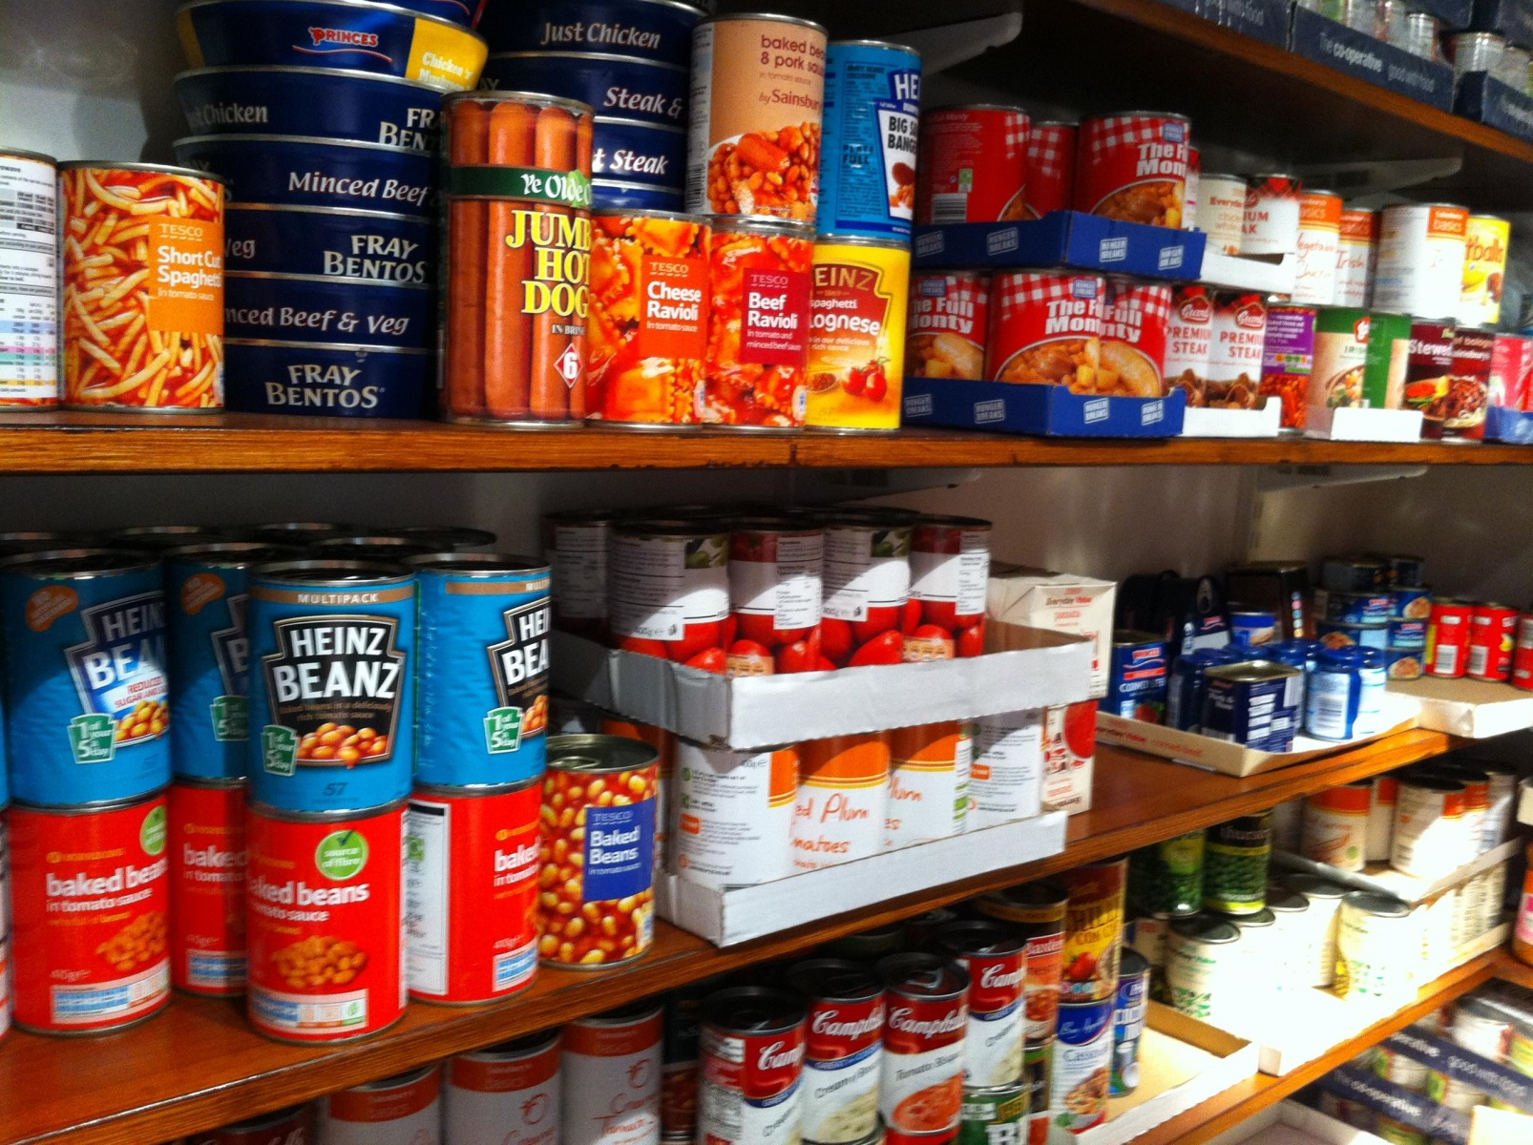
Campus Food Banks

Slide 5
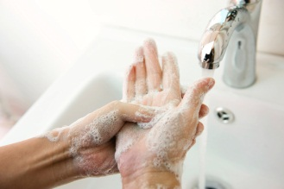
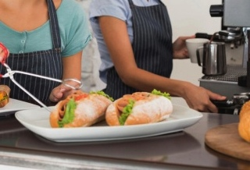


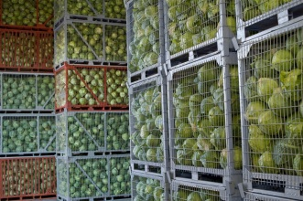
Foodborne Illness
Opportunities
Employee Health & Hygiene
Receiving
Storage
Preparation
Serving

Slide 6

Food Pantries Food Safety Practices
Basic Food Safety Training
Do/Do Not Accept Rules
Sanitation Procedures
Effective
Handwashing
Recordkeeping
Illness
Reporting
Pest
Control
Use By
Dates
Recall Procedures

Slide 7
DO
DO ACCEPT
Food products that do not require refrigeration
Whole, fresh fruit
Whole, fresh vegetables
Baked goods (not cream or meat filled)
Unopened commercially packaged or canned foods in sound condition
Condiments (e.g., salt, sugar, ketchup, relish, mustard, jams and jellies)

Slide 8
DON’T
DON’T ACCEPT
Leftover food or food prepared or canned in a home
Swollen, leaking, rusty, severely dented food containers
Unpasteurized dairy products
Spoiled, physically or chemicals contaminated foods
Ungraded eggs
Custom processed meats or poultry
Foods damaged by fire, flood, or accident

Slide 9
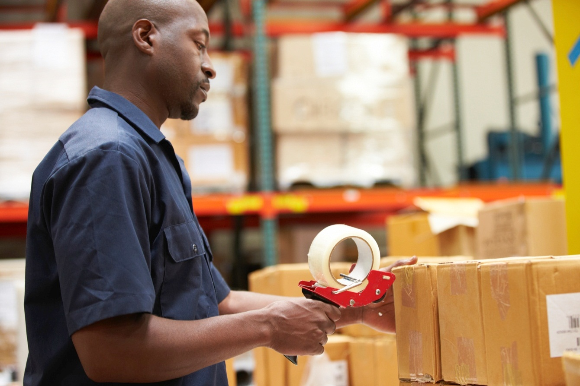
Receiving Food
  Known Suppliers
  Wholesome Stock
        - Free from spoilage
        - Free from pest/pest
        evidence
        - Packaging seals intact
        - Not expired
        - Appropriate temperature
  Documentation
Notes:
First opportunity to prove product is managed safely.
FSMA integration into sanitary transportation

Slide 10
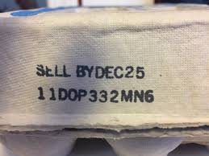
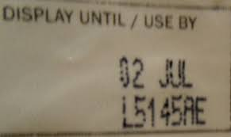
Food Dating
"Sell-By" date tells how long to display the product for sale. Customer should take the product before the date expires.
"Best if Used By (or Before)" date notes when the product will have the best flavor or quality as determined by the manufacture. This is not a purchase or safety date.

Slide 11
Recordkeeping and Recalls
Maintain records of:
Large donations including the source, date and amount donated
Recalls
  Written recall procedure
  Responsible person for following recall announcements, checking stock and completing recall steps
    Pull products from availability
    Determine method for discarding
    Communicate to workers
    Post on campus communications, communicate to clients

Slide 12
Michigan Department of Agriculture & Rural Development Rules
"Food establishment" means an operation that:
stores, prepares, packages, serves, vends food directly to the consumer, or otherwise provides FOOD for human consumption such as a restaurant; satellite or catered feeding location; catering operation if the operation provides FOOD directly to a CONSUMER or to a conveyance used to transport people; market; vending location; conveyance used to transport people; institution; or FOOD bank…
"Food establishment" does not include:
An establishment that offers only prePACKAGED FOODS that are not POTENTIALLY HAZARDOUS (TIME/TEMPERATURE CONTROL FOR SAFETY) FOODS;
b) A produce stand that only offers whole, uncut fresh fruits and vegetables;
(c) A FOOD PROCESSING PLANT; including those that are located on the PREMISES of a FOOD ESTABLISHMENT
More information at http://www.michigan.gov/documents/mdard/MI_Modified_2009_Food_Code_396675_7.pdf.

Slide 13
Michigan Department of Agriculture & Rural Development Rules
"Person in charge" means the individual present at a FOOD ESTABLISHMENT who is responsible for the operation at the time of an inspection. They must be able to:
Demonstrate food safety knowledge
Direct food employees
"Employee" means the PERMIT HOLDER, PERSON IN CHARGE, FOOD EMPLOYEE, PERSON having supervisory or management duties, PERSON on the payroll, family member, volunteer, PERSON performing work under contractual agreement, or other PERSON working in a FOOD ESTABLISHMENT.

Slide 14
Michigan Department of Agriculture & Rural Development Rules
Potentially Hazardous Food (Time/Temperature Control for Safety Food).
"Potentially hazardous food (time/temperature control for safety food)" means a FOOD that requires time/temperature control for safety (TCS) to limit pathogenic microorganism growth or toxin formation.

Slide 15

Sanitary Building
Floors, walls and ceiling must be easy to clean and in good repair.
Lighting is good.
Ventilation is provided to minimize odors.
Shelving, fixtures and cabinets are kept in good repair.

Slide 16

Pest Control
To Control Pests:
Interior receptacles for waste and returnables need to be durable, cleanable, insect- and rodent-resistant, leak-proof, and nonabsorbent.
Outside refuse kept in leak-proof, non-absorbent containers with tight lids.
Inspect the premises for pests and eliminate harborage areas. Properly seal all holes, gaps, and other openings to the outside to prevent pests from entering.
Inspect incoming shipments of food and supplies for pests.
Dispose of boxes and bags used to bring in food promptly.

Slide 17
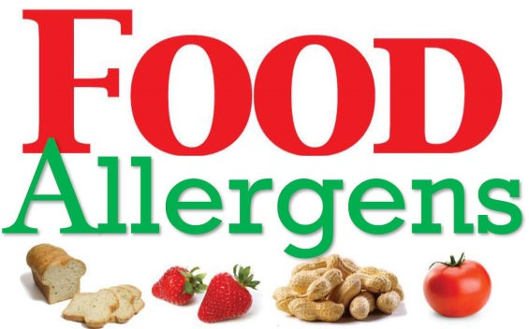


Training Options
Michigan Department of Agriculture & Rural Development - State Certified Food Manager
http://www.michigan.gov/mdard/0,4610,7-125-50772_45851_45855-182605--,00.html
Michigan Approved Allergen Training
http://www.michigan.gov/mdard/0,4610,7-125-50772_45851_45855-182605--,00.html
ServSafe – Food Safety Training
https://www.servsafe.com/

Slide 18
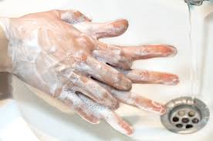
Employee and Volunteer Health and Hygiene
Don’t work if ill with respiratory or gastrointestinal issues
Make sure volunteers have a number to call to report off work
Workers should wash their hands:
  when beginning their shift
  after touching their face or hair
  when changing tasks (stocking food, taking out trash)
  after using the bathroom, smoking or eating
Food and drink should not be left open or consumed in the food bank

Slide 19
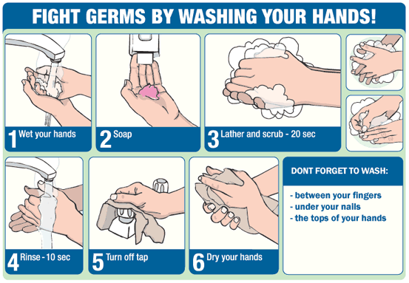
Proper Handwashing
Source – ww.cdc.gov

Slide 20
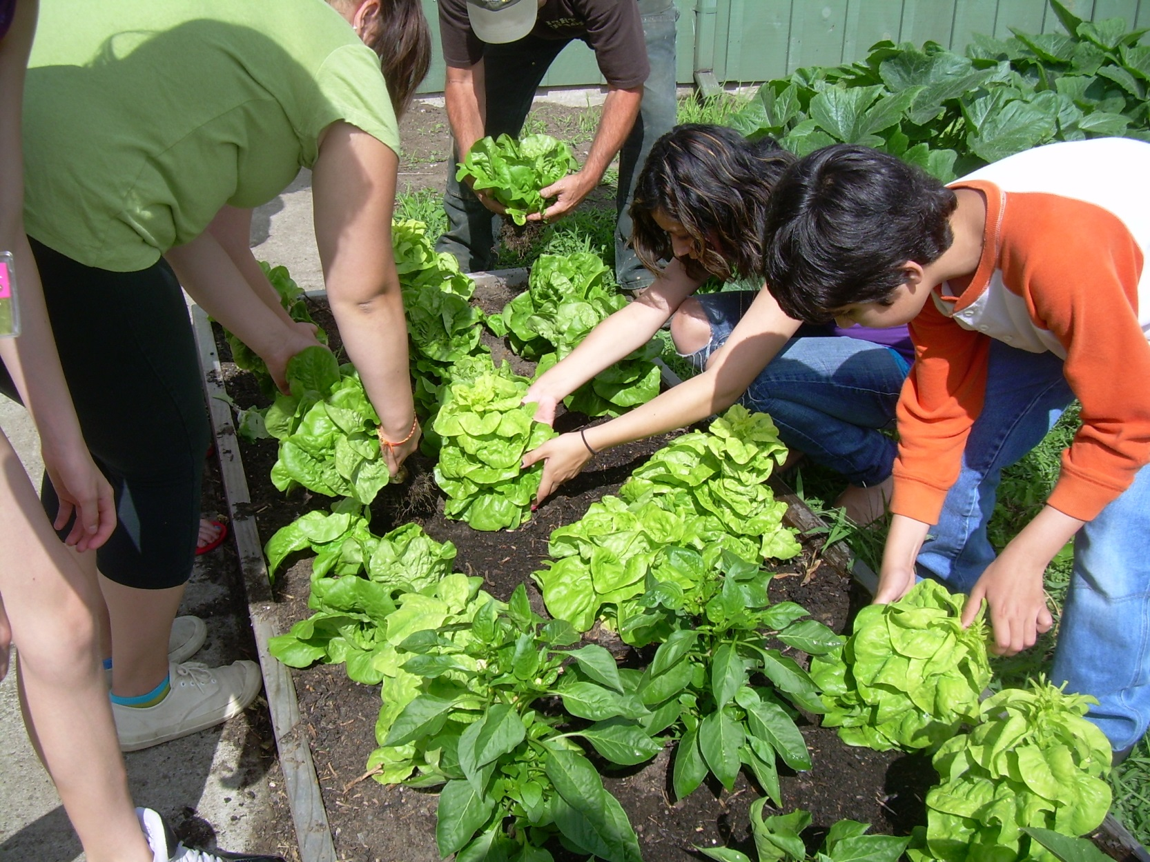
Community Gardens

Slide 21
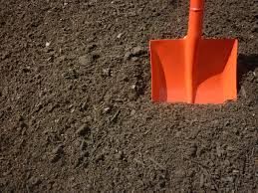
Site Controls
The growing site can impact the safety of the food grown:
Know the history of the site
Evaluate soil conditions
Research potential hazardous materials exposure
Evaluate herbicides

Slide 22
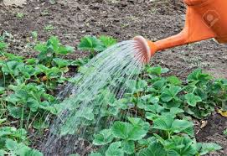
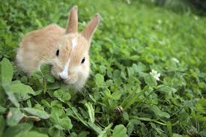
Site Controls
Choose Water Carefully
Irrigate with potable water and not water from streams
Test water before using it in the garden
Controlling Animals
Animals in the garden can introduce fecal matter and potentially foodborne illnesses
Fence in the garden to keep animals out
Trim branches so that birds will nest elsewhere

Slide 23
Garden Worker Sanitation
Workers should wash their hands with soap and water before they handle produce
They should rewash after using a bathroom, handling chemicals or compost materials or handling trash
If no running water is available, disposable gloves should be used to handle produce
Gardeners should not work in the garden if they are ill with diarrhea or cold symptoms
Cover cuts or other wounds on gardener’s arms, legs or hands
Source treated compost to ensure it’s prepared correctly

Slide 24
General Garden Safety
Heat & Sunburn
Chemical Exposure – Pesticides & Fertilizers
Hydration
Poisonous Plants
Garden Sanitation
Use Tools & Supplies Safely
Potential Contamination From Flooding
Insects

Slide 25

Harvesting, Cleaning and Handling
Do not harvest damaged plants, look for slug/snail slime or damage, or contaminated plants.
Use clean, food-grade containers to hold harvested produce.
When cutting produce from plants, use sharp cutting tools that are clean and sanitized.
Keep containers used to harvest produce off the ground. Use a clean tarp or wheelbarrow to keep produce clean.

Slide 26

Insurance Coverage

Slide 27
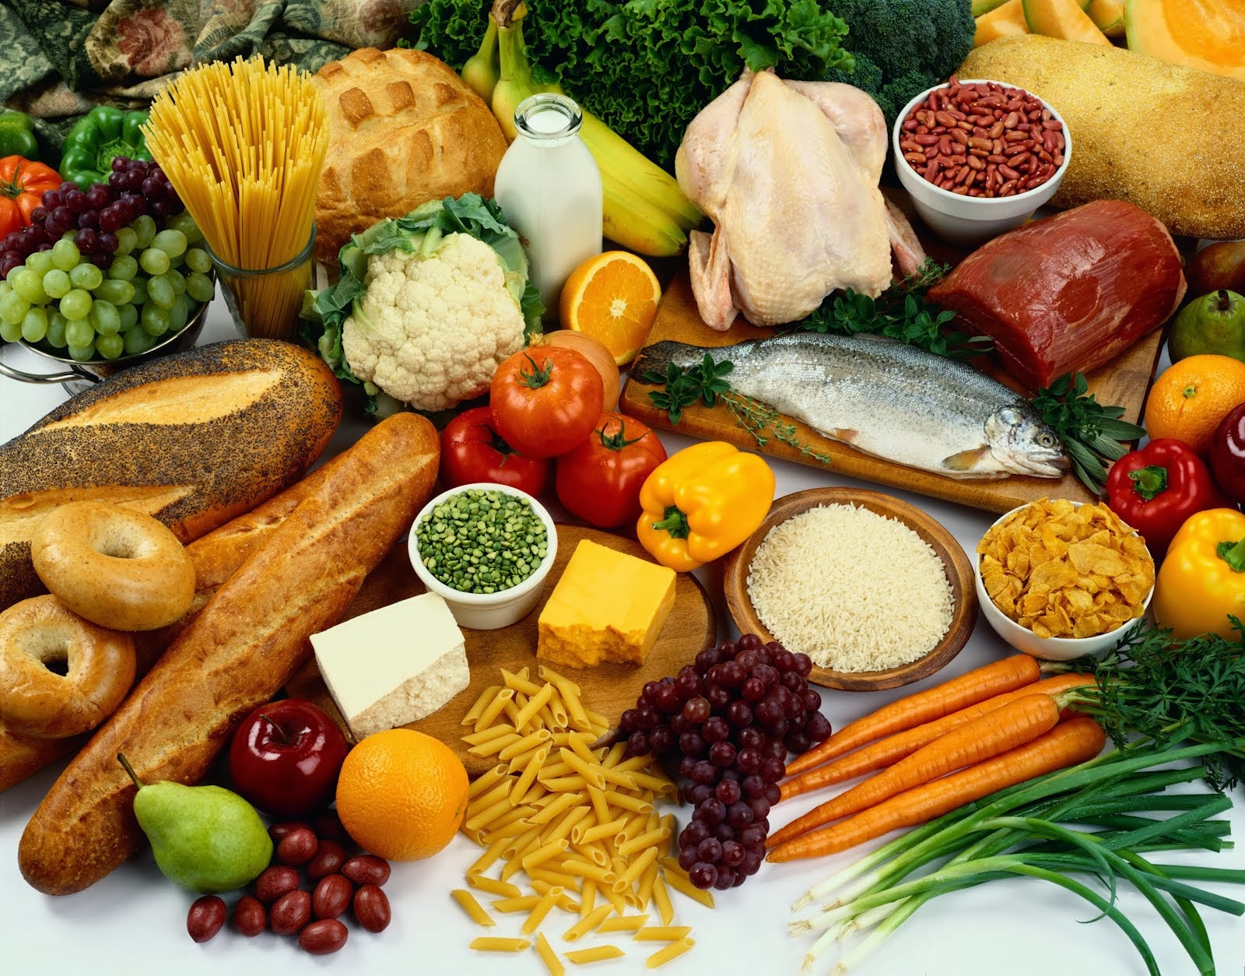
Resources

Slide 28
Regulatory Resources
USDA Recall Alerts Listing - http://www.fsis.usda.gov/wps/portal/fsis/topics/recalls-and-public-health-alerts?src_location=Content&src_page=FSISRecalls.
FDA Food Safety Recall Email Alerts - .http://www.fda.gov/Safety/Recalls/.
FDA Safe Food Handling Fact Sheets - http://www.fsis.usda.gov/wps/portal/fsis/topics/food-safety-education/get-answers/food-safety-fact-sheets/safe-food-handling
Food Safety for Schools and Community Gardens Handbook - https://foodsafety.ces.ncsu.edu/wp-content/uploads/2016/09/school-community-gardens-handbook-10-24-12.pdf?fwd=no
Notes:
FDA email alerts – Pantry Operator can stay up to date on recalls and know if they need to be pulled

Slide 29
?

Slide 30
This document and any recommendations, analysis, or advice provided by Marsh (collectively, the “Marsh Analysis”) are intended solely for the entity identified as the recipient herein (“you”). This document contains proprietary, confidential information of Marsh and may not be shared with any third party, including other insurance producers, without Marsh’s prior written consent. Any statements concerning actuarial, tax, accounting, or legal matters are based solely on our experience as insurance brokers and risk consultants and are not to be relied upon as actuarial, accounting, tax, or legal advice, for which you should consult your own professional advisors. Any modeling, analytics, or projections are subject to inherent uncertainty, and the Marsh Analysis could be materially affected if any underlying assumptions, conditions, information, or factors are inaccurate or incomplete or should change. The information contained herein is based on sources we believe reliable, but we make no representation or warranty as to its accuracy. Except as may be set forth in an agreement between you and Marsh, Marsh shall have no obligation to update the Marsh Analysis and shall have no liability to you or any other party with regard to the Marsh Analysis or to any services provided by a third party to you or Marsh. Marsh makes no representation or warranty concerning the application of policy wordings or the financial condition or solvency of insurers or reinsurers. Marsh makes no assurances regarding the availability, cost, or terms of insurance coverage.

