Slide 1
Accessibility Check
Open current syllabus or MS Word doc
Open the Review tab on the top menu
Select Check Accessibility
How many issues does the document have?

Slide 2
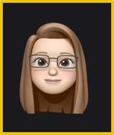
Document Accessibility
For Elearning
Cara Junghans
Assistive Technology Coordinator, WMUx
B.A. Secondary Education Social Studies
M.A. Higher, Adult, and Lifelong Education
Pg.C. Educational Technology
Cara.junghans@wmich.edu

Slide 3
Training Overview
The case for Accessibility
Review principles of accessibility and success criteria for creating accessible electronic documents
Best practices for creating accessible Word and PowerPoint
What makes a PDF document accessible? And when to use them
Accessibility Checkers built into Office and Elearning
Resources

Slide 4
Guiding laws and policy
The single most important thing to understand is that people use web sites in very different ways. This doesn’t just mean disabled people using special equipment but everyone – regardless of whether you might think of them as having a “special need”. – MEL PEDLEY, Owner of Black Widow Web Design

Slide 5
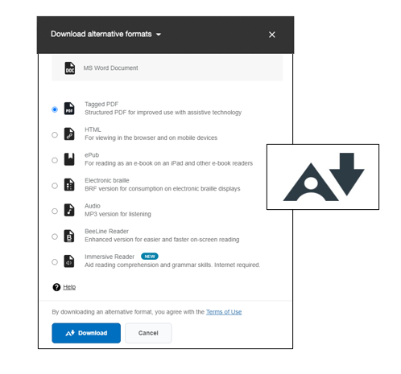
Accommodations, learning styles, convenience
Registered Disability | # of WMU Students
ADD/ADHD | 439
Autism Spectrum Disorder | 104
Blind/Low Vision | 32
D/deaf | 26
Learning Disability | 155
Medical Disability | 188
Mobility | 2
Other | 5
Psychological/Mental Health | 317
Temporary | 17
Total | 1,285
Count of Registered Disabilities with WMU DSS Office, Fall 2022

Slide 6
Principles of accessibility and success criteria for creating accessible electronic documents
Perceivable​
Text alternatives are equivalent for non-text content​ by ensuring that people who cannot hear audio or see video have alternatives​
Content can be presented in different ways​ and formats
Operable​
Functionality is available from a keyboard​
Users can easily navigate, find content, and determine where they are​
Content does not cause seizures​
3. Understandable
Text is readable and understandable
Content appears and operates in predictable ways
4. Robust
Content is compatible with current and future user tools
Content can be downloaded in an alternative format (Elearning)

Slide 7
Creating accessible documents
Intentional design and formatting
Logical Structure - Headers / Styles / Tags
Alt text – text for visual elements
Tables
Bulleted and numbered Lists
Hyperlinks with meaningful text
Captions
Color friendly palettes and contrast
Use Accessibility Checker
Document properties are set
Available Tools and Support
Authoring formatting options and Accessibility Checker
ALLY for Elearning Instructor Feedback
ALLY for Elearning Alternative Downloads
Go.wmich.edu Accessibility Articles
Self-paced Document Trainings via Siteimprove

Slide 8
Accessible Elearning Content: MS Word (365)

Slide 9
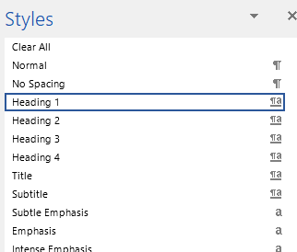
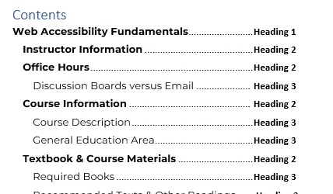
Headings and Styles provide navigation
Use Styles to create a logical structure that forms an outline of the content
Use Styles to create a Table of Contents
Open Navigation pane to view heading levels

Slide 10
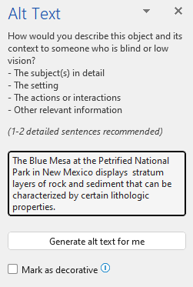
ALT Text / Image Descriptions
Alternative text, or “ALT Text”
Describes the content of images, graphs and charts. It should be added to every image that conveys meaning in instructional and communications materials.
How to write effective ALT Text
Be specific, and succinct
Use no more than two sentences to describe the image
Never start with “Image of …” or “Picture of …”
Include text that's part of the image
Don't add alt text to 'decorative' images
Review for spelling errors
Avoid images that do not add value - DECORATIVE
Add Alt Text
Select the Picture
Right click to select Alt text or use the Picture formatting menu on the top to select add Alt Text

Slide 11
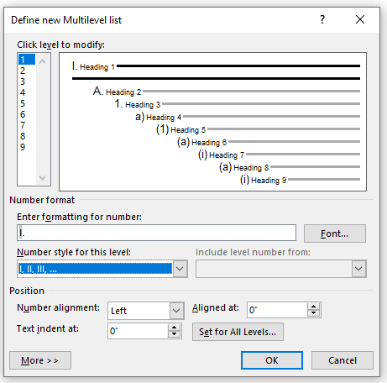
Lists
Unordered List
List with no specific order
Accessibility commonalities
Headers / Styles / Tags
Alt text
Tables – header rows and descriptions
Captions
Color and contrast
Consistency
Document properties
Ordered List
List with specific order
Directions Access Elearning
Open your web browser and type elearning.wmich.edu into the search bar
Log in with your Bronco NetID or guest account
Click the grid of 9 boxes at the top of the page to access the Elearning search and search for Web Accessibility Compliance
Multi-level List (outlining)

Slide 12
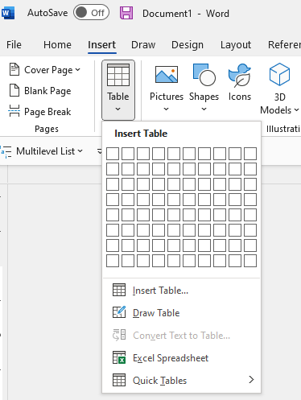
Tables
Tables are for Data!
Avoid complex tables - Do not merge cells
Check the Table Properties
Designate a Header Row
Add ALT Text
Be prepared to explain in writing, any data presented in a table, graph, chart, etc…

Slide 13
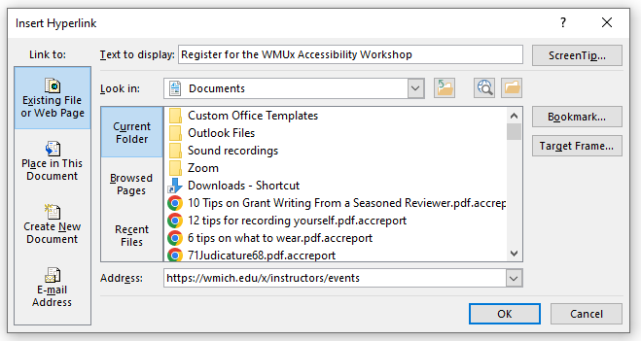
Meaningful Hyperlinks
Meaningful link text provides a clear description of where users will go once, they click on the link.
Link text that is the actual URL and is bad for screen reader users, if you can, avoid using just the URL
Highlight/select
Ctrl + K to open the Insert Hyperlink
Paste url in address
https://weather.com/weather/today/l/Kalamazoo+MI?canonicalCityId=c0af2e4d9dbb29ff340645ffa7f3303bf1a4752c754898066632b8d839ac9a4e
Examples of links that may be unclear if read out of context of the surrounding content:
Click Here to see today's weather.
More Info about web accessibility.
Examples of links that are concise, descriptive, and clear:
Today's weather.
Learn about web accessibility

Slide 14
Accessibility Checker
Use the built-in Accessibility checker
Open the Review tab from the ribbon
Select Check Accessibility
The Accessibility panel will open and provide the inspection results and additional information about the Errors, Warnings, and Tips
Check Accessibility options
Check entire document
Add Alt text
Open Navigation Pane for structure and heading view

Slide 15
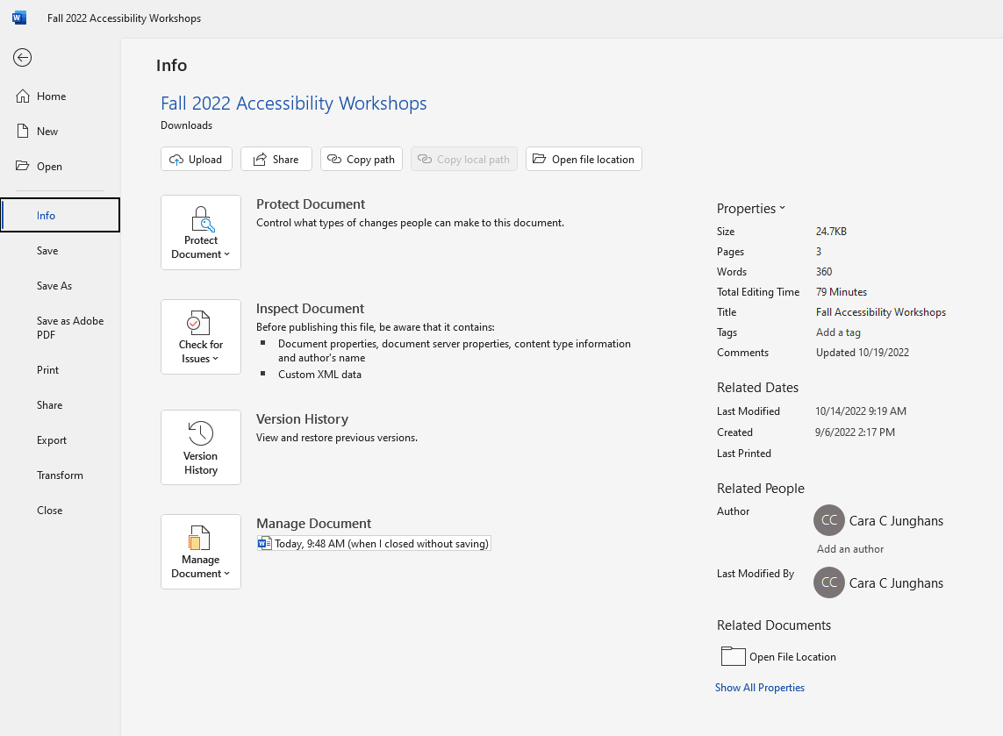
Document Properties
Ensure document properties are set and you have assigned a document title
Go to File on the top menu
Select Info
From the Properties menu on the right, add a Title and any relevant Comments (updates and modification notes)

Slide 16
Accessible Elearning Content: MS Power Point (365)

Slide 17
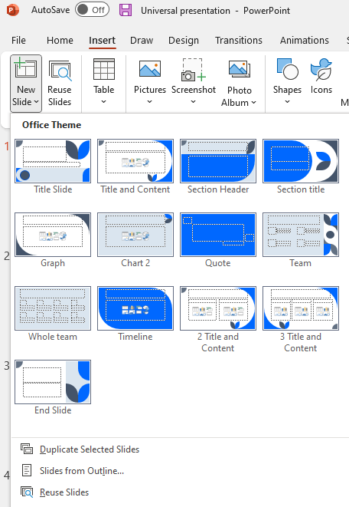
Formatted Templates and Slide Layouts
Use Formatted Templates when available
Select New
Type Accessible in the Search for online templates and themes
Use Slide Layouts for consistency and accessibility
From the top menu, select Insert
Use the New Slide option
This will create formatted slides with a title for each slide.

Slide 18
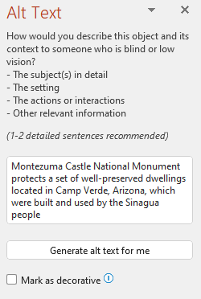
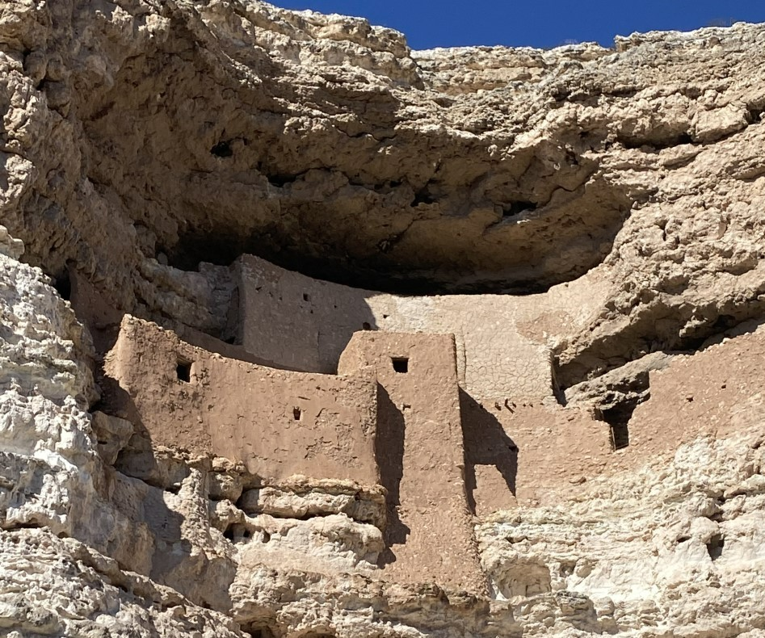
Alt Text
Add Alt text to all graphics and images
Select the Picture
Right click to select Alt text or use the Picture formatting menu on the top to select add Alt Text
Mark as Decorative if the graphic or image does not add value to the content.

Slide 19
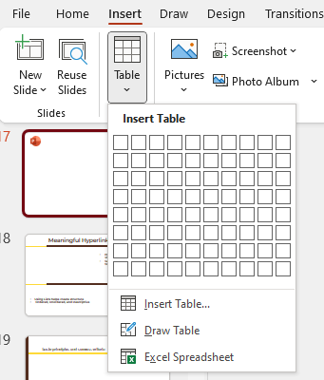
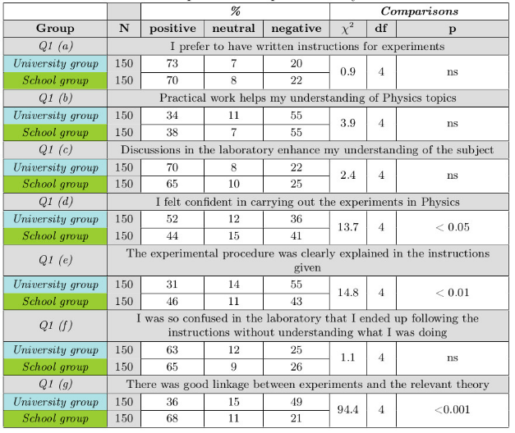
Data Tables
Do Not:
Use images of tables – be prepared to explain the data table in writing
Do not merge table cells
Avoid complex tables
Tables are for data!
Use the Insert > Table
Select the inserted table
Open the Table Design option from the top menu
Assign Header Rows and Banded Rows

Slide 20
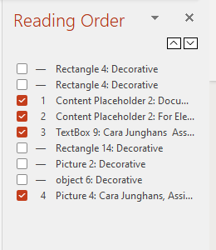
Slide Reading Order – Super Important!
With your presentation open, select Review > Check Accessibility.
When the reading order of the objects on a slide doesn't match one of the common ways objects are spatially ordered, Accessibility Checker lists the slide here.
Point at a slide number in the list, then select the up and down arrows to correct the reading order and mark objects as decorative

Slide 21
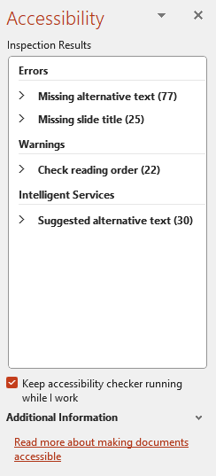
Accessibility Checker for PowerPoint
Use the built-in Accessibility checker
Open the Review tab from the ribbon
Select Check Accessibility
The Accessibility panel will open and provide the inspection results and additional information about the Errors, Warnings, and Tips
*Select an inspection result to learn where the issue it and more about why it matters and how to fix it

Slide 22
Accessible Elearning Content: PDFs

Slide 23
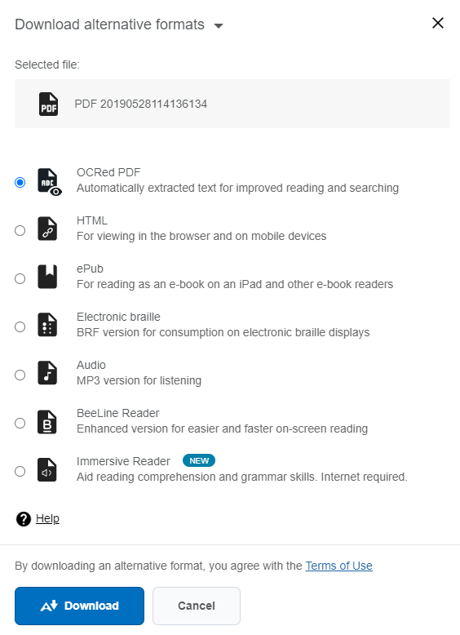
PDF Best Practices
PDFs created by scanning may actually be an image and not searchable text
Optical Character Recognition (OCR) is a technology that recognizes text within a digital image. It is commonly used to recognize text in scanned documents and images. With optical character recognition (OCR), you can extract text and convert scanned documents into editable, searchable PDF files instantly.
ALLY for Elearning will indicate if a PDF has been OCRed

Slide 24
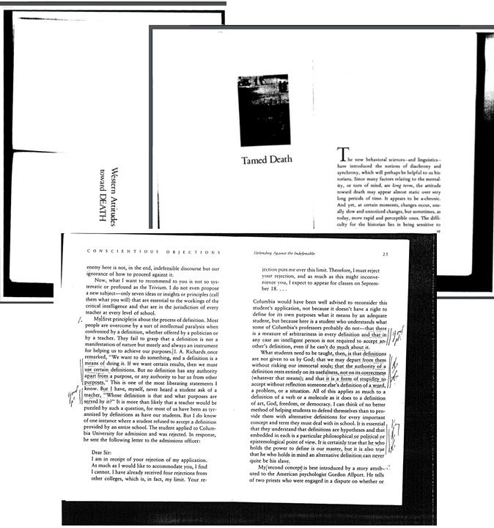
PDF Best Practices and Resources
Ensure that you have a CLEAN and STRAIGHT Scan
Document Properties are assigned
Headings/Tags
*Tags and Reading order is correct (Adobe DC)
*Images have Alt text (Adobe DC)
*Tables have header rows assigned (Adobe DC)
Online Resources – Alternative Versions
Does the PDF have an updated version of the content online?
Library Resources:
Subject Librarians
Digital Resource Librarian

Slide 25
Accessible Elearning Content: HTML Editor

Slide 26
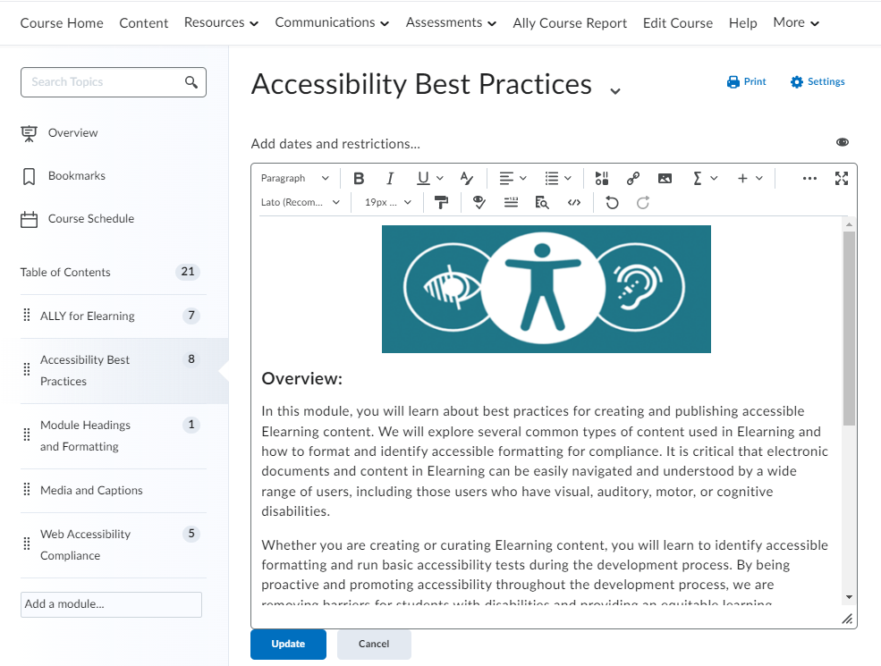
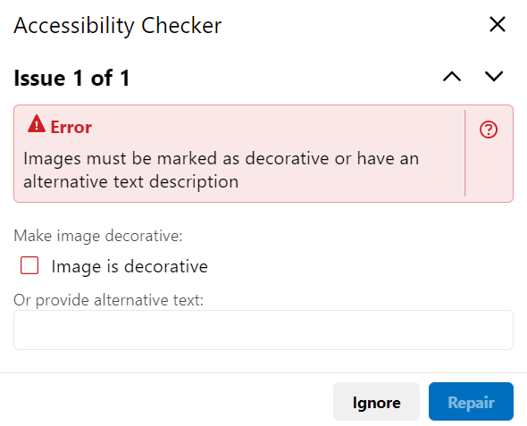
Elearning HTML Accessibility
Elearning HTML Accessibility Checker
Use of paragraphs as headings
Sequential headings
Ordered list structure
Unordered list structure
Contrast
Image ALT text
Complex table summary
Table caption and summary
Table heading scope, markup, and headers
Headings start at level 2

Slide 27
Accessible Elearning Content: ALLY
Receive feedback on the accessibility of your content
and Improve content accessibility with Ally's step-by-step instructions
In addition to providing you with insight into your content accessibility, Ally automatically creates alternative versions of your files.

Slide 28
Accessibility Indicators
Low (0-33%): There are severe accessibility issues.
Medium (34-66%): The file is somewhat accessible and needs improvement.
High (67-99%): The file is accessible but more improvements are possible.
Perfect (100%): Ally didn't identify any accessibility issues but further improvements may still be possible.

Slide 29
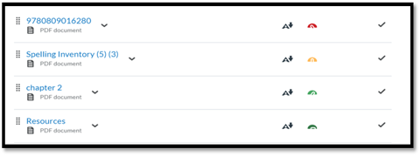
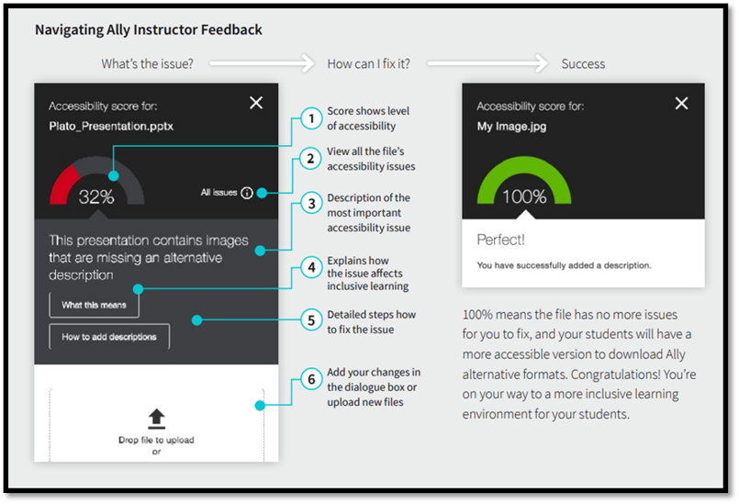
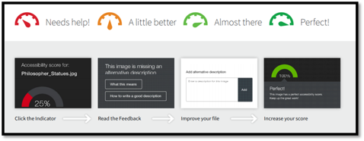
Instructor Feedback Panel

Slide 30
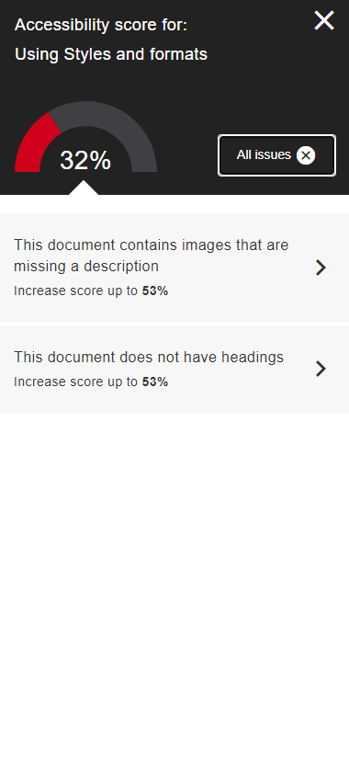
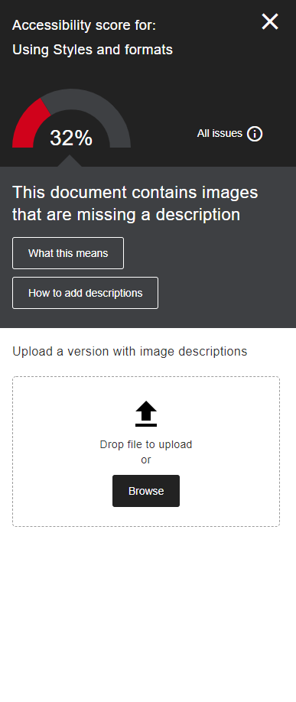
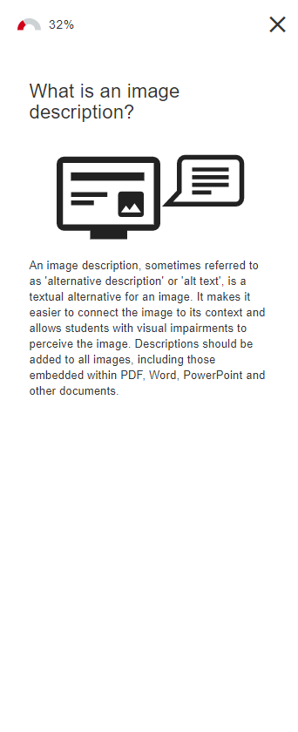
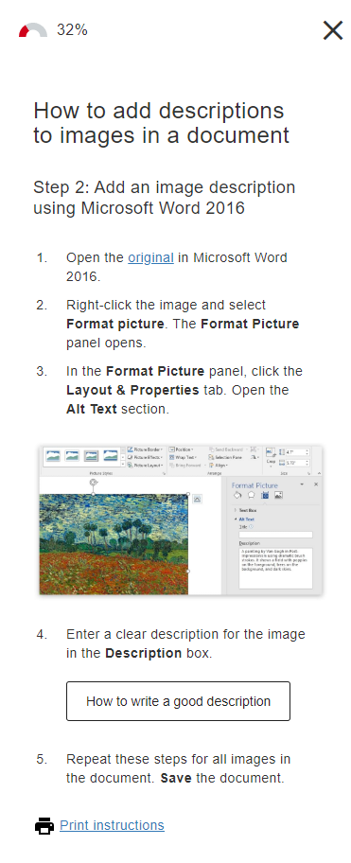
The Instructor Feedback Panel
1.
2.
3.
4.
5.
6.

Slide 31
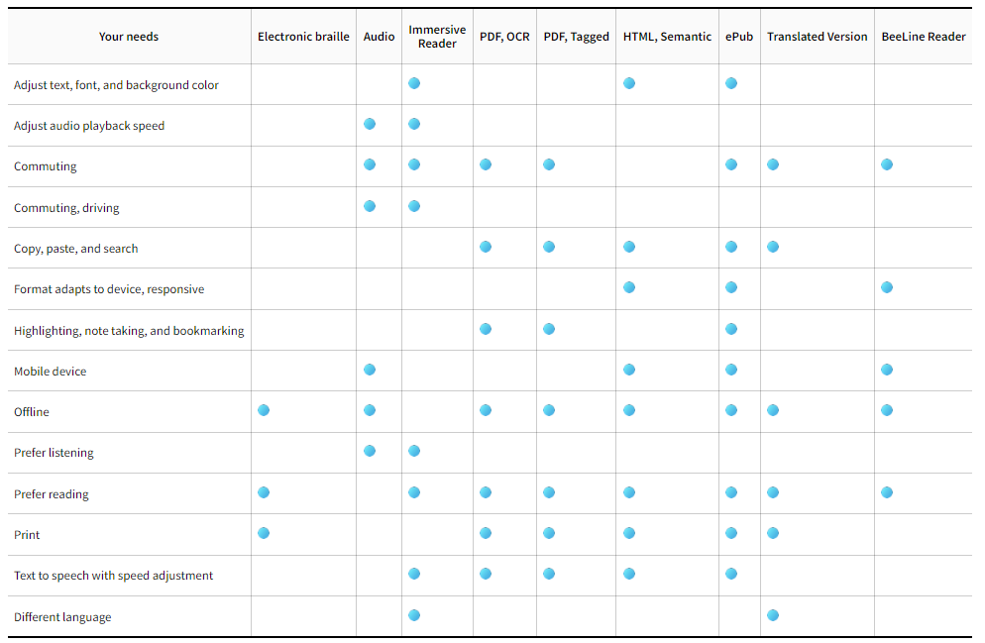
Alternative Downloads – For Quality and Students

Slide 32
Media - Request Closed Captions and Transcripts
All videos, audio, and interactive media posted online must be captioned.
Request Captions and Transcripts
Allows individuals with a hearing disability to access the content of your videos.
Improves comprehension of, attention to, and memory about the video.
Are beneficial for students watching videos in their non-native language.
With closed captions on, viewers can watch your videos in places where audio is unavailable. If someone is in a noisy dorm or in a crowded cafeteria, captions will convey the speech when the sound is obscured.
https://wmich.edu/elearning/requestcaptions

Slide 33
Resources and Questions
GO.WMICH.EDU - Accessibility Resources and guides

