Slide 1
Campus Operations Meeting November 13th, 2023

Slide 2
Campus Operations Meeting
Agenda
Welcome & Introduction
New Travel Management Services Partner
Payments to Individuals
Purchasing Forms
Quick Hits

Slide 3
New Travel Management Services Partner

Slide 4
New Travel Partner
Formal Announcement of Collegiate Travel Planners
Value added partnership
Conversion Date
Training Dates ( In-Person and Virtual)
Lightning and Profile Timelines
Unused Tickets with AAA

Slide 5
Payments to Individuals

Slide 6
Honorarium
An honorarium is normally a one-time payment granted in recognition of a special service or distinguished achievement for which propriety precludes setting a fixed price, such as a special lecture, participation in a workshop or panel discussion, or similar activities. If the fee is prescribed by the individual or if it is negotiated, an honorarium situation does not exist, rather a contract for services exists. Further, it is inappropriate to pay honoraria to individuals who make significant instructional contributions to a course, or to pay honoraria over several months, such as to visiting scholar.

Slide 7
Honorarium
Payment should never be made prior to a speaking engagement or it is not an honorarium and you will need to go through the IC process.
If you pay someone after a speaking engagement, the payment may be classified as an honorarium or an IC.
The answer to the following questions will determine if the payment can be considered an honorarium:
Has the speaker requested payment for the engagement?
Did the speaker send an invoice for payment?
Did the department state in advance of the event that a payment of a stated dollar amount would be made?
Did the department send a letter or document indicating the individual would be paid a specified amount for speaking?
If the answer to any of the questions listed above is “yes” then the payment is not an honorarium and must follow the process for paying an independent contractor.

Slide 8
Honorarium
Honorarium:
Honoraria are processed through accounts payable. The following guidelines apply to honoraria payments:
Honoraria payments have no time/date stipulations, thus normal payment terms apply = Net 30 days.
Honoraria represent taxable income to the recipient. If accumulated honoraria payments are $600.00 or more during a calendar year, a 1099 is sent to the recipient and the IRS.

Slide 9
Honorarium – Paid to Foreign Nationals
What needs to happen:
Must go through Export Control Process
Obtain a copy of the passport and visa
Determine if the visa status is able to be paid an honorarium or have travel expenses reimbursed
Request additional documentations as required based on visa status
All recipients of an honorarium or reimbursement of travel expenses must complete Form W-8BEN
Unless exempted by a current tax treaty with the NRA’s Country of residence, payment for honoraria or reimbursement of undocumented travel expenses are subject to 30% federal tax withholding and State income tax withholding of 4.25%
Form 8233 must be completed in order to claim treaty benefits with a valid US tax identification number
Form 1042 will be issued at the end of the calendar year

Slide 10
Honorarium – Paid to Foreign Nationals
ATTESTATION STATEMENT
Academic Activity:
Honorarium for Guest Visitor/Presenter at Western Michigan University
For the Department of ____________________________________________
For dates of __________________ to __________________.
This academic activity must be 9 days or less at Western Michigan University.
Amount of Honorarium: $
I attest that I have not and will not be paid honorarium or reimbursement for expense payments by more than five U.S. institutions or organizations during a six-month period including the above referenced visit to Western Michigan University.
Signed by: ___________________________________ ____________________
Payee: (Name) Date

Slide 11
Independent Contractor (IC) Yes or No?
Giving Keynote at our annual departmental conference:
November 1, 2023
12:00 - 12:45 p.m.
$500
Coaching and evaluating teacher performance:
$100 per teacher
Fall semester
Panel participant for Indigenous Peoples Day:
$2,000 honorarium
Teaching dance class to external community population:
$50/class
1.5 hours/class
1/1/24 through 4/30/24
Every Friday from 5-6:30
Located in WMU building

Slide 12
Employee Classifications

Slide 13
Employee Classifications
Is Employee Misclassification Illegal?

Slide 14
Independent Contractor (IC)
Characteristics of an IC – IRS 20 Factors – 3 Categories
Behavioral Control – who controls what the worker does and how it gets accomplished
Financial Control – who has the right to control and direct the business aspects of the worker’s job
Relationship Factors – how long will the entities work together; is travel or other benefits included in compensation

Slide 15
Independent Contractor (IC)
Typical Characteristics:
Hired to complete one or a few specific tasks
Control how/when/where the service is performed
No training/supervision required
Does not perform the normal duties of WMU employees (teaching, admin work, CEO, budget analyst)
Short employment period
Receives one payment after work is complete
Uses own supplies/equipment
Uniquely qualified to perform the service
Works for many others (WMU is not main source of income)
Declares a profit or loss
Is a person with a ss# on W-9; does not use an EIN

Slide 16
Independent Contractor (IC)
Behavior Control:
*Who determines when/where/how the work is completed? *Who determines the order of performing the work? *Who determines where to purchase supplies/necessities to fulfill the obligation? *Who decides there’s a need to hire additional individuals to assist with the job?

Slide 17
Independent Contractor (IC)
Financial Control:
*Who determines when and how the worker is paid?
*Are expenses reimbursed?
*Are the person’s services available to others?
*Who provides the equipment necessary to perform the work?

Slide 18
Independent Contractor (IC)
Relationship:
*Is there a written contract between the parties? *Are there any health or other benefits included in relationship? *How long will this arrangement last? *To which party does the work belong when work is finished?

Slide 19
Scenario
Artist Fee: will include all rehearsal time to create and prepare the work for performance in the concert
Rehearsals: to be determined, but suggested a minimum of 1, 2-hour rehearsal per week with you, and an additional 1-hour rehearsal each week with your 2 student rehearsal directors. Also at least one long rehearsal weekend day in September or October to set the piece.
Parking Pass: you will receive a parking pass for campus from the start of your rehearsals through the event
Studio Key: you will receive a key to the dance studios and sound
Dance details:
Cast will be all interested first-year dancers. We are expecting a class of about 28-30 students. You may split the group to a double-cast, or work with them as 1 cast. If you do 1 cast, please make sure all highlighted roles are double-cast/covered and that any absence in performance due to injury/illness could be covered with minimal adjustments by your rehearsal directors.
Suggested length around 6 minutes, maximum of 8 minutes.
Music must be selected by the end of September. Strongly suggest using open-source music or other suggestions we discussed today.
Costumes will be pulled from current stock with additional purchased items (Amazon preferred), coordinated by our costume manager. No alternations/fittings.
Lighting design concert designer
Important Dates
Rehearsals can begin as early as Friday, September 15
Sunday, December 3, 5-8pm: dance must be complete by this run
Performances are Feb. 9-11 in our performance center
Spacing rehearsal will be scheduled for 1 hour the week of Jan. 29
Technical rehearsal will be either Friday, Feb. 2 or Monday, Feb. 5
Conflict Dates – days to avoid
October 18-21
October 27-29
November 11-18
November 22-26
December 1
December 8-9

Slide 20
Who am I?
I am a WMU student hired in a department
Student Employee
I am co-teaching English 1000
PIO/GA/Faculty/Temp employee
I am a professional carpenter and am hired to install cabinets in your office
AFSCME
I work at WMU, but do not earn benefits
Temp Employee
I work for WMU as a chef, but am hired on the side to type meeting notes for a WMU Committee
Temp Employee
I have been hired short term, to enter information into a database in the College of Ed; I work at a desk with WMU Supplies
Temp Employee
I officiate volleyball games
Independent Contractor
I have a special license that qualifies me as an expert in my field
Independent Contractor
I work for Stryker normally, but will present “How to Build a Hospital Bed from Scratch” to CHHS.
Independent Contractor
I am a business
Purchase Order

Slide 21
Independent Contractor (IC)
CONSIDER…..
Determination process is not an exact science
Examine the entire picture
DO NOT CONSIDER…..
“It’s too much work”
“That’s not what we agreed to”
“Our budget can’t afford the taxes”
“They don’t want taxes taken out”

Slide 22
Independent Contractor (IC)
IRS 20 Factor Websites:
https://labor.nv.gov/About/PEA/PEA_IRS_TEST/
https://www.irs.gov/businesses/small-businesses-self-employed/independent-contractor-self-employed-or-employee

Slide 23
Independent Contractors (IC)
Reminders: Fill the form out completely Be specific – what, where, when, why, how Follow the routing of signatures on the form Never have two contracts – if vendor has a contract, we would not use an IC – one or the other Scope of work should be very detailed and clear Form should be through all signatures BEFORE work begins NEVER promise money at the time of work DO NOT create an invoice for the IC Do not pay the IC before work is completed ICs need to observe all of the usual campus rules including Minors on Campus Policy Always go to https://wmich.edu/legal/contracts/agreements for form – do NOT save/do not Google Do not pay an IC with Procard Follow purchasing rules >$5,000 Give totals (# of students being supervised x $ amount each)

Slide 24
IC Payments to Foreign Nationals Working in the U.S.
Why are payments to foreign nationals so complex?
Contract
Export control
Immigration
Tax
All of these bodies of law must be complied with when paying foreign nationals

Slide 25
IC Payments to Foreign Nationals Working in the U.S.
EXPORT CONTROL LAWS
“Export control” is a catch all term that covers how the U.S. prevents the unintended export of goods, information or services from the United States to foreign countries, persons, or entities.
Before inviting a foreign national, submit the online international visitor form to verify that the visitor can legally be invited.

Slide 26
IC Payments to Foreign Nationals Working in the U.S.
TAX LAWS
All honorarium and independent contractor payments to foreign nationals are subject to 30% U.S. tax withholding absent a valid tax treaty claim.
Note that visitors providing a service to WMU must have a U.S. social security or ITIN in order to claim a tax treaty exemption from withholding.
Form 8233 must be completed and signed by the visitor. The tax treaty section number and explanation of why the exemption applies are required on the form. After the form is accepted by WMU, a copy is required to be mailed to the IRS and there is a 10 day waiting period before payment can be made.

Slide 27
IC Payments to Foreign Nationals Working in the U.S.
TAX LAWS
In order to issue payment to a foreign national for services performed in the US we will need the following documentation:
A copy of the individuals passport
A copy of their visa
Copy of the I-94
The visa type will determine what additional documentation is required.

Slide 28
IC Payments to Foreign Nationals Working in the U.S.
DOCUMENTATION REQUIRED BY VISA TYPE
J-1 Exchange Visitor categories (professor, research scholar, short term scholar, specialist)
WMU is sponsor of DS-2019
DS-2019 (service within dates of DS-2019)
I-94
Passport
O-1 Visa
I-94 and I-797
Passport
Eligible to receive payment if WMU is indicated on the I-797 (related to service contract)

Slide 29
IC Payments to Foreign Nationals Working in the U.S.
DOCUMENTATION REQUIRED BY VISA TYPE (CONTINUED)
P-1,P-2 & P-3 Visas
I-94 and I-797
Passport
Eligible to receive payment if WMU is indicated on the I-797 (related to service contract)
H-4 visa with EAD card
Employment Authorization Document (I-766)
J-2 visa with EAD card
Employment Authorization Document (I-766)
F-1 visa with EAD card
Employment Authorization Document (I-766) for Optional Practical Training
I-20 showing it is practical training in their field

Slide 30
IC Payments to Foreign Nationals Working in the U.S.
SUMMARY
Submit to export control
Determine if visa status allows WMU to make a payment or reimburse travel expenses.
Obtain passport, visa, I-94 along with the additional documentation required by visa status
Foreign national must complete Form W-8BEN.
WMU is required to withhold 30% from payments to Foreign Nationals unless a treaty exists and the treaty benefit is requested.
To apply for treaty benefits the individual must provide Form 8233 which requires a US tax identification number. In order to claim benefits the treaty article and paragraph will need to be identified on the Form 8233 and Form W-8BEN.
Form 1042 will be issued at the end of the year.

Slide 31
“New” Purchasing Forms

Slide 32
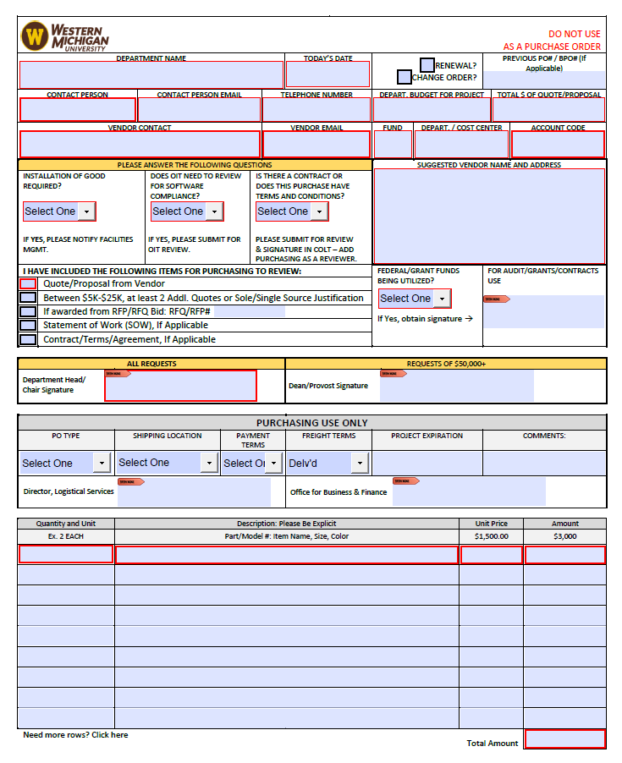
Purchasing – Purchase Requistion
New Purchase Requisition Form:
Drive Standardization
Provide step by step guidelines for the entire purchasing process to assist all end users.

Slide 33
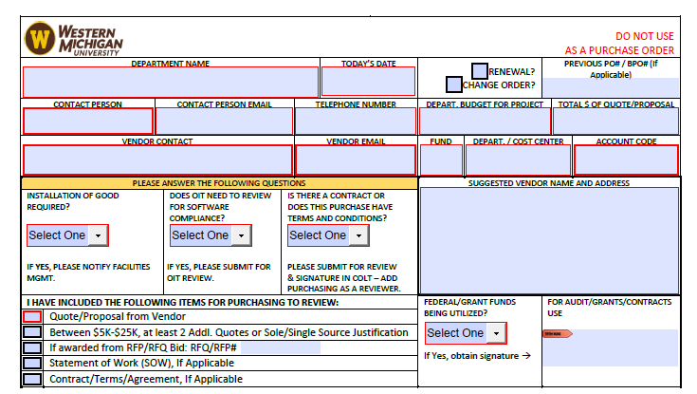
Purchasing – Purchase Requisition

Slide 34
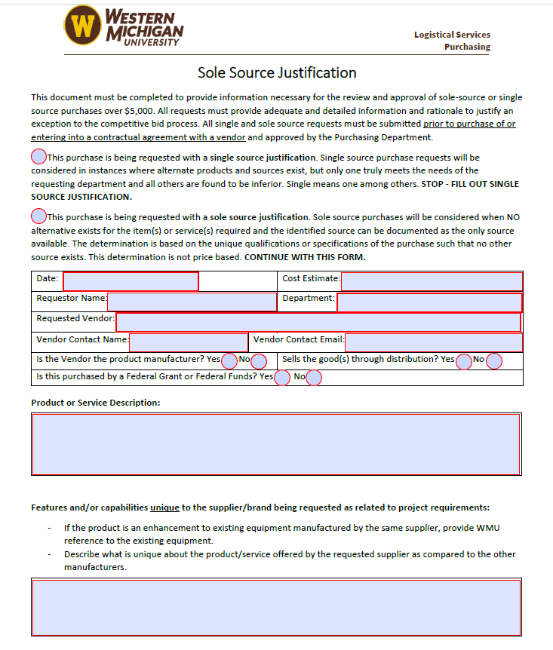
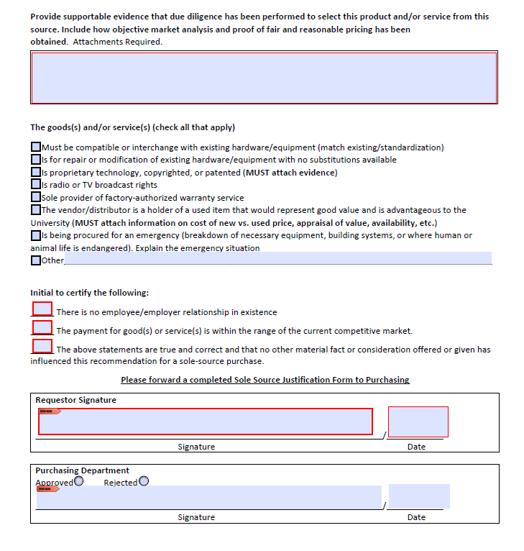
Purchasing – Sole Source Justification

Slide 35
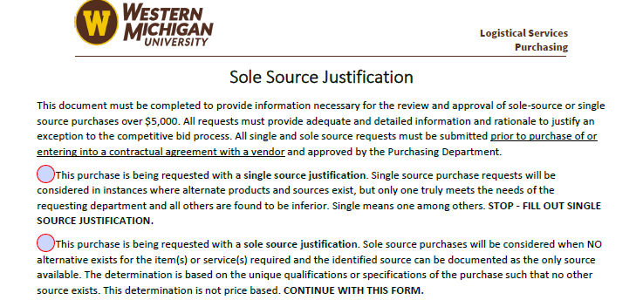
Purchasing – Sole Source Justification

Slide 36
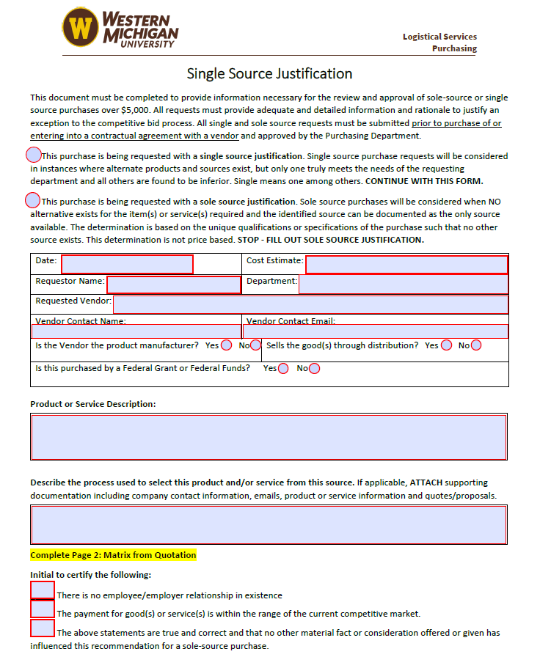
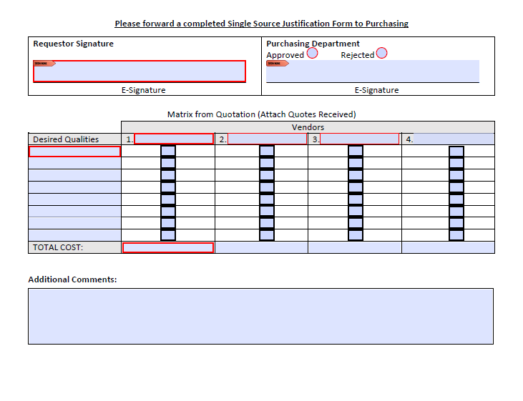
Purchasing – Single Source Justification

Slide 37
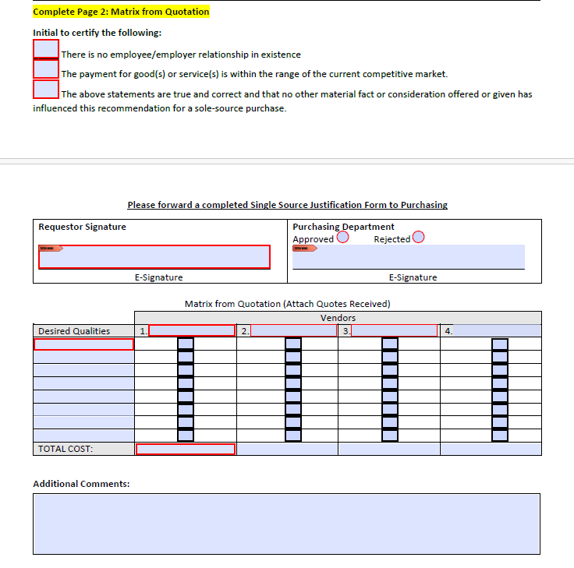
Purchasing – Single Source Justification
Need to confirm no conflict of interest exists
The Matrix represents your evaluation criteria and justification

Slide 38
Purchasing Forms
Next Steps:
Finish testing PDF versions of the new forms
Replace “old” forms on website with the new forms
Finish development and testing of electronic versions of the forms “eForms”
Launch eForms

Slide 39
Quick Hits

Slide 40
Quick Hits
Preparing for the heating season: Important reminders:
As the weather transitions to cooler temperatures, it's time to prepare for the heating season. With our heating systems returning to operation after a long break, we want to ensure everyone stays comfortable and safe on campus. While we discourage using personal space heaters on campus to prevent circuit overloads, we understand that some areas may experience cooler temperatures. If you find your workspace uncomfortable, please refrain from using space heaters. Instead, we encourage you to submit a Bronco Fix-It request. Our dedicated technicians will promptly investigate the issue and perform any necessary repairs to ensure your area is comfortable. Thank you for your cooperation and understanding.
Bronco Fix-It request

Slide 41
Quick Hits
AFSCME Holidays and Closure Days:
Please note if your building or unit will require Facilities Management services on an AFSCME Holiday or Closure Day, use the FM Event Request Form to order service. The following days do not have FM Staff for standard service:
Friday, November 24, 2023
Friday, December 22, 2023 – January 2, 2024
Monday, January 15, 2024
Friday, March 8, 2024
Monday, May 27, 2024
Facility Event Service Request | Facilities Management | Western Michigan University (wmich.edu) .

Slide 42
Quick Hits
“Just a reminder, the university offers an anonymous reporting hotline where anyone can go to report concerns of unethical or illegal activities on campus. This hotline is managed by EthicsPoint, a company independent from the university. Internal Audit is the only area that has access to the posts on this site, so a poster can be assured that the information is kept confidential and cannot be seen by their supervisor or coworkers. The hotline can be found at www.wmuhotline.ethicspoint.com. Please encourage anyone to use this site if they believe anyone is engaging in unethical or illegal activities.”

Slide 43
Quick Hits
We will be launching our new Enterprise Agreement in the coming weeks after we go through our implementation process.
Look for a welcome announcement soon!!!

Slide 44
Future Schedule
Future Campus Operations Meeting Dates:
Tuesday, September 12th, 2023 – (1:30 p.m. – 3:00 p.m.)
Monday, November 13th, 2023 – (1:30 p.m. – 3:00 p.m.)
Tuesday, February 13th, 2024 – (1:30 p.m. – 3:00 p.m.)
Tuesday, May 14th, 2024 – (1:30 p.m. – 3:00 p.m.)

Slide 45
THANK YOU!
See Everyone February 13th, 2024

