Slide 1
Student Organization Risk
Cindy Smail, Loss Control Consultant Marsh Advisory

Slide 2
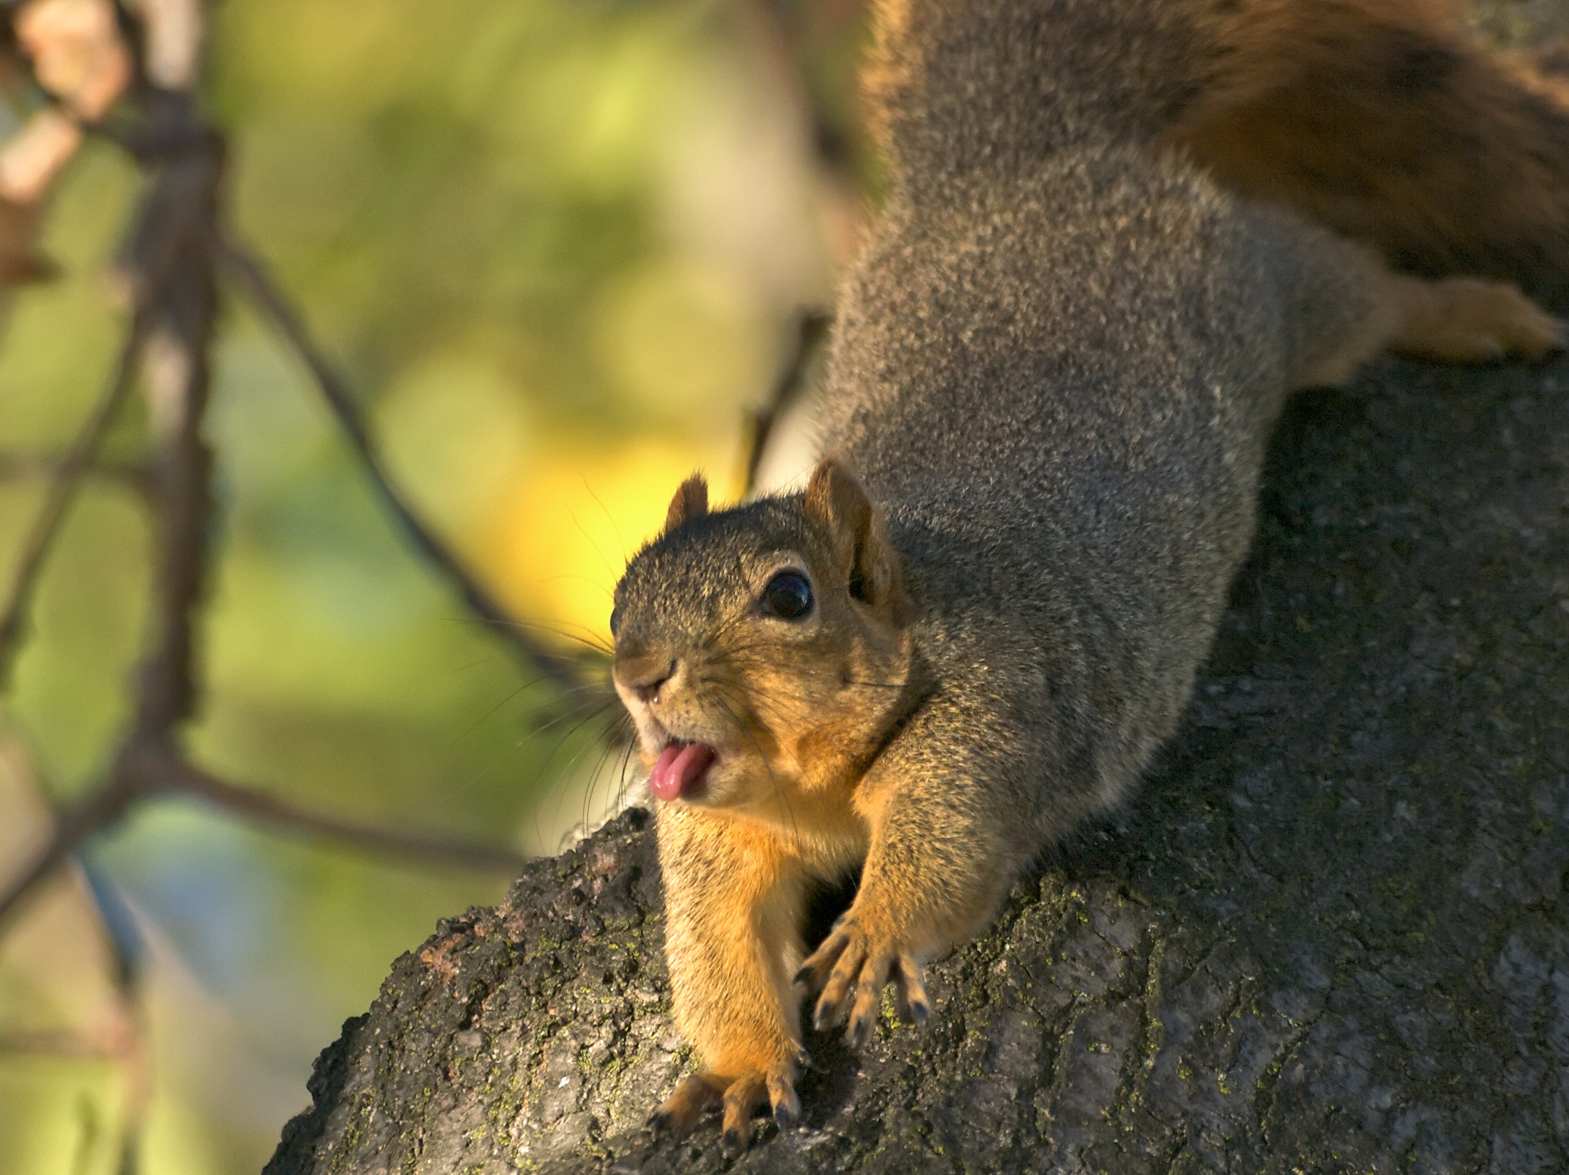
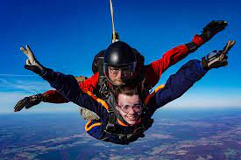
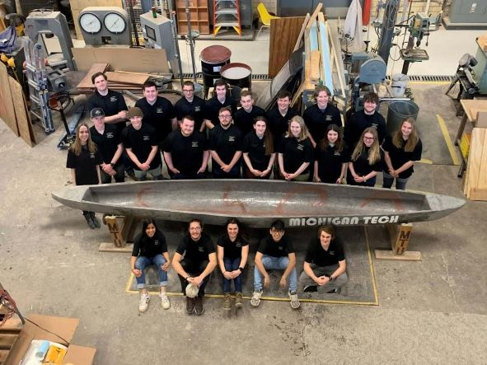
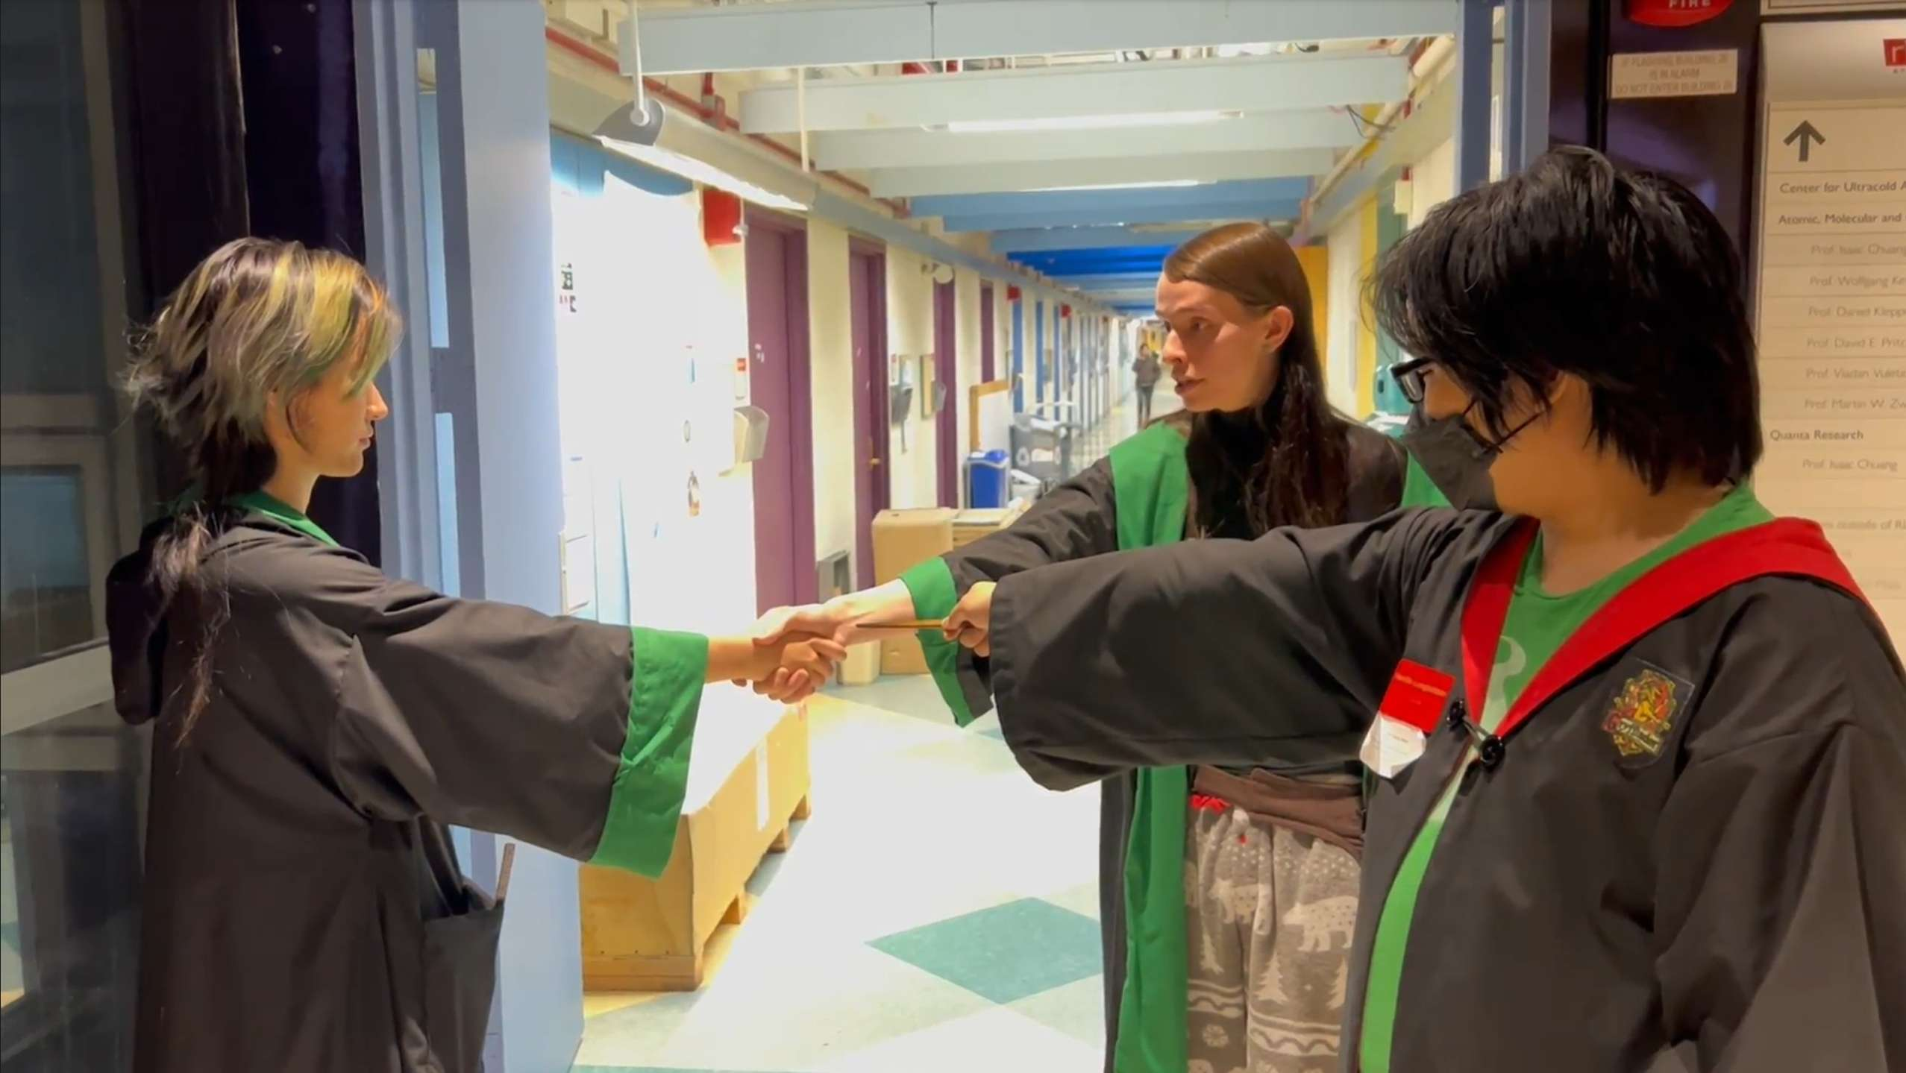
Notes:
Squirrel Club – University of Michigan
Clown nose club - North Carolina State University
The Harvard Tiddlywinks Society - Harvard University
Assassins Guild – Massachusetts Institute of Technology, LARP (live action role play)
Sky-diving Club - Virginia Tech
Concrete Canoe Club – Michigan Tech
Great Benefits
Friendship
Enrichment
Growth – personal and professional
Potential to be a leader
Resume addition
Build confidence and skills
Explore careers
Volunteer opportunities
Fun!

Slide 3
Today’s Discussion
The Concern
RSO Risks
Next Steps
Control & Duty of Care
Organization Structure & Support

Slide 4
What are you worried about?

Slide 5
There are Issues…
Travel
Event Complexity
University Name
Risky Activities
Minors
University Space
Controversial Speakers
Sexual Misconduct
Notes:
Event Complexity - group size, length of event, location (on or off campus; domestic or international), complicated or high risk activities.
Risky Activities – science related, performing arts, physical activities (Dance/Sports/Outdoor Activities), increased fire hazards (vigils, fire pits, etc.)

Slide 6
Cases
Year | Institution | Case
2021 | University of Iowa | University was sued as the result of a student organization barring a gay member from becoming a leader of the Christian student group. Incident was in 2017, settled for $1.93 million in 2021.
2021 | Iowa State University | Two students drowned when rowing crew boat capsized. Bad weather, not having critical safety gear and training were factors. Univ. officials had ignored years of warnings about RSO safety concerns. One parent settled for $2 million, other parents suing as well.
2022 | Various Chicago Pharmacy Institutions | College dean embezzled $650,000 from a national student organization while serving as its volunteer executive director. Sentenced to one year in federal prison.
… and too many Greek hazing claims to count.

Slide 7
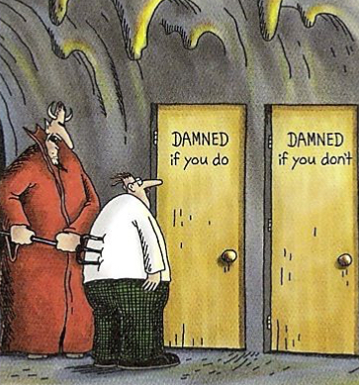
Level of Control
Higher levels of control = increased duty to oversee and protect
Lower levels of control = potential duty of care concerns
Anna Bidoonism
Notes:
Liability if a court determines the institution could/should have reasonably foreseen the harm and didn’t enact precautions.
Limit liability by:
Clearly defining your institution’s relationship with the organizations
Enacting RM policies and practices for facility use, event planning, travel, alcohol, hazing, etc.
Have policies and procedures to recognize/register student orgs. While consistency in policy is important, institutions can give differing privileges and responsibilities to different groups if needed.

Slide 8
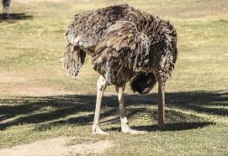
Duty of Care
Oversight
& Reasonable Rules
Notes:
In the last three decades, courts have been more likely to site duty of care in student org cases.
More supervision, regulations and support = more likely duty of care decision.
Knowing about the activity that caused harm can also increase liability.
Prior knowledge of the student activity that results in the harm at issue also makes a court’s finding of liability more likely.
So, is less involvement better? This is a short-sighted view.
Law and policy considerations.
Expectation that institution should have known, especially when activity is common and well known on campus.
The most sophisticated institutions recognize that reasonable rules and oversight will often prevent serious harm from occurring.

Slide 9
Duty of Care Deciding Factors
Relationship with the Student Org
Funding & Other Support
Planning, Oversight & Approval
Location & Travel
Prior Knowledge
Notes:
Relationship with the student organization
Sponsored or independent?
Aligned with your institution’s mission?
Do students have to be part of the org for academic credit?
Funded & other support
Are funds provided by the institution?
Who makes decisions on how funds are used?
Does the institution provide supplies, space or other resources?
Planning, oversight & approval
Are faculty or staff involved? What are their roles?
Is an advisor required?
Is review or discipline provided by the institution?
Activity location and travel
Are activities on or off campus? Who owns the location?
Is transportation provided by the institution?
Is travel regulated?
Prior knowledge
Has something similar happened in the past?
Have there been policy violations by the group in question or similar groups?

Slide 10
Organization Classifications
Sponsored
Strongly aligned with mission
Advisor
Independent
Broadly supports institutional purpose, social, political or religious purposes
Considered “arm’s length”
Unorganized
Not affiliated with institution
Cannot use institution name and logo, watch for use of name and logo without permission
Members in good standing
Institution funded
Use institution name and logo
May be included in GL coverage
Consider risk level when deciding to recognize
Most in good standing
Limitations on insurance
May have Advisor
Limited funding
Limited use of institution name and logo
Institution should consider having a policy on unrepresented student groups
Notes:
Sponsored
Closely align with institution’s mission, often a particular department (society of chemistry students, honor society or professional group, ASSE student group).
Activities are integral to the educational experience.
Advisors maintain oversight and organizational control, duties delineated and included in the advisor’s responsibilities.
Members are registered and in good standing.
Funded from student activity fees or institution operational funds, could also get funds from fundraising and member recruitment activities.
Allow use of your institutional name, logo, and artwork with guidelines that apply to sponsored activities.
Some institutions extend GL coverage to sponsored organizations while acting under institution direction/control. Non-sanctioned activities can cause exposure as it could be considered that the institution accepts responsibility for the group.
Independent
Formed for a broad purpose that supports the institution. Purpose may be wide and not tied to academic programs, i.e. leadership.
Relationship considered “arm’s length.”.
Most formed for social, political, or religious purposes, i.e. Chess Club, Christians on Campus, LGBTQ organizations.
Consider risk level when determining whether to recognize, i.e. Chess Club is less risky while Rock Climbing Club is greater risk.
Require all/most of the group’s officers and members be registered students in good academic standing.
Some require advisors based upon institution’s legal counsel. If advised, training and policies recommended.
Insurance coverage differs, consider requesting institution be additional insured on COI and require the organization to indemnify the institution for losses that happen out of on/off-campus events that are funded in whole/part by university support.
Unorganized
Institution should establish policies addressing the status of student groups that aren’t recognized.
Not permitted use of the university name, logo, equipment, or facilities.
Unable to assert any affiliation with your university in written or online documents.

Slide 11
Organization Policy Points
Application process
Officer training requirements
Support sources requested - monetary and nonmonetary support (space, office equipment, supplies, etc.) and application process
Conduct rules, specifically alcohol, hazing, nondiscrimination policies, judicial process
Use of institutional name, logo, etc.
Property use terms
Fundraising activities
Member recruitment activities
Incident and injury reporting
Notes:
Application should include:
Org’s constitution
Roster of officers and members
Contact information
Purpose
Intended activities
Regular meeting/event location
Be wary of private individuals looking to use your institution’s property for their own purposes, perhaps using student organizations to gain access. For example, a martial arts vendor paying students to start “clubs” for the purpose of offering instructional fee-based classes on campus and to avoid paying a lease fee.

Slide 12
Facilities & Events Concerns
A clear application process is needed for student groups asking to use campus facilities. Special attention should be given to events that have safety concerns, potential PR concerns and may draw a large audience.
Security
Setup
Transportation
Crowd Control
Sanitation
Catering & Food Safety
Permits
Emergency Management & Medical Needs

Slide 13
Advisors
Which orgs need an advisor?
What’s the advisor’s role?
Does the advisory have liability if something goes wrong?
What policies are needed and are they in place?
What training is needed and is it in place?
Advisors provide guidance, ensures rules are followed while allowing students to guide and take ownership.
Notes:
Considerations
Does the org need an advisor?
All recognized/registered orgs required to have an advisor
There are heightened risks
The org is closely connected or funded by the institution
What is the Advisor’s role?
Provide strong advice and ensure the org acts in the best interest of the institution and follows policies
Intervene and/or report misconduct when necessary
Provide opportunity for the org to make their own decisions
What Is the Advisor’s liability?
Understand liability insurance coverages to be able to provide guidance to advisors
Communicate that advisors must act within the scope of their assigned role and follow campus policies
What Training is Needed?
Advisor qualifications
Roles and responsibilities - advisors and the org
Institution policies; org registration, travel policy, facilities use guidelines, financial policies, etc.

Slide 14
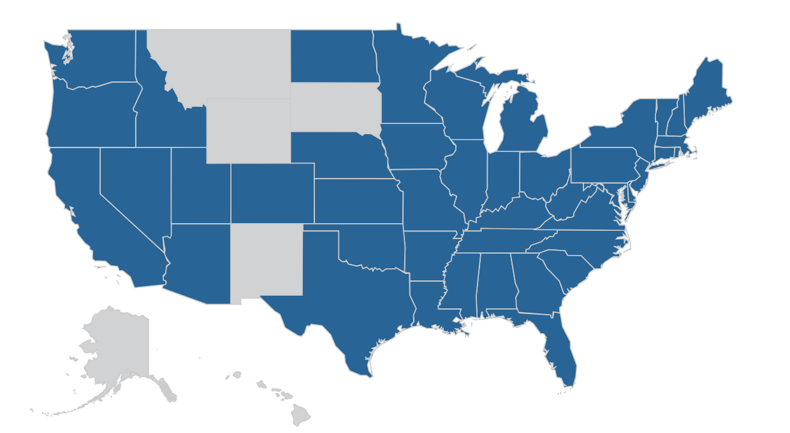
Hazing
Policy Components:
A clear statement prohibiting hazing in any manner
Hazing definition
Examples of hazing, from the extreme to the mundane
How to report hazing
Procedures on how the institutional will respond to hazing reports
Disciplinary actions/sanctions for violations
It’s the law…
Notes:
Michigan is one of many states that has a law on hazing.
Not just a Greek and athletics concern…

Slide 15
Greek Concerns
Greek organizations produce significantly more claims than other groups.
Claims are often more serious and severe and involve physical and sexual assaults, alcohol and hazing, including fatalities.
Awards and settlements are high value.
It can be difficult to distance Greek organizations.
Institutions should have a policy on unsanctioned Greek organizations.
Notes:
There can be difficulty if a Greek house is on institution owned land, and there is a landlord-tenant relationship. One way to reduce risk is to consider tying the orgs recognition to the lease. That way the lease can be terminated if recognition is removed.
Unsanctioned Greek organizations policy possible components:
Can discourage participation by stating the org isn’t sanctioned and the institution provides no support, oversight, or advice.
Identifies consequences of participating if there is a violation of the organization’s policies. States there are personal liability concerns for injuries/claims from org activities.
Includes a list of unsanctioned groups and information on when/why the group is unrecognized and why.
Warns of safety risks.

Slide 16
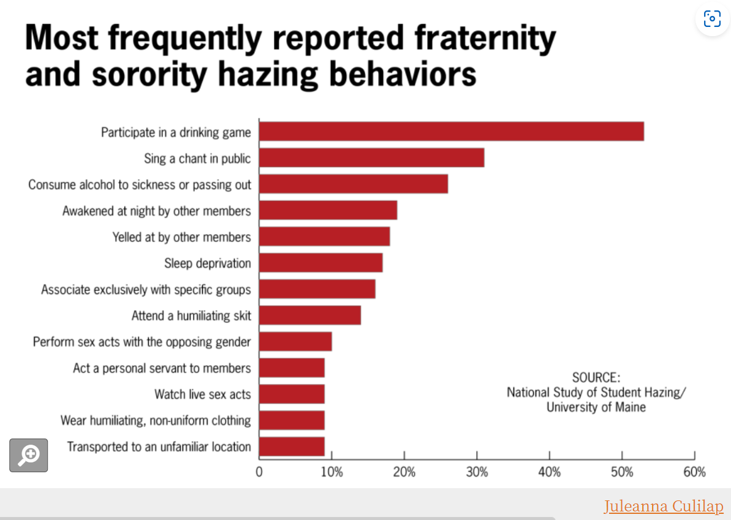
Hazing in Greek Organizations
Since 2000, there have been more than 50 hazing-related deaths.

Slide 17
Alcohol Questions to Ask
Questions | Answers
When is alcohol allowed at student events? | If sales are allowed, have limits and controls in place.
Is alcohol allowed at on-campus events? How about off-campus student events? | On campus is better than off campus, with controls. Consider prohibiting alcohol at off campus events.
Can institution funds purchase alcohol? | Best not to use institution funds. If allowed require group to be sponsored and have approval, supervision and monitoring at event.
Is there an event manager and staff who work the event are employed by a third-party provider? Do they have the required insurance, indemnification and documentation? | Third party provides some insulation. Check insurance and indemnifications are in order.
Are controls in place to safely serve (bracelets, ban on alcohol, time serving, quantity served)? | Controls limit risk at the event and provides better defense if there is an issue.
Notes:
Primary event manager responsibilities:
Attend and supervise event
Hire and train staff
Ensure there is a procedure to check ID, monitor intoxication and refuse service
Greatest risks is most likely to occur at off-campus events, organized by recognized student groups. Consider prohibiting the use of university funding to purchase alcohol at off-campus events. If university funding is allowed for alcohol purchases, consider limiting it to only those groups that are sponsored. Also consider requiring advance approval for alcohol service. Institutions should ensure institutional supervision.

Slide 18
Driver Safety
Driver Regulations
- Licensing
- Age
- MVR
- Insurance
- Training
Safe Driving Practices
- Maximum hours
- Late-night driving
- Safety belts
- Driver distractions
- Safe driving & compliance with laws
- Vehicle inspections
- Weather preparedness
Emergencies
- Breakdown plans
- Collision response
- Emergency equipment
- Advance itinerary
- Attendee roster and contact information
- Campus emergency contact
- Roadside assistance
Notes:
Driver qualifications
Valid driver’s license
Acceptable driving record
Meet a minimum driver age (21) to ensure experienced behind the wheel
Driver training
Safe driving practices
Maximum on the number of hours behind the wheel without a break/during a 24-hour period
Prohibit late-night driving
Require the driver and all passengers wear seat belts
Ban the use of cell phones/ electronic devices by drivers
Do not allow anyone in the vehicle while under the influence of drugs or alcohol, including passengers
Require all laws and regulations are met and that drivers operate at a speed appropriate for traffic, weather, and road conditions
Vehicle breakdowns and emergencies
Drivers should have a plan on what to do in case of a vehicle breakdown or emergency
University-owned vehicles should be equipped with emergency equipment (jack, spare tire, flashlight, fire extinguisher, etc.
Vehicles should have the registration, insurance card, accident instructions, and contact numbers
Require student groups taking trips to provide up-to-date advance information that would be needed in an emergency:
Itinerary, route, destination and contact person information and phone number
Listing of participants and emergency contact information
Consider requiring student groups purchase some type of roadside assistance plan

Slide 19
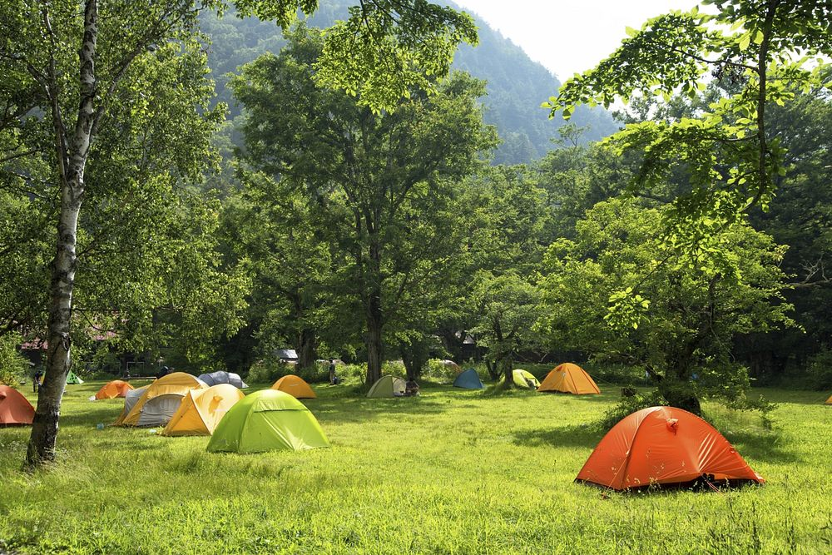
Outdoor Clubs
Complete a risk assessment and actions to reduce/respond to those risks for every trip.
Briefing on the risks of each trip.
Assumption of risk forms signed for each trip.
Defined leader responsibilities.
Procedures in place for sign up, pre-trip, trip and post-trip procedures
Training – leadership, wilderness first aid, food safety, equipment, wilderness safety, inclement weather, emergency response, hygiene, vehicle safety and incident reporting.

Slide 20
Intramural Activities
Notes:
Intramural sports can carry high levels of risk.
Dangerous activities - skydiving, snowboarding, whitewater rafting, horse activities and rugby.
Greatest risk is vehicle travel, often in private vehicles
Fatigue and alcohol can be a factor.

Slide 21
NEXT STEPS
Spread the word
Determine areas of concern
Review policies and controls
Make no assumptions! Just because it’s a long-standing tradition doesn’t mean it’s safe
ESPN
Notes:
Texas A&M Bonfire Tragedy
Collapse of the 59 ft. student-built bonfire at Texas A&M University on November 18, 1999.
12 student deaths, more than two dozen injured
Dozens of students on the structure when it fell at 2:42 AM
Long-standing tradition at Texas A&M, symbolizing the unity and spirit of the university community.
Cause of the collapse was determined to be a combination of factors, including design flaws, construction errors, and the excessive weight of the logs used in the bonfire.
Although an engineering school, engineering support was not part of the event
Reported that structure grew bigger every year.
Reported lack of institution involvement and oversight.

Slide 22
Resources
Ben Kesslen, If student deaths won’t stop fraternity hazing, what will?, NBC News, If student deaths won't stop fraternity hazing, what will? (nbcnews.com), March 12, 2021
Hazing Prohibited Law, Section 750.411t, Michigan Legislature, Michigan Compiled Laws Complete Through PA 149 of 2023, Michigan Legislature - Section 750.411t
Hazing Research, College of Education and Human Development, The University of Maine, Hazing - College of Education and Human Development - University of Maine (umaine.edu)
Marsh Serious Events in Higher Education Report, 2022
Stop Hazing, Hazing Prevention Resources, Hazing Statistics, Data and Facts | StopHazing | Hazing Prevention Resource
United Educators Large Loss Report, United Educators, 2023, 2023 Large Loss Report (ue.org).
United Educators, Recognizing Student Organizations: A Guide for Higher Education, March 2022, Checklist: Recognizing Student Organizations | United Educators (ue.org).
United Educators, Crisis Response: A Library of Tabletop Exercises, October 2023, Crisis Response: A Library of Tabletop Exercises | United Educators (ue.org)

Slide 23
?

Slide 24
This document and any recommendations, analysis, or advice provided by Marsh (collectively, the “Marsh Analysis”) are intended solely for the entity identified as the recipient herein (“you”). This document contains proprietary, confidential information of Marsh and may not be shared with any third party, including other insurance producers, without Marsh’s prior written consent. Any statements concerning actuarial, tax, accounting, or legal matters are based solely on our experience as insurance brokers and risk consultants and are not to be relied upon as actuarial, accounting, tax, or legal advice, for which you should consult your own professional advisors. Any modeling, analytics, or projections are subject to inherent uncertainty, and the Marsh Analysis could be materially affected if any underlying assumptions, conditions, information, or factors are inaccurate or incomplete or should change. The information contained herein is based on sources we believe reliable, but we make no representation or warranty as to its accuracy. Except as may be set forth in an agreement between you and Marsh, Marsh shall have no obligation to update the Marsh Analysis and shall have no liability to you or any other party with regard to the Marsh Analysis or to any services provided by a third party to you or Marsh. Marsh makes no representation or warranty concerning the application of policy wordings or the financial condition or solvency of insurers or reinsurers. Marsh makes no assurances regarding the availability, cost, or terms of insurance coverage.

