Slide 1
Social Media Risk
An Emerging Threat
Cindy Smail, Loss Control Consultant Marsh Advisory

Slide 2
Today’s Discussion
Social Media on Campus
Health Impacts
Faculty & Staff
Safety & Security Concerns
Addictive Quality of Social Media
Next Steps

Slide 3
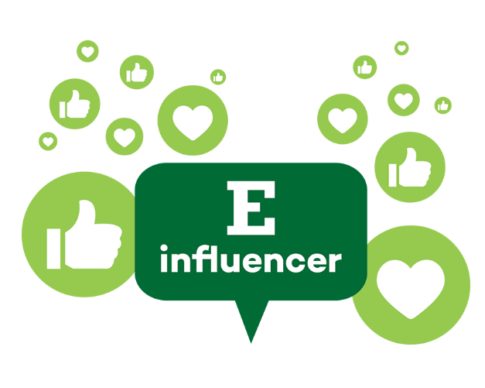
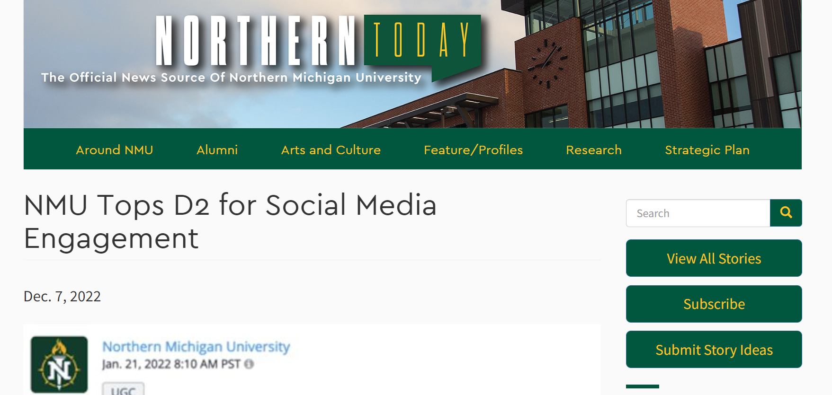
Social Media is An Integral Part of Campus

Slide 4
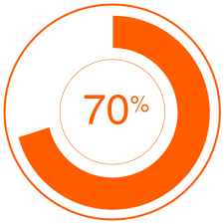
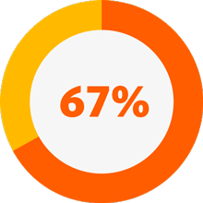
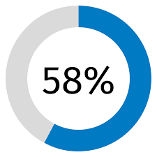
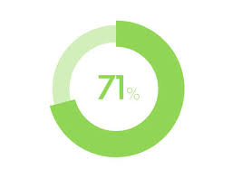
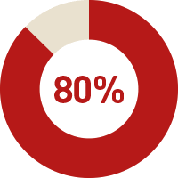
Positive Impacts
Girls of color report encountering positive or identity-affirming content related to race
Feel like they have people who can support them through tough times
Helps them feel more accepted
Have a place to show their creative side
Are more connected to what’s going on in their friends’ lives
Surgeon General’s Advisory - Social Media and Youth Mental Health (hhs.gov)
Notes:
Surgeon General’s Advisory Report excerpt
“Social media can provide benefits for some youth by providing positive community and connection with others who share identities, abilities, and interests. It can provide access to important information and create a space for self-expression. The ability to form and maintain friendships online and develop social connections are among the positive effects of social media use for youth. , These relationships can afford opportunities to have positive interactions with more diverse peer groups than are available to them offline and can provide important social support to youth. The buffering effects against stress that online social support from peers may provide can be especially important for youth who are often marginalized, including racial, ethnic, and sexual and gender minorities. , For example, studies have shown that social media may support the mental health and well-being of lesbian, gay, bisexual, asexual, transgender, queer, intersex and other youths by enabling peer connection, identity development and management, and social support. Seven out of ten adolescent girls of color report encountering positive or identity-affirming content related to race across social media platforms. A majority of adolescents report that social media helps them feel more accepted (58%), like they have people who can support them through tough times (67%), like they have a place to show their creative side (71%), and more connected to what’s going on in their friends’ lives (80%). In addition, research suggests that social media-based and other digitally-based mental health interventions may also be helpful for some children and adolescents by promoting help-seeking behaviors and serving as a gateway to initiating mental health care.”

Slide 5
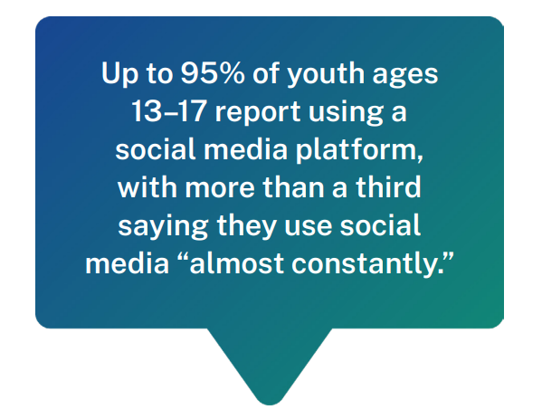
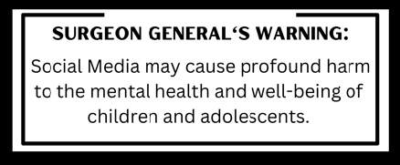
US Surgeon General Advisory
Social Media and Young Mental Health
Surgeon General’s Advisory - Social Media and Youth Mental Health (hhs.gov)

Slide 6
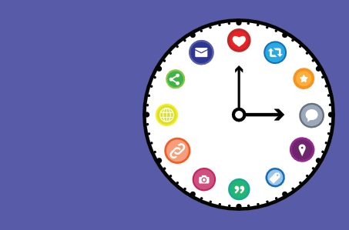
Student Social Media Risk
How many hours does the average college student spend on social media daily?
Notes:
3 – 4 hours just on social media sites.

Slide 7
Sooooo Many Apps!
Most Popular Social Media Apps - Cyberbullying Research Center
Notes:
And more every day…

Slide 8
Social Media…
Where Hypocrisy, Falseness, Double Standards, Rumors & Depression meet up for coffee.
READBEACH

Slide 9
Social Media - Designed to be Addictive
"exploiting a vulnerability in human psychology“
Sean Parker, Facebook’s Founder
In 2017, Sean Parker said publicly that the company set out to consume as much user time as possible. Facebook has since put some controls in place but the structure continues.
Source: Social media apps are 'deliberately' addictive to users - BBC News
Notes:
Platforms use algorithms to determine what content they are most likely to engage with and show them that content. This means that users are more likely to see posts from their friends and family, encouraging them to keep using the platform.
The longer the user spends on the platform, the more information is gathered and the more the supplier is able to advertise.

Slide 10
Social Media – May be Designed to be Addictive
Social media has a reinforcing nature – social media use = dopamine released by brain = user keeps going back for more dopamine.
Algorithms gather information on users' interests and habits and feed them addictive content.
Users keep connected due to fear of missing out. Predominance in every day life requires constant connection.
Distorted lens on appearances and reality draws users in to make comparisons. Users spend significant time curating their postings.
Anxiety and depression keeps users coming back to feel better.
The unpredictable nature of social media (how many likes, who likes the post, if retweeted), keeps the user coming back. Likes = self worth.
Notes:
Social media platforms ignite the same reaction in the brain as gambling and recreational drugs.
Engaging in pleasurable activity, the brain releases a hormone (dopamine). Dopamine is responsible for feelings of pleasure.
Social media notifications (likes, retweets, comments) can increase dopamine levels. This may cause positive feelings, reinforcing additional social media use.
Business Ethics Quarterly - authors wrote those who design social media platforms benefit from user addiction and may intentionally design these platforms to be addictive.

Slide 11
Health Impacts…
Anxiety
Depression
Sleep Deprivation & Disturbances
Difficulty Concentrating
Weight Gain
Self Control Challenges/Addiction
Eye Strain
Back & Neck Strain
Eating Disorders
Notes:
Social media users often present a curated version of people's lives, leading to comparison and feelings inadequate. Pressure mounts to show a perfect image online, which can be exhausting and damaging to their mental health. Social media is directly linked to mental health conditions in college-aged people, especially young women.

Slide 12
Warning Signs
Compulsion to check social media
Spending long periods of time on social media
Difficulty regulating social media use
Spending less time doing offline activities
Become restless and troubled when not using social media
Use of social media negatively impacting studies or work
Irritability, sadness or anxiety
Weight changes
Sleep changes – less, more or during daytime
Conflict as a result of social media use
Sounds a lot like mental health warning signs…

Slide 13
Social Media Use - Faculty & Staff
United Educator (UE) Claim Example: A tenured professor posted criticism of Muslims on Facebook. Students and faculty members filed internal complaints asserting that the post and the professor’s in-class speech constituted harassment. Additionally, two faculty members who challenged the professor about his comments filed internal complaints alleging retaliation by the professor. The university’s investigation determined the professor’s post did not violate its anti-harassment policy, but that he did retaliate against the two faculty members. This finding prompted the professor to sue the university, alleging, among other things, violations of free speech, freedom of religion, and the right to political association.
UE Recommendations
Faculty Handbook – outline the university’s values and communicate them regularly. Include social media in codes of conduct
Educate on Academic Freedom and Free Speech – ensure faculty, staff and students understand limitations and rights
Social Media Use Guidelines – create and implement guidelines to encourage responsible and respectful use without censorship
Assess Potentially Threatening Speech
Source - Manage Risks Associated With Faculty Use of Social Media | United Educators (ue.org)

Slide 14
Safety & Security Concerns
Stalking
Bullying
Hacking & Phishing
Identity Theft
Impersonation
Negative Use of Online Persona
Minimize Social Media Use
Don’t Overshare
Maximize Privacy Settings
Disable Geotagging
Lockdown Security

Slide 15
NEXT STEPS
Consider social media as a risk
Support responsible student social media efforts as a risk mitigation effort
Create and implement social media use guidelines
Review and communicate handbook social media policies
Educate everyone on campus about academic freedom and free speech
Ensure there is a process in place to assess potentially threatening speech, practice before a threat arises

Slide 16
Resources
Hilary Andersson, Social Media Apps are ‘Deliberately’ Addictive to Users, BBC News, Social media apps are 'deliberately' addictive to users - BBC News, July 4, 2018.
Rachel C. Conrad, Jessica M. Haddad, Alice Hibara, Katherine Kester, Cindy H. LiuChristina Macenski, Allison Mosier-Mills, Marguerite Schneider, The Impact of Social Media on College Mental Health During the COVID-19 Pandemic: a Multinational Review of the Existing Literature, National Library of Medicine, The Impact of Social Media on College Mental Health During the COVID-19 Pandemic: a Multinational Review of the Existing Literature - PMC (nih.gov), October 2, 2021.
Cyberbullying Research Center - Cyberbullying Research Center - How to Identify, Prevent, and Respond
Hilary Pettegrew, Esq., Campus Sexual Misconduct and Student Social Media Posts, United Educators, Campus Sexual Misconduct and Student Social Media Posts | United Educators (ue.org), October 2020.
MedicalNewsToday, Social media addiction: Recognizing the signs and how to beat it (medicalnewstoday.com), December 21, 2022.
Social Media and Youth Mental Health (hhs.gov) Surgeon General’s Advisory, 2023.

Slide 17
?

Slide 18
This document and any recommendations, analysis, or advice provided by Marsh (collectively, the “Marsh Analysis”) are intended solely for the entity identified as the recipient herein (“you”). This document contains proprietary, confidential information of Marsh and may not be shared with any third party, including other insurance producers, without Marsh’s prior written consent. Any statements concerning actuarial, tax, accounting, or legal matters are based solely on our experience as insurance brokers and risk consultants and are not to be relied upon as actuarial, accounting, tax, or legal advice, for which you should consult your own professional advisors. Any modeling, analytics, or projections are subject to inherent uncertainty, and the Marsh Analysis could be materially affected if any underlying assumptions, conditions, information, or factors are inaccurate or incomplete or should change. The information contained herein is based on sources we believe reliable, but we make no representation or warranty as to its accuracy. Except as may be set forth in an agreement between you and Marsh, Marsh shall have no obligation to update the Marsh Analysis and shall have no liability to you or any other party with regard to the Marsh Analysis or to any services provided by a third party to you or Marsh. Marsh makes no representation or warranty concerning the application of policy wordings or the financial condition or solvency of insurers or reinsurers. Marsh makes no assurances regarding the availability, cost, or terms of insurance coverage.

