Slide 1
Contracts 101 May 15, 2018
Brought to you by the Office of the General Counsel,
BUSINESS SERVICES & the PURCHASING Department
Western Michigan University

Slide 2
What is a contract?
Offer + Acceptance + Consideration = A Binding Promise
“Meeting of the minds”
“Terms & Conditions”
Contract Authority vs. Budget Authority
Contract: You have explicit, written authority from the Board to sign contracts and legal documents
Budget: You are authorized to commit funds from a fund & cost center

Slide 3
What is a contract?
A rose by any other name . . .
Buy/Sell Agreement​
Terms and Conditions
Publishing Contract​
Letter of Agreement​
MOU (Memorandum of Understanding)​
MOA (Memorandum of Agreement)​
Affiliation Agreement​
Appointment letters ​
Letter of intent​
Commitment letter​
License​
Lease​
Housing contracts​
Use agreement (intellectual property)​
Software agreement​
SOW (Statement of Work)
MSA (Master Services Agreement)
SLA (Service Level Agreement)
EULA (End User License Agreement)
Insurance policies​
Trust documents​
Gifts & Grants​
Entertainment or performance contracts​
Maintenance or Service agreements​
Non Disclosure Agreements (NDA)
Construction contracts​

Slide 4
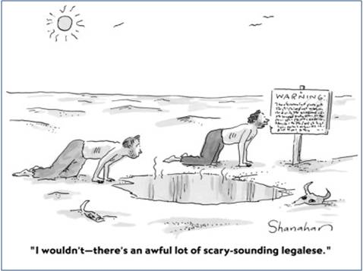
What does that mean?!
indemnify/indemnification/hold harmless
choice of law
contracting party
confidential information
back-dating agreements
warranties

Slide 5
Why does this process take so long?

Slide 6
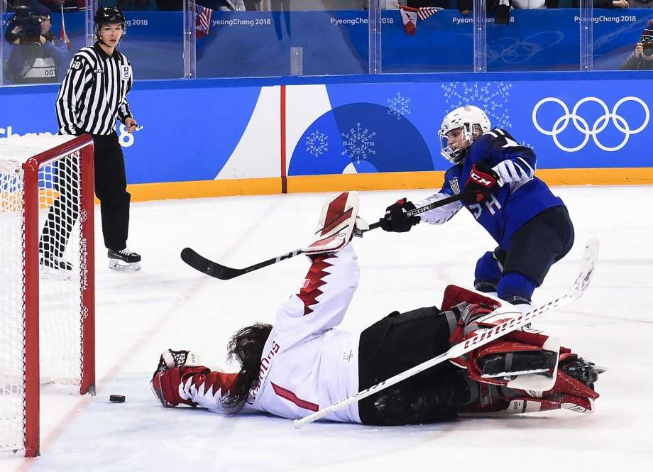
How do I get my agreement signed? What are the steps? Who can help me? Where do I even start?
Like playing Hockey:
Purchasing = identify the basic skills of playing hockey
Business Services = equipment checks, location, rules, insurance
General Counsel = rules & penalties for violating the rules
OIT = special considerations like goalies, overtime, shoot-outs

Slide 7
Purchasing: How to Play the Game The Team: Wendy, Tom, Jackie, Teri
You want to buy something, but you don’t yet have a contract.
Basic Skills Involved:
Know the forms, links, policies
Obtain information/quotes/ estimates from the vendor
Submit paperwork (to wmu-purchasing@wmich.edu)
The team is working with you (like a coach) on the strategy of the game.

Slide 8
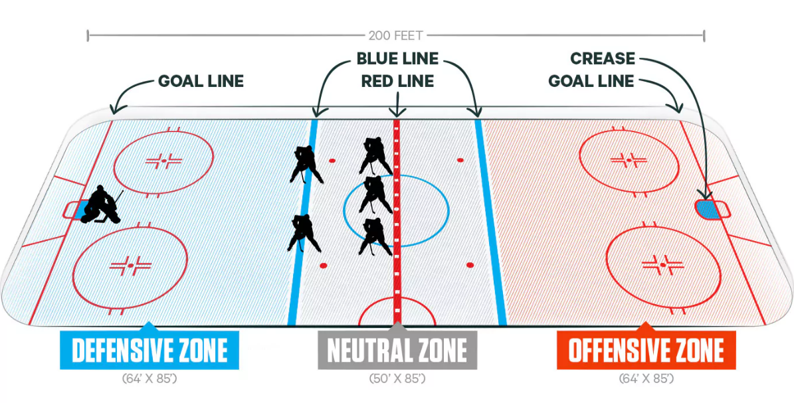
Business Services: What Equipment and Safety Checks do you Need? The Team: Michele & Laura
Your purchase includes a contract that needs review.
Key Responsibilities:
Review for conflicts with other campus/university activities (ex: union contracts)
Ensure insurance requirements (protect the university)
Review for adherence to business policies
Sign on behalf of BOT of WMU

Slide 9
General Counsel: Are you following the rules? What happens if you don’t? The team: Carrick, Jessica, Karen, Kayla
Rules: FOIA/confidentiality; binding arbitration; state law; intellectual property; everyone protected?
Why are there so many?
We are the government – reasonable restrictions on what the government may/should do
Use of tuition and taxpayer dollars
We aren’t trying to take away “the power” – we are trying to learn and understand.
No litigation…yet

Slide 10
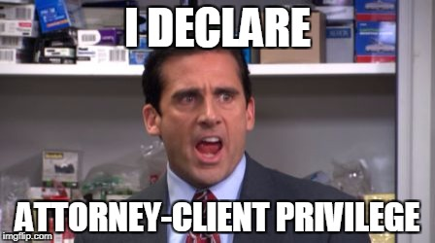
Privileged Communications
Advice of counsel (me) to the client (you) on legal issues
Do not forward to anyone outside of the University
My office does not have signature authority → I cannot “approve” a contract

Slide 11
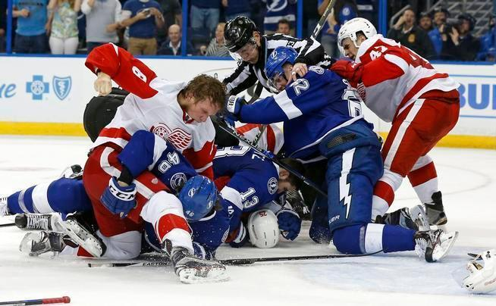
How can I help make this faster?
Know how to play the game: read the documents and send all pertinent information/details (complete the checklists!)
Understand your team: Know the WMU players AND your vendor (supply contact info, identify good and not-so-good suppliers)
Play a friendly game: Let us ask questions (we’re not starting a fight or finger pointing – just gathering info)

Slide 12
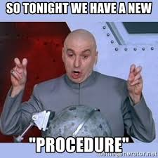
Announcing, for the first time in North America . . .
Contract reviews 2.0!
New checklist (insert groan here)
New procedures
New submission process
https://wmich.edu/business-services/non-research-contracts

Slide 13
Still not sure? ASK!!
Ask: a) your boss; b) purchasing; c) business services
Call your attorney (CYA)

Slide 14
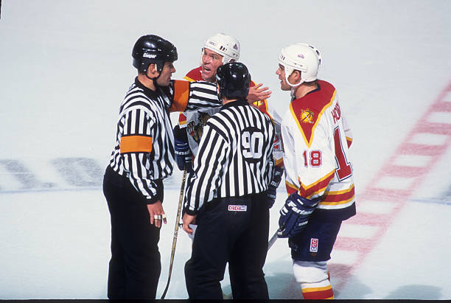
Questions?

Slide 15
Two more things . . .

Slide 16
GDPR
Effective May 25, 2018
Need to identify and track any business with people or companies in Europe
Complicated: If you regularly communicate with people in Europe, contact OGC and OIT so we can make sure the correct procedures are in place.
WMU Policy will be posted as of May 18, 2018, on the Policy Page
More info: https://www.safecomputing.umich.edu/protect-the-u/safely-use-sensitive-data/general-data-protection-regulation-compliance

Slide 17
Logistical Services Updates
Purchasing Update: Bid Policy
Lower bid limit has been increased from $5,000 to $10,000
No change to procurement card limit of $5,000
Purchase requisitions are still required for purchases over $5,000
Purchases between $5,000 and $10,000 will require three quotes to accompany the purchase requisition, but will NOT require competitive bid
Competitive bids will continue to be used for purchases over $10,000
Surplus Update: Threshold at which reimbursements are made
Effective June 1st reimbursements will be done for items valued over $100 instead of $50

