Slide 1
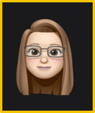
ALLY for Elearning:
Learn how to use ALLY to assess and fix the accessibility issues in your course
Cara Junghans
Accessibility Compliance Specialist, WMUx
B.A. Secondary Education
M.A. Higher, Adult, and Lifelong Education
Pg.C. Educational Technology
Cara.junghans@wmich.edu

Slide 2
Global Accessibility Awareness Day 2023
Thursday, May 18, 2023
GAAD Challenge:
Use the ALLY Instructor Feedback to make one or more items in your course accessible today

Slide 3
Overview
Understanding and navigating ALLY Instructor Feedback
Alternative Downloads for Instruction (doc quality) and Students
Resources
*Open one of your Elearning courses to engage in this workshop, explore your content with ALLY, ask questions, and start making progress toward more accessible content.

Slide 4
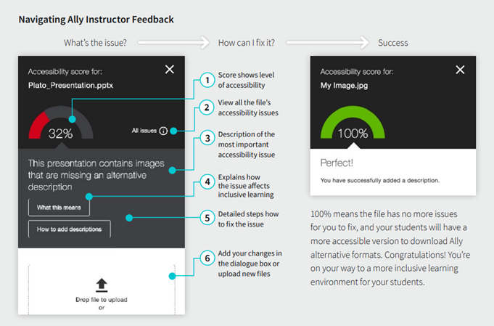
Navigating and using the Instructor Feedback Panel

Slide 5
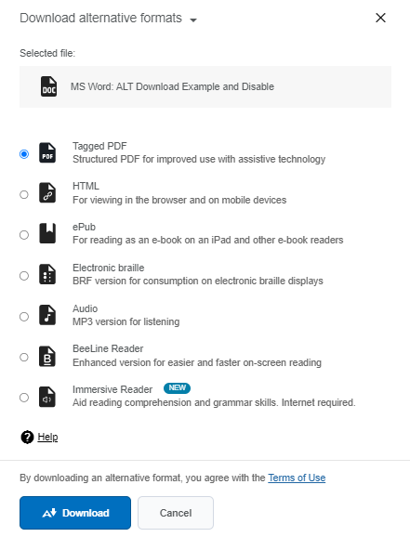
Alternative Downloads for
Students and Instructors

Slide 6
ALLY for Elearning Demo

Slide 7
Questions and Resources
WMUx Instructional Accessibility Guides
ALLY Guide for Instructors
wmux-accessibility@wmich.edu
Cara.junghans@wmich.edu
Request Captions and Transcripts
Notes:
https://help.blackboard.com/sites/default/files/documents/2019-10/AdoptionToolit_D2L.pdf
https://go.wmich.edu/s/article/Accessibility-Resources-and-Assistive-Technology-Guides-for-Students?topicName=Diversity%2C%20equity%20and%20inclusion&topicId=0TO5e0000019c6HGAQ
Cara.junghans@wmich.edu
https://wmich.edu/x/instructors/services/video-caption-request

