Slide 1
Instructional Design & Development Summer Series
Course Design that Supports Neurodivergent Learners
WMUx Instructional Design & Development Team

Slide 2
Session Goals
A chance to learn more about a diverse student population
Being proactive to reduce confusion and questions from students
Tactics to help build and maintain classroom community
Sharing small changes that will benefit all learners
Notes:
Jef will cover instructional resources and contact us

Slide 3
Agenda
Neurodiversity vs. Neurodivergence
Utilizing UDL (Universal Design for Learning) to Support All Students
Considerations to Support All Students
Support Panel Q&A:
WMU's Autism Services Center
WMUx Accessibility Specialist
Resources
Notes:
Jef will cover instructional resources and contact us

Slide 4
What is Neurodiversity?
Neurodiversity describes the idea that people experience and interact with the world around them in many different ways. There is no one "right" way of thinking, learning, and behaving. Differences are not viewed as deficits.

Slide 5
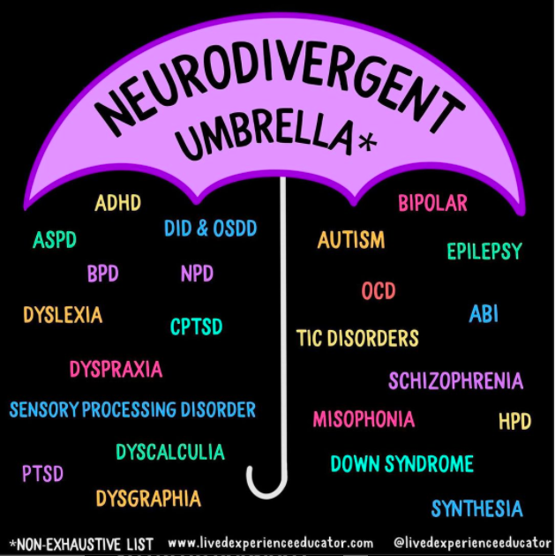
What is Neurodivergent?
Neurodivergent is a nonmedical term that describes people whose brains develop or work differently from neurotypical brains.

Slide 6
Universal Design for Learning (UDL)
UDL aims to change the design of the learning experience rather than change the learner. Intentionally designing to reduce barriers allows all learners to engage in rigorous, meaningful learning.
http://udlguidelines.cast.org

Slide 7
UDL & Neurodiversity
Examples that support student choice, flexibility, and accessibility:
Utilize multiple ways to communicate information
Consider various options for assignment & assessment formats
Use multiple structured assignments to scaffold large assessments
Offer content in a variety of ways
Use a variety of active learning & engagement strategies
Poll/survey students to learn about the type of learning experience that will best suit them

Slide 8
Plus-one Approach
The plus-one approach is a way to work towards building a course that integrates the principles of UDL.
Rather than feeling overwhelmed by overhauling an entire course to fit UDL, a plus-one approach means looking at ways students engage with content and demonstrate acquired knowledge/skills, then adding one more option
Example:
When verbal directions and/or information is given verbally in a F2F class, also provide the same information is a visual way through an Elearning platform

Slide 9
Considerations that Support all Learners
Scheduling
Documented due dates
Regular, or at least key, reminders
Scaffolding
Make sure pieces work toward a whole
Smaller assignments contribute to larger ones
Clear Directions/Objectives
Avoid ambiguous or vague directions
Explain, give detail, and dictate what you want clearly

Slide 10
Considerations that Support all Learners Continued
Purpose or Objective Statements
Beginning class or assignments with a goal
Accessible Documents
Ensuring documents can be easily accessed and navigated
Using Ally on Elearning
Online Presence
Update and maintain the Elearning page
Post news announcements
Post lecture notes and materials

Slide 11
Autism Services Center (ASC)
ASC provides support that goes beyond what is provided by DSS
Students and families apply to work with the ASC if they believe their student may need additional support
Supports students, families, WMU staff and faculty

Slide 12
ASC Services
Weekly one-on-one meetings with a graduate point person
Skill Building Workshops
Communication with families (with a FERPA release)
Supported communication between students and their faculty, WMU staff, and other instructors
Structured study times
Social opportunities
Regularly scheduled virtual parent meetings

Slide 13
Biggest Challenges
Time management, planning, and organization
Communicating with others
Verbal and written
Self-advocacy (asking for help)
Problem solving, especially when something goes wrong
Forming meaningful social connections

Slide 14
Being Proactive
Utilizing Universal Design for Learning
Providing clear directions/expectations for assignments
Using course schedules, in addition to a syllabus, are helpful
Posting announcements on Elearning regarding any changes to the class
Communicating with the ASC – midterm progress reports, emails
Replying all when a student has added the ASC or their graduate point person to an email
Updating grades on Elearning frequently and providing feedback

Slide 15
When to Contact the ASC
Students start the semester by sending an introduction email to their instructors
Many use that opportunity to share their participation in ASC services
Don’t hesitate to reach out to the ASC if a student who shared they are working with the ASC is struggling
Email is the best way to communicate
psy-autismservicescenter@wmich.edu
Please reach out if you have any other concerns regarding a student who is working with the ASC

Slide 16
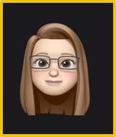
Digital Accessibility: Services and Support
Cara Junghans
Accessibility Compliance Specialist, WMUx
B.A. Secondary Education Social Studies
M.A. Higher, Adult, and Lifelong Education
Pg.C. Educational Technology
Cara.junghans@wmich.edu

Slide 17
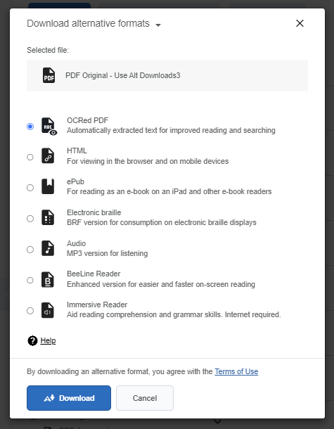
ALLY for Elearning: Alternative Downloads
Notes:
https://help.blackboard.com/Ally/Ally_for_LMS/Student/Alternative_Formats

Slide 18
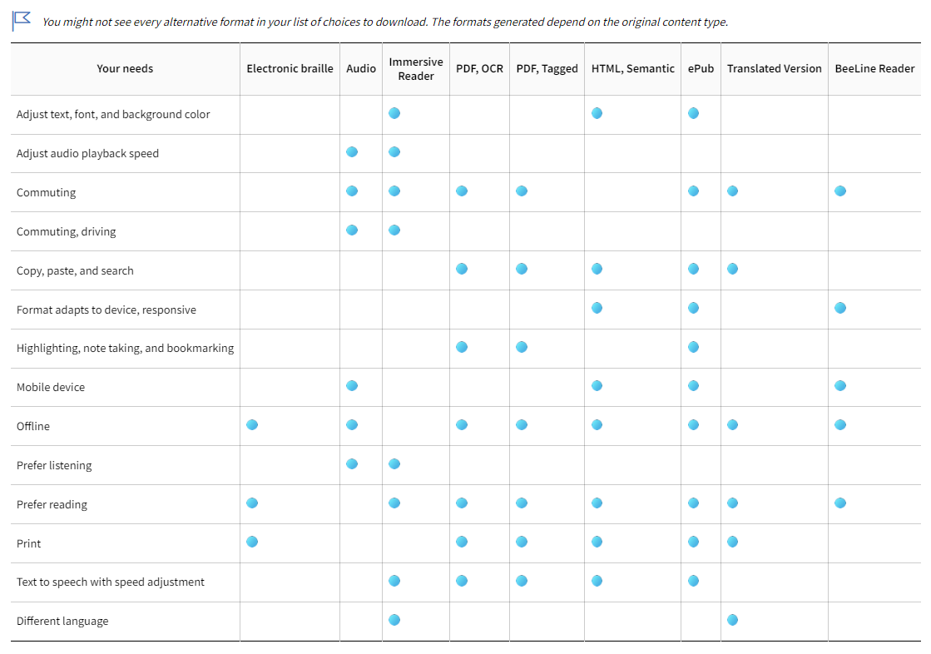
Elearning Styles and Needs: Alternative Downloads
Notes:
https://help.blackboard.com/Ally/Ally_for_LMS/Student/Alternative_Formats

Slide 19
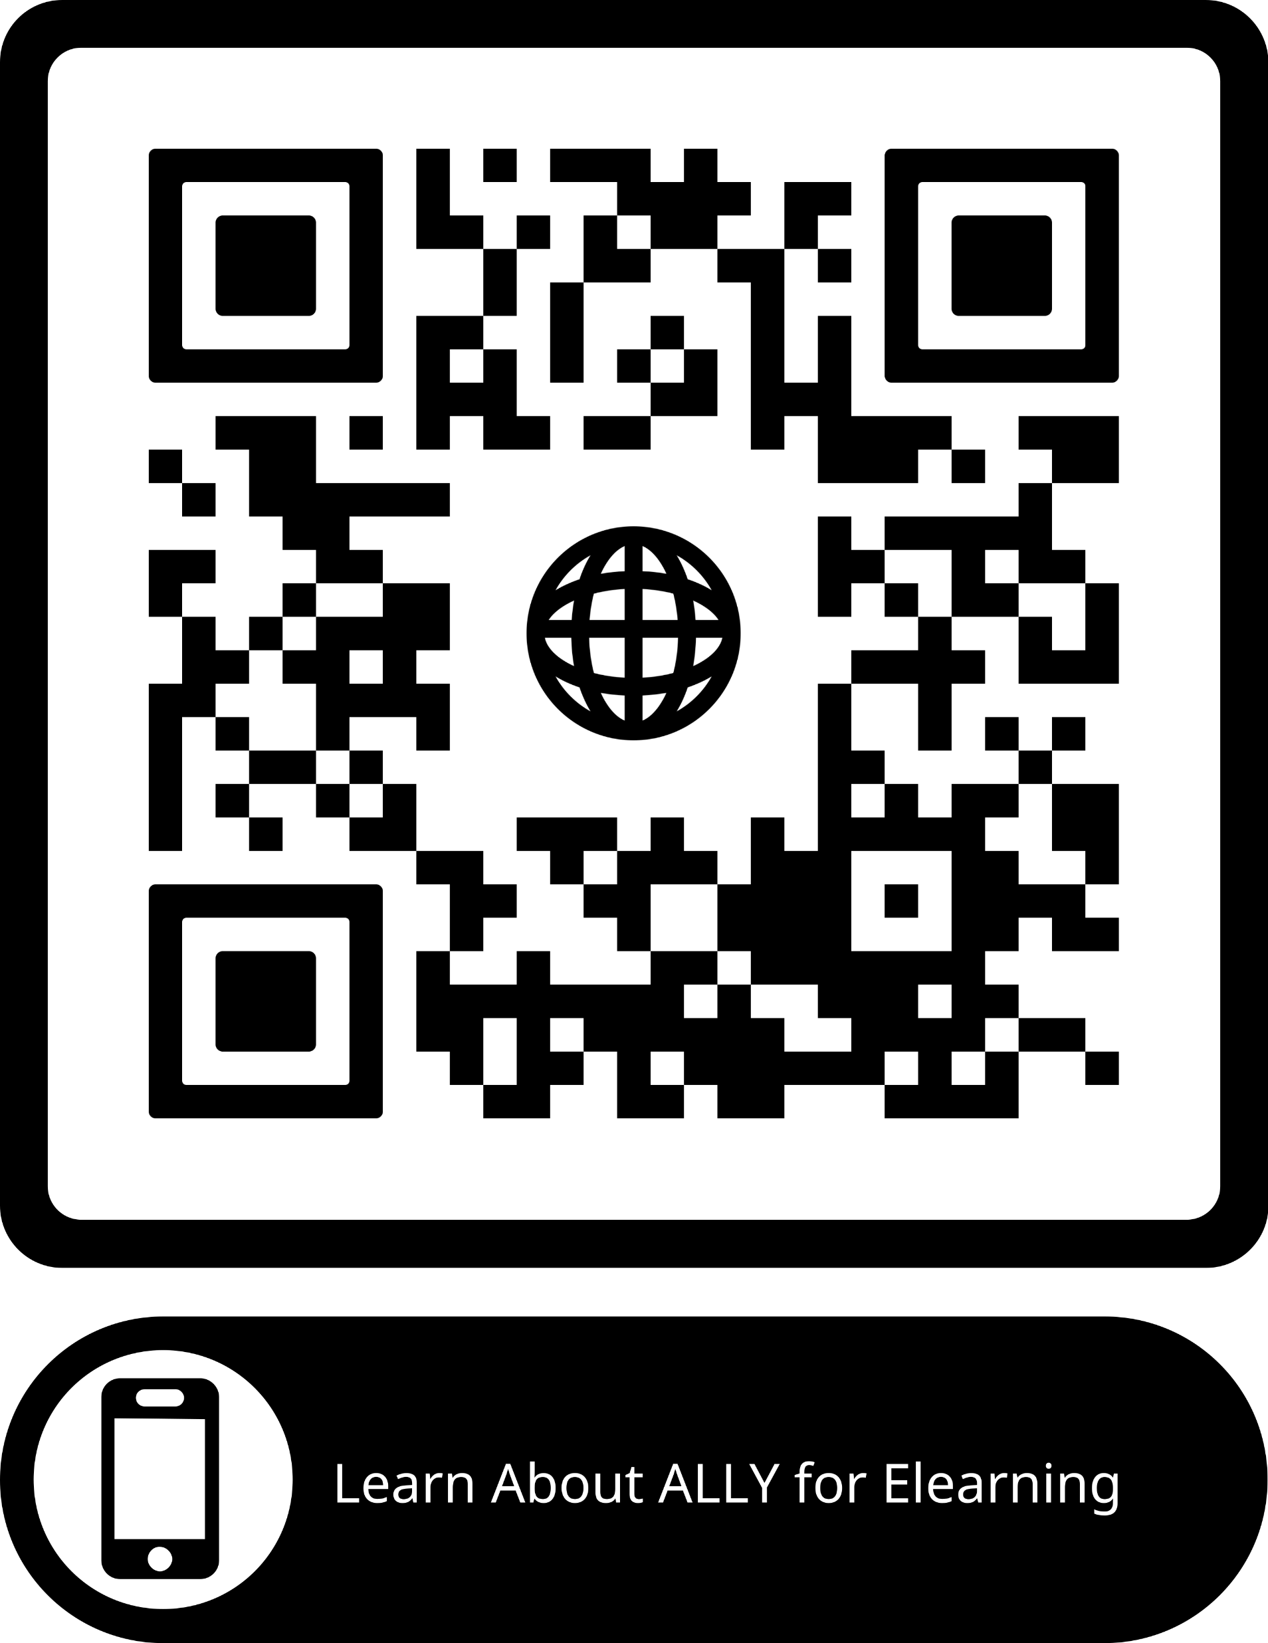
QR Code to ALLY
Notes:
https://help.blackboard.com/Ally/Ally_for_LMS/Instructor

Slide 20
Resources
Elearning Template
Syllabus Template
Tips and Strategies Document
Contact for ID's & Cara

Slide 21
Contact Us
The best way to reach instructional design is by completing the Contact Us form on the WMUx Website

