Slide 1
WMUx Teaching and Learning Team Academic Job Market Basics
May 2023

Slide 2
X
WMUx Teaching and Learning Team
Instructional Design
Course development and redesign
Accessibility Support
Accessibility consultations and solutions
Instructional Technology Center
Learning Management System Support
Teaching technology review and support
Office of Faculty Development
Close captioning
Assistive technology review and support
Learning experience consultations
Teaching consultations
Professional development consultations
Scholarship of teaching and learning
Events, workshops, and trainings

Slide 3
X
Job Market Documents
Letter of Intent
Curriculum Vitae (CV)
Recommendations
Provides evidence that your experience aligns with the duties set out in the job ad
Focuses on research, teaching, and service experience
Shows that you have researched the position and institution
Remind your recommender of courses/grades/other info
Give them a chart of schools/due dates/links
Explain what you want them to emphasize in your letter
An academic-focused resume that includes information on your experience divided into a variety of categories
Clear layout – easy to read
Teaching Philosophy
Diversity Statement
Evidence/Support
Focused on learner (not just content), as well as an outcome that you wanted to emphasize
Provides an example of your process as a teacher
Should be as specific as possible
Offers your definition of DEIB
Explains how you incorporate DEIB into your research/teaching
Writing samples
Sample syllabi and assignments
Student evaluations and teaching observations

Slide 4
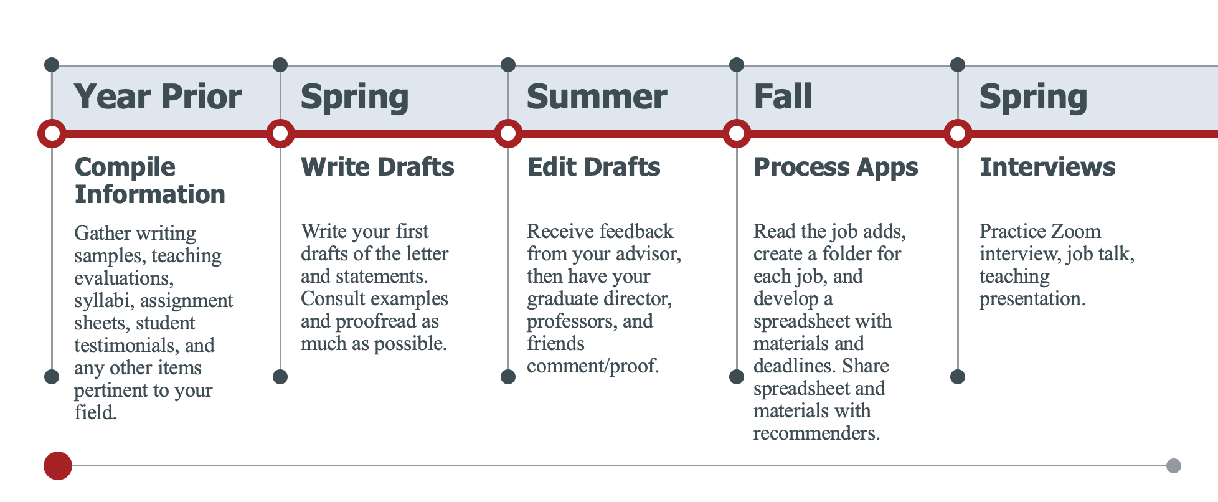
X
Timeline

Slide 5
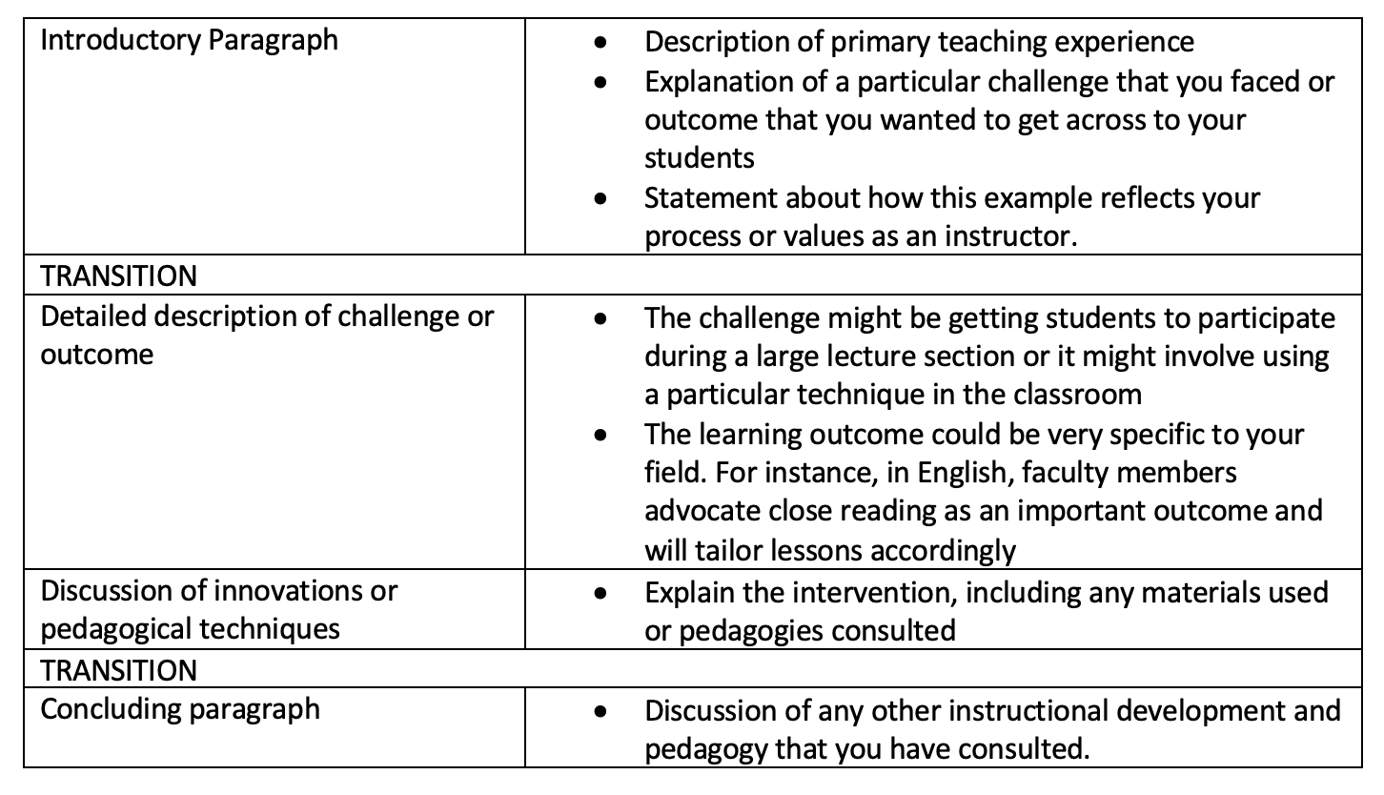
Teaching Philosophy Template

Slide 6
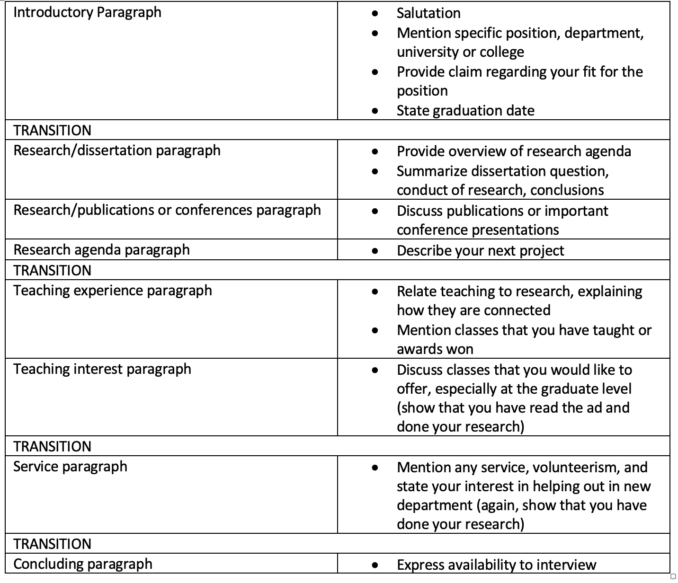
Letter of Intent Template
This template assumes a R1 or R2 position. If you are applying for a position that emphasizes teaching, reduce the research section and increase the teaching section.
For all letters: LESS IS MORE.

Slide 7
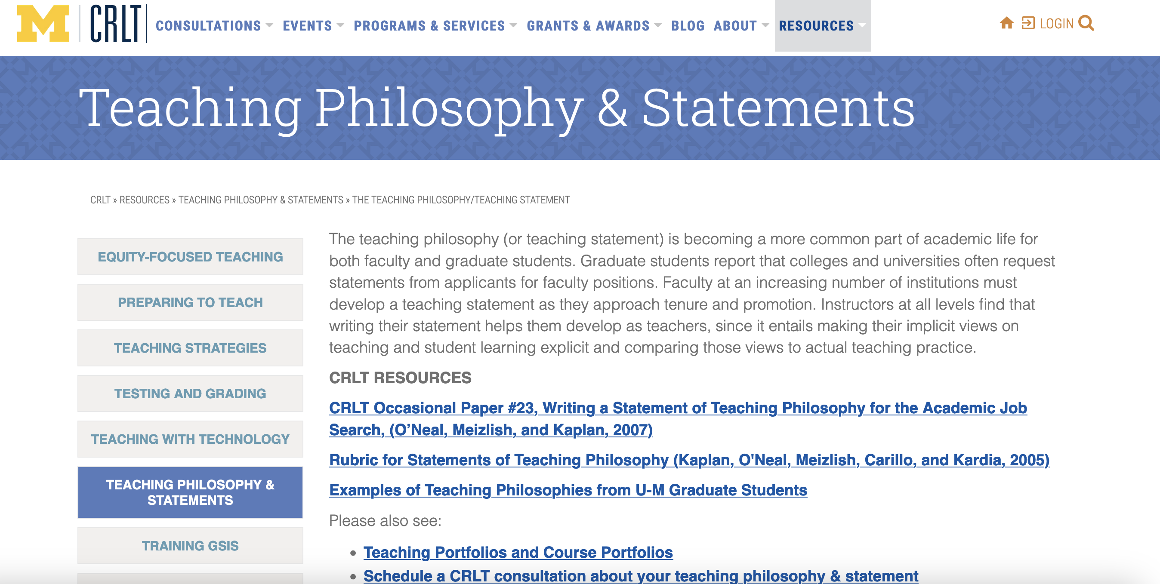
X
Resources

