Slide 1
EVAL 6970: Meta-Analysis Review of Principles and Practice of Meta-Analysis
Dr. Chris L. S. Coryn
Spring 2011

Slide 2
Agenda
Review of principles and practice of meta-analysis
Questions

Slide 3
Why Effect Sizes?
Imagine your doctor gave you the following information
Research shows that people with your body-mass index and sedentary lifestyle score on average 2 points lower on a cardiac risk assessment test in comparison to active people with a healthy body weight
Would this prompt you to make drastic changes to your lifestyle?

Slide 4
Why Effect Sizes?
Now imagine your doctor said this to you instead
Research shows that people with your body-mass index and sedentary lifestyle are four times as likely to suffer a serious heart attack within 10 years in comparison to people with a normal body weight
Would this prompt you to make drastic changes to your lifestyle?

Slide 5
The Problem of Interpretation
It is not sufficient to know the size and direction of an effect
Effect magnitudes must be interpreted to extract meaning
Effects by themselves are meaningless unless they can be contextualized against some frame of reference

Slide 6
The Problem of Interpretation
Medicine is a special case when it comes to reporting results in metrics that are widely understood
Most people have heard of cholesterol, blood pressure, the body-mass index, blood-sugar levels
These metrics are easily amenable to interpretation

Slide 7
The Problem of Interpretation
In the social sciences many phenomena can be observed only indirectly
Self-esteem, trust, satisfaction, and depression are typically measured using scales and such scales are usually considered arbitrary when there is no obvious connection between a score and an individual’s actual state or when it is not known how a one-unit change on the score reflects change in the underlying construct
These metrics are useful for gauging effect sizes, but make interpretation difficult

Slide 8
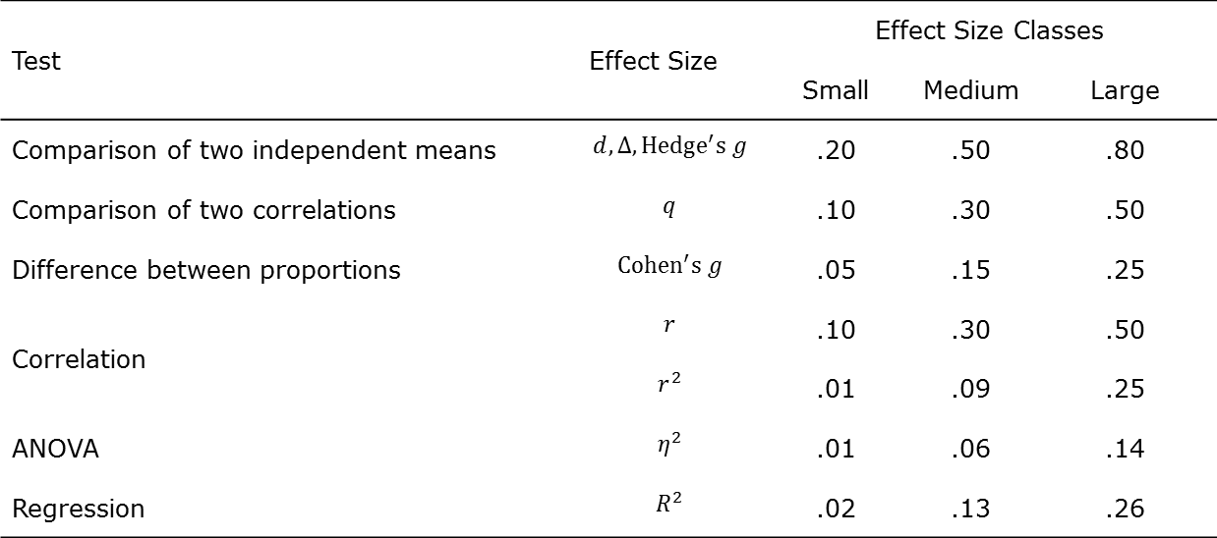
Cohen’s Effect Size Benchmarks
Test | Effect Size | Effect Size Classes
 |  | Small | Medium | Large
Comparison of two independent means | $$d, Δ, Hedge^{′}s g$$ | .20 | .50 | .80
Comparison of two correlations | $$q$$ | .10 | .30 | .50
Difference between proportions | $$Cohen^{′}s g$$ | .05 | .15 | .25
Correlation | $$r$$ | .10 | .30 | .50
 | $$r^{2}$$ | .01 | .09 | .25
ANOVA | $$η^{2}$$ | .01 | .06 | .14
Regression | $$R^{2}$$ | .02 | .13 | .26

Slide 9
Principles of Meta-Analysis
Formulate statement of problem
Identify and retrieve literature
Code literature
Analyze data
Interpret results

Slide 10
Forest Plot (Fixed-Effect)

Slide 11
Forest Plot (Random-Effects)

Slide 12
Heterogeneity Statistics
 |  | Effect Size and 95% CI |  |  | Test of Null |  | Heterogeneity |  |  |  |  | $$τ^{2}$$
Model | $$N$$ | $$M$$ | $$LL$$ | $$UL$$ | $$Z$$ | $$p$$ | $$Q$$ | $$df(Q)$$ | $$p$$ | $$I^{2}$$ | $$τ^{2}$$ | $${SE}_{τ^{2}}$$ | $$V_{τ^{2}}$$ | $$τ$$
Fixed | 12 | 0.94 | 0.85 | 1.02 | -1.44 | 0.15 | 29.72 | 11 | 0.00 | 62.99 | 0.05 | 0.05 | 0.00 | 0.23
Random | 12 | 0.87 | 0.72 | 1.06 | -1.42 | 0.16

Slide 13
Funnel Plot (To Left of Mean)

Slide 14
Funnel Plot (To Right of Mean)

Slide 15
Publication Bias Statistics
Duval and Tweedie’s Trim and Fill = 3 (to right of mean) and 0 (to left of the mean)
Kendall’s $τ$-b = -0.439 (one-tailed $p$ = 0.023; two-tailed $p$ = 0.046)
Egger’s Test of the Intercept indicates an intercept of -1.269, with $t$ = 1.688, $df$ = 10, and a two-tailed $p$-value of 0.122
Orwin’s Fail-Safe N = 11

