Slide 1
EVAL 6970: Meta-Analysis Formulating a Problem, Coding the Literature, and Review of Research Designs
Dr. Chris L. S. Coryn
Kristin A. Hobson
Fall 2013

Slide 2
Agenda
Formulating a problem
Coding the literature
Review of research designs
In-class activity
Next meeting

Slide 3
Formulating a Problem
Like any research, meta-analysis should begin with a careful statement of the topic to be investigated or the question to be answered
This statement will guide study selection, coding of information, and data analysis

Slide 4
Formulating a Problem
The problem statement needs to be straightforward and complete, but at this stage, need not be highly detailed
The problem statement will become clearer and more concise when eligibility criteria are developed

Slide 5
Formulating a Problem
“How effective are challenge programs in reducing the subsequent antisocial behavior of juveniles with behavior problems? What are the characteristics of the least and most successful programs? Do these programs have favorable effects on other outcomes such as relations with peers, locus-of-control, and self-esteem?”
—Lipsey & Wilson (2001)

Slide 6
Formulating a Problem
The statement of problem on the prior slide yields a preliminary specification of the research literature at issue (studies of the effects of challenge programs on juveniles with behavior problems), the major category of independent variables (program characteristics), and key dependent variables (antisocial behavior, interpersonal relationships, locus-of-control, and self-esteem)

Slide 7
Primary Coding Topics
Eligibility criteria and screening form
Development of coding protocol
Hierarchical nature of data
Assessing reliability of coding
Training of coders
Common mistakes

Slide 8
Study Eligibility Criteria
Flow from research question
Identify specifics of:
Defining features of the program/policy/intervention
Eligible designs and required methods
Key sample features
Required statistical data
Geographic/linguistic restrictions, if any
Time frame, if any
Also explicitly states what is excluded

Slide 9
Screening Form
Develop a screening form with clearly defined criteria
Complete form for all studies retrieved as potentially eligible
Modify criteria after examining sample of studies (controversial)
Double-code eligibility
Maintain database on results for each study screened

Slide 10
Development of Coding Protocol
Goal of protocol
Describe studies
Differentiate studies
Extract findings (effect sizes if possible)
Coding forms and manual
Both important

Slide 11
Development of Coding Protocol
Types of information to code
Report identification
Study setting
Participants
Method
Treatment or experimental manipulation
Dependent measures
Effect sizes
Confidence ratings

Slide 12
Development of Coding Protocol
Iterative nature of development
Structuring data
Data hierarchical (findings within studies)
Coding protocol needs to allow for this complexity
Analysis of effect sizes needs to respect this structure
Flat file
Relational hierarchical file

Slide 13
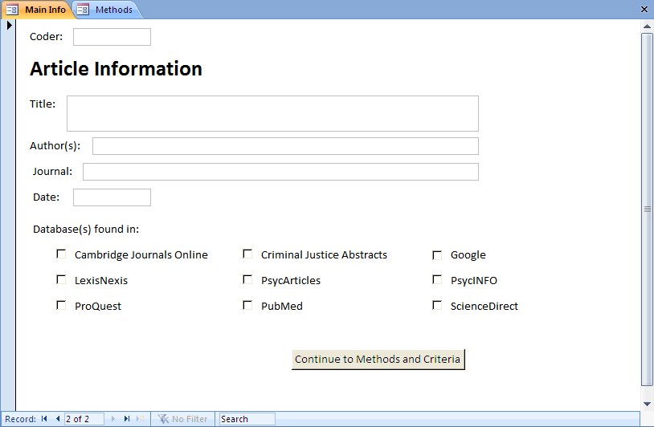
Article Information

Slide 14
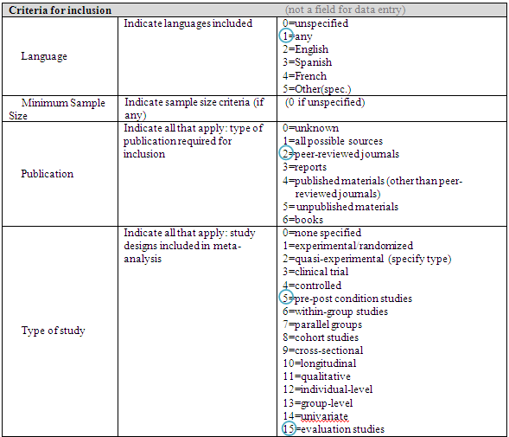
Coding for Inclusion/Exclusion

Slide 15
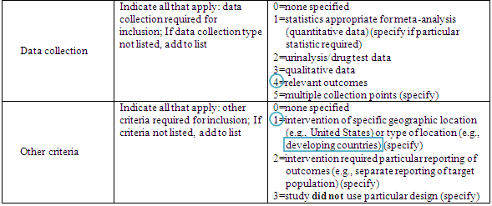
Coding for Inclusion/Exclusion

Slide 16
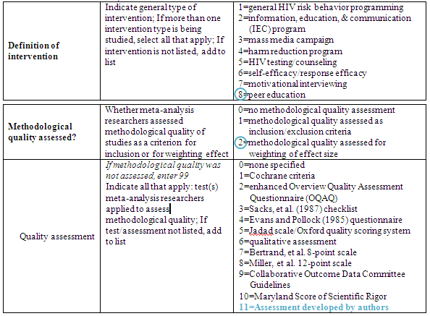
Coding Methodology

Slide 17
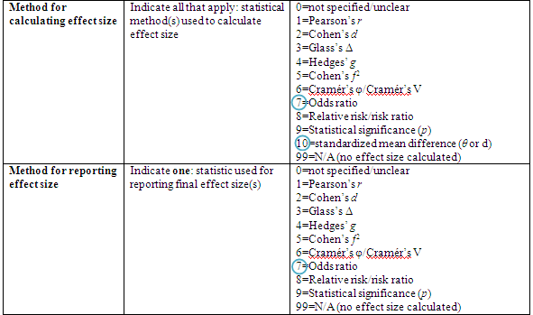
Coding Effect Size

Slide 18
Flat File Structure
Multiple effect sizes handled by having multiple
variables, one for each potential effect size
Note that there is only one record (row) per study

Slide 19
Hierarchical Structure
Study Level Data File
Effect Size Level Data File
Note that a single record in the file above is “related” to five records in the file to the right

Slide 20
More Complex Structure
Study Level Data File
Outcome Level Data File
Effect Size Level Data File
Note that study 100 has 2 records in the outcomes data file and 6 outcomes in the effect size data file, 2 for each outcome measured at different points in time (Months)

Slide 21
Multiple Flat File Structure
Advantages
Can “grow” to any number of effect sizes
Reduces coding task (faster coding)
Simplifies data cleanup
Smaller data files to manipulate
Disadvantages
Complex to implement
Data must be manipulated prior to analysis
Must be able to select a single effect size per study for any analysis
When to use
Large number of effect sizes per study are possible

Slide 22
“Working” with Flat Files
Permanent Data Files
Select subset of effect sizes of
interest to current analysis
(e.g., a specific outcome at
posttest)
Study Data File
Outcome Data File
Effect Size Data File
Verify that there is only a
single effect size per study
Create
composite
data file
yes
no
Composite Data File
Average effect sizes,
further select
based explicit criteria, or
select randomly
Working Analysis File

Slide 23
What About Sub-Samples?
What if you are interested in coding effect sizes separately for different sub-samples, such as, boys and girls or high-risk and low-risk youth?
Just say “no”!
Often not enough of such data for meaningful analysis
Complicates coding and data structure
If you must, plan your data structure carefully
Include a full sample effect size for each dependent measure of interest
Place sub-sample in a separate data file or use some other method to reliably determine effect sizes that are statistically dependent

Slide 24
Coding Mechanics
Paper Coding
Include data file variable names on coding form
All data along left or right margin eases data entry
Coding into a spreadsheet
Coding directly into a database
Using forms
We will work with databases and form-building in the coming weeks

Slide 25
Coding Directly to Database
Advantages
Avoids additional step of transferring data from paper to computer
Easy access to data for data cleanup
Database can perform calculations during coding process (e.g., calculation of effect sizes)
Faster coding
Can perform queries to extract relevant data
Disadvantages
Can be time consuming to set up
Requires a higher level of computer skill

Slide 26
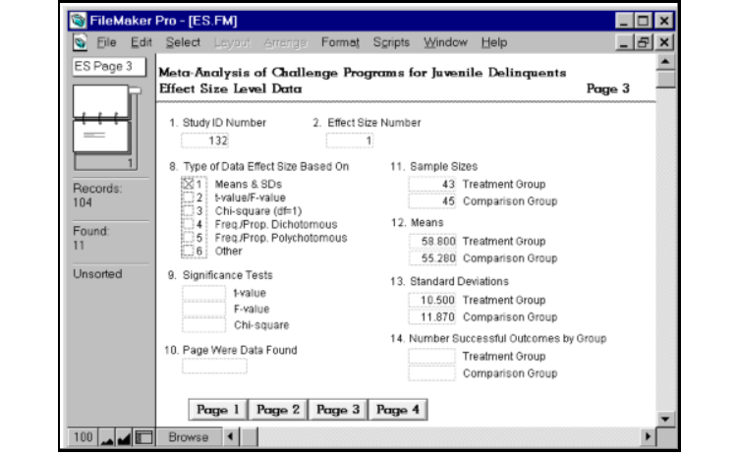
Databases with Forms
FileMaker database form

Slide 27
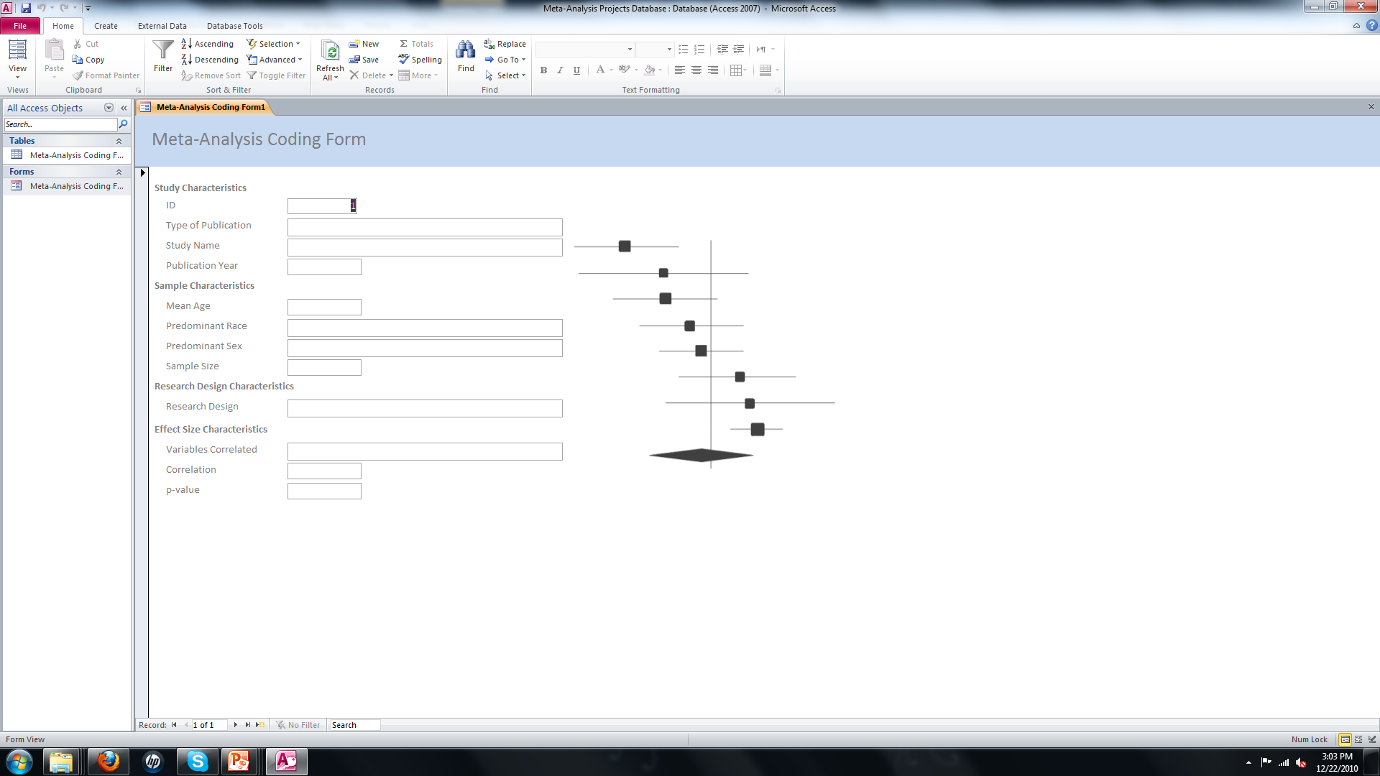
Databases with Forms
Access database form

Slide 28
Reliability of Coding
At a minimum, 2 coders per study
Best if all coders code all studies (fully-crossed as coder $×$ study)
Interrater reliability
At a minimum
Estimate observed agreement
Estimate agreement taking probability of chance agreement into account
This should be done at several points (e.g., as a test of the coding protocol, for decisions about inclusion/exclusion of studies)

Slide 29
Coefficient of Agreement
The coefficient of observed agreement represents the total proportion of observations ($p_{o}$) on which there is agreement
$$p_{o}=\sum_{i=1}^{c}{\sum_{j=1}^{c}{p_{ij}}}$$
where c denotes the total number of cells, i denotes the i^{th} row, and j denotes the j^{th} column

Slide 30
Coefficient of Agreement
 |  | Coder 2
 |  | Characteristic Present ($j_{1}$) | Characteristic Not Present ($j_{2}$) | Row Total
Coder 1 | Characteristic Present ($i_{1}$) | $$c_{11}$$ | $$c_{21}$$ | $$n=c_{11}+c_{21}$$
 | Characteristic Not Present ($i_{2}$) | $$c_{12}$$ | $$c_{22}$$ | $$n=+c_{12}+c_{22}$$
 | Column Total | $$n=c_{11}+c_{12}$$ | $$n=c_{21}+c_{22}$$ | $N=(c_{11}+c_{12}+c_{21}+c_{22}$)
$$p_{o}=\sum_{i=1}^{c}{\sum_{j=1}^{c}{p_{ij}}}=\frac{c_{11}+c_{22}}{N}$$

Slide 31
Coefficient of Agreement
 |  | Coder 2
 |  | Characteristic Present ($j_{1}$) | Characteristic Not Present ($j_{2}$) | Row Total
Coder 1 | Characteristic Present ($i_{1}$) | 500 | 1 | 501
 | Characteristic Not Present ($i_{2}$) | 2 | 25 | 27
 | Column Total | 502 | 26 | 528
$$p_{o}=\sum_{i=1}^{c}{\sum_{j=1}^{c}{p_{ij}}}=\frac{c_{11}+c_{22}}{N}=\frac{500+25}{500+1+2+25}=\frac{525}{528}=.9943$$

Slide 32
Cohen’s Kappa
Cohen’s kappa ($κ$) represents the extent of agreement exceeding that which would be expected purely by chance
$$κ=\frac{p_{o}−p_{e}}{1−p_{e}}$$
Where $p_{e}$ is expected agreements

Slide 33
Cohen’s Kappa
 |  | Coder 2 |  | Marginal Row Probabilities
 |  | Characteristic Present ($j_{1}$) | Characteristic Not Present ($j_{2}$) | $$p_{i.}$$
Coder 1 | Characteristic Present ($i_{1}$) | $$c_{11}$$ | $$c_{21}$$ | $$p_{1.}=\frac{(c_{11}+c_{21})}{N}$$
 | Characteristic Not Present ($i_{2}$) | $$c_{12}$$ | $$c_{22}$$ | $$p_{2.}=\frac{(c_{12}+c_{22})}{N}$$
Marginal Column Probabilities | $$p_{.j}$$ | $$p_{.1}=\frac{(c_{11}+c_{12})}{N}$$ | $$p_{.2}=\frac{(c_{21}+c_{22})}{N}$$ | $N=(c_{11}+c_{12}+c_{21}+c_{22}$)
$$p_{e}=\sum_{i=1}^{c}{\sum_{j=1}^{c}{p_{i.}p_{.j}}}=p_{.1}p_{1.}+p_{.2}p_{2.}$$

Slide 34
Cohen’s Kappa
 |  | Coder 2 |  | Marginal Row Probabilities
 |  | Characteristic Present ($j_{1}$) | Characteristic Not Present ($j_{2}$) | $$p_{i.}$$
Coder 1 | Characteristic Present ($i_{1}$) | 500 | 1 | $$p_{1.}=\frac{(500+1)}{528}$$
 | Characteristic Not Present ($i_{2}$) | 2 | 25 | $$p_{2.}=\frac{(2+25)}{528}$$
Marginal Column Probabilities | $$p_{.j}$$ | $$p_{.1}=\frac{(500+2)}{528}$$ | $$p_{.2}=\frac{(1+25)}{528}$$ | $$N=528$$
$$p_{e}=\sum_{i=1}^{c}{\sum_{j=1}^{c}{p_{i.}p_{.j}}}=p_{.1}p_{1.}+p_{.2}p_{2.}=.9507\left(.9488\right)+.0492\left(.0511\right)=.9045$$
$$κ=\frac{p_{o}−p_{e}}{1−p_{e}}=\frac{.9943−.9045}{1−.9045}=\frac{.0898}{.0955}=.9043$$

Slide 35
Training and Calibrating Coders
Start with a small sub-sample of representative studies (i.e., practice coding)
Assess interrater reliability
Identify areas of inconsistency/disagreement
Modify coding procedures, forms as necessary (reassess after modification)
Regular meetings (develop normative understandings)
Use specialized coders (e.g., computing effect sizes by hand or using effect size calculators)
In the end, a consensus procedure will be necessary for “disagreeing” codes

Slide 36
Common Mistakes
Not understanding or planning the analysis prior to coding (e.g., failure to recognize hierarchical nature and statistical dependencies of some data)
Underestimating time, effort, and technical/statistical demands
Plan on approximately 8 hours per study for coding
Using a spreadsheet for managing a large review
Over-coding
Trying to extract more detail than routinely reported

Slide 37
Managing the Bibliography
Information you need to track
Source of reference (e.g., ERIC, PubMed)
Retrieval status
Retrieved
Requested from interlibrary loan
Eligibility status
Eligible
Not eligible
Relevant review article
Coded status
Word processor not up to the task
Spreadsheets are cumbersome
Use a database of some form

Slide 38
Research Design Review
Basic designs that you are likely to encounter
Experimental designs
Randomized controlled trial
Units are randomly assigned to two or more conditions (typically a treatment and a control or comparison group)
Most common design is between subjects (e.g., posttest-only design)
Can also include a within subjects factor (e.g., a pretest-posttest design)

Slide 39
Research Design Review
Basic designs that you are likely to encounter
Quasi-experimental designs
Similar to randomized controlled trials, except that units are not assigned to conditions randomly
One or more groups
One-group designs (within subjects) are often in the form of a one-group pretest-posttest
Some types of single-subject designs fall in this category as do case-control designs

Slide 40
Research Design Review
Basic designs that you are likely to encounter
Everything else is generally nonexperimental (in a very broad sense, though many designs that I consider quasi-experimental would be labeled as nonexperimental by others)
Cross-sectional, correlational (one point in time, one group)
Intact, naturally occurring groups (e.g., males, females)
Passive, naturalistic

Slide 41
Today’s In-Class Activity
Individually, or in your working groups, calculate the coefficient of observed agreement ($p_{o}$), expected agreement ($p_{e}$), and Cohen’s kappa ($κ$) for problems #1, #2, and #3 on the following slides
How reliable is each in terms of observed agreement and taking chance agreements into account?

Slide 42
Problem #1
 |  | Coder 2
 |  | Experimental Design | Other Type of Design
Coder 1 | Experimental Design | 33 | 748
 | Other Type of Design | 679 | 26
$$p_{o}=?$$
$$p_{e}=?$$
$$κ=?$$

Slide 43
Problem #2
 |  | Coder 2
 |  | Effect Size Based on Means and Standard Deviations | Effect Size Based on t-value or F-value
Coder 1 | Effect Size Based on Means and Standard Deviations | 1,267 | 48
 | Effect Size Based on t-value or F-value | 53 | 926
$$p_{o}=?$$
$$p_{e}=?$$
$$κ=?$$

Slide 44
Problem #3
 |  | Coder 2
 |  | Meets Inclusion Criteria | Does Not Meet Inclusion Criteria
Coder 1 | Meets Inclusion Criteria | 345 | 41
 | Does Not Meet Inclusion Criteria | 38 | 326
$$p_{o}=?$$
$$p_{e}=?$$
$$κ=?$$

