Slide 1
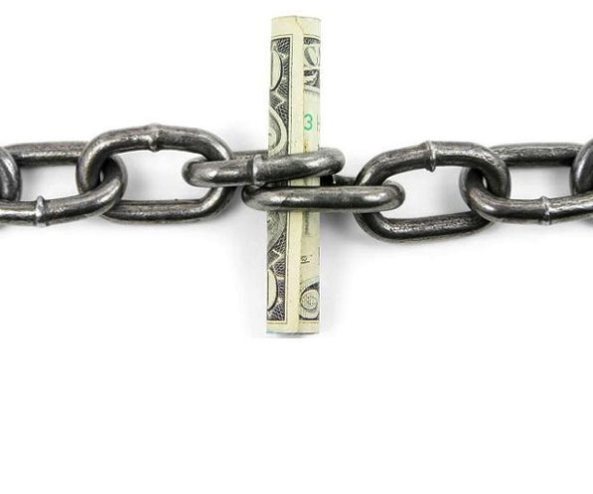
EVAL 6970: Cost Analysis for Evaluation
Dr. Chris L. S. Coryn
Nick Saxton
Fall 2014

Slide 2
Agenda
The importance of cost-analysis for evaluation and decision making
Introduce and describe four modes of cost analysis
Discussion
Activities

Slide 3
e·val·u·a·tion noun
The act or process of determining the merit, worth, or significance of something or the product of the process

Slide 4
Importance of cost-analysis for evaluation and decision making

Slide 5
Importance of cost-effective analysis
As a means for making more efficient use of available resources
To reduce the costs of attaining particular objectives
To maximize what can be accomplished using available resources

Slide 6
Importance of cost-effective analysis
As a means for making comparisons among alternatives courses of action
Effectiveness and costs should not be considered in isolation
Ultimately, to provide a basis for non-arbitrary, informed decision making

Slide 7
Importance of cost-effective analysis
Cost-analysis (of any type) is rarely considered in most evaluations
Private sector evaluations are often an exception as return on investment is very frequently a part of such evaluations

Slide 8
Cost-analysis approaches in evaluation and decision making

Slide 9
Cost-effectiveness analysis
Evaluation of alternatives according to both their costs and their effects with regard to producing some outcome
Assumes that
Only alternatives with similar or identical goals can be compared
A common measure of effectiveness can be used to assess them

Slide 10
Cost-effectiveness analysis
Enables the selection of those alternatives that provide maximum effectiveness per unit of cost or that require the least cost per unit of effectiveness
A method for making relative comparisons between alternatives rather than absolute judgments about worth

Slide 11
Intervention | Cost per student per year | Effect on test score (points) | Cost/effectiveness ratio (cost per unit of effectiveness)
Infrastructure
Water | $1.81 | 3.51 | $0.52
School furniture | $5.45 | -- | --
School facilities | $8.80 | 7.23 | $1.22
“Hardware” | $16.06 | 8.97 | $1.79
Material inputs
Textbook usage | $1.65 | 6.40 | $0.26
Writing material | $1.76 | 4.70 | $0.37
“Software” | $3.41 | 4.86 | $0.70

Slide 12
Cost-benefit analysis
Evaluation of alternatives according to their costs and benefits when each is measured in monetary terms
Can be used to determine absolute or relative cost-benefit(s)

Slide 13
Cost-benefit analysis
Because all alternatives can be evaluated in terms of monetary values and costs, it can be determined
If any particular alternative has benefits exceeding its costs
Which set of alternatives with different objectives has the highest ratio of benefits to costs
Which of a set of alternatives among different areas shows the highest benefit-cost ratio to determine where investments should be made

Slide 14
Cost-benefit analysis
As long as costs and benefits can be meaningfully expressed in monetary units, comparisons can be made among differing objectives
If important benefits cannot be expressed in monetary units then cost-benefit is inappropriate

Slide 15
Academy | Costs | Dropouts saved |  | Benefit per dropout saved |  | Benefits | Net benefits (total benefits – total costs) | Benefit-cost ratio
A | $89,424 | -3.4 | X | $86,000 | = | -$292,400 | -$381,824 | --
C | $174,600 | 21.5 | X | $86,000 | = | $1,849,000 | $1,674,400 | 10.59
E | $106,998 | 1.8 | X | $86,000 | = | 154,800 | $47,802 | 1.45
F | $35,280 | 2.0 | X | $86,000 | = | $172,000 | $136,720 | 4.88
G | $382,830 | 5.8 | X | $86,000 | = | $498,800 | $115,970 | 1.30
H | $57,534 | -2.0 | X | $86,000 | = | -$172,000 | -$229,534 | --
J | $136,572 | 0.2 | X | $86,000 | = | $17,200 | $119,372 | 0.13
K | $218,226 | 3.4 | X | $86,000 | = | $292,400 | $74,174 | 1.34
Total | 1,201,464 | 29.3 | X | $86,000 | = | $2,519,800 | $1,318,336 | 2.10

Slide 16
Cost-utility analysis
Multiple measures of effectiveness are combined into a composite estimate of ‘utility’
Often different “importance weights” are assigned to different measures of effectiveness
Can only be used to assess relative utility of alternatives rather than absolute utility

Slide 17
 |  | Measures of effectiveness
Alternative | Cost per student | Speed | Comprehension | Word knowledge | Student satisfaction | Overall utility (weighted sum) | Cost/utility ratio
A | $168 | 8 | 6 | 6 | 7 | 6.7 | $25.26
B | $153 | 5 | 4 | 6 | 3 | 4.5 | $34.00
C | $210 | 6 | 9 | 7 | 7 | 7.6 | $27.81
D | $195 | 4 | 9 | 9 | 5 | 7.2 | $27.27
E | $279 | 9 | 6 | 4 | 6 | 6.4 | $43.94
Importance weight |  | 0.25 | 0.40 | 0.20 | 0.15

Slide 18
Cost-feasibility analysis
A method for estimating only the costs of an alternative in order to ascertain whether or not it can be considered
Determines only whether or not alternatives are within boundaries of consideration, not which ones should actually be selected
Outcomes are not measured, therefore cannot determine worth of alternatives

Slide 19
Maximum class size | Total operational costs (in billions) | Per-pupil operational costs
20 | $2,127 | $189
18 | $5,049 | $448
15 | $11,047 | $981

Slide 20
Summary of cost-analysis approaches

Slide 21
Type of analysis | Analytical questions | Measure of costs | Measure of outcomes | Strengths | Weaknesses
Cost-effectiveness | Which alternative yields a given level of effectiveness for the lowest cost? | Monetary value of resources | Units of effectiveness | Easy to incorporate standard evaluations of effectiveness Useful for alternatives with a single or small number of objectives | Difficult to interpret results when there are multiple measures of effectiveness Cannot judge overall worth of a single alternative; useful only for comparing two or more alternatives

Slide 22
Type of analysis | Analytical questions | Measure of costs | Measure of outcomes | Strengths | Weaknesses
Cost-benefit | Which alternative yields a given level of benefits for the lowest cost? Are the benefits of a single alternative larger than its costs? | Monetary value of resources | Monetary value of benefits | Can be used to judge absolute worth Can compare results across a wide variety of alternatives | Often difficult to place monetary value on all relevant benefits

Slide 23
Type of analysis | Analytical questions | Measure of costs | Measure of outcomes | Strengths | Weaknesses
Cost-utility | Which alternative yields a given level of utility at the lowest cost? | Monetary value of resources | Units of utility | Incorporates individual preferences for units of effectiveness Can incorporate multiple measures of effectiveness into single units of utility Promotes stakeholder participation in decision making | Sometimes difficult to arrive at consistent and accurate measures of individual preferences Cannot judge overall worth of a single alternative; only useful for comparing two or more alternatives

Slide 24
Type of analysis | Analytical questions | Measure of costs | Measure of outcomes | Strengths | Weaknesses
Cost-feasibility | Can a single alternative be carried out within an existing budget? | Monetary value of resources | None | Permits alternatives that are not feasible to be immediately ruled out, before evaluating outcomes | Cannot judge overall worth because it does not incorporate outcome measures

Slide 25
Activities

Slide 26
Activity 1
WMU is currently in the process of conducting an “academic program review”
Programs will likely be terminated, expanded, restructured, or combined
In small groups, take one position or the other (to use or not use cost analysis) and support your position with at least three reasons for using or not using cost analysis in this context
If you support the use of cost analysis, which of the types discussed today would be most appropriate and why?
If you do not support the use of cost analysis, why not?

Slide 27
Activity 2
Individually or in small groups, identify a program that you might use for the course’s ‘application paper’ assignment (see course syllabus) and determine what mode, or modes, of cost-analysis might be appropriate

