Slide 1
EVAL 6970: Meta-Analysis Effect Sizes and Precision: Part I
Dr. Chris L. S. Coryn
Kristin A. Hobson
Fall 2013

Slide 2
Agenda
Effect sizes based on means
Review questions
In-class activity

Slide 3
Note
Statistical notation varies widely for the topics covered today and in future lectures
By convention (and for consistency), we will predominately use Borenstein, Hedges, Higgins, and Rothstein’s (2010) notation

Slide 4
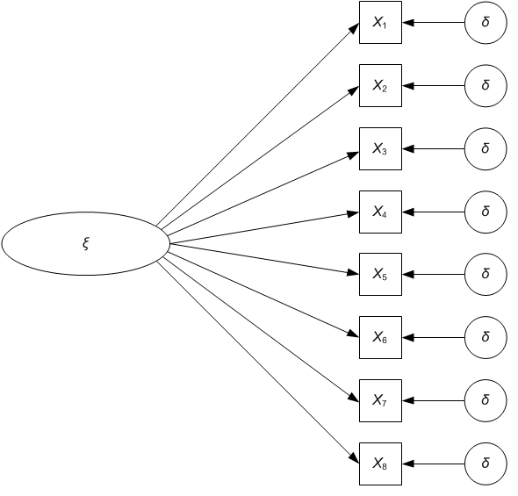
The Apples and Oranges Argument: Both are Fruits
There is a useful analogy between including different outcome measures in a meta-analysis, the common factor model, multiple-operationism, and concept-to-operation correspondence

Slide 5
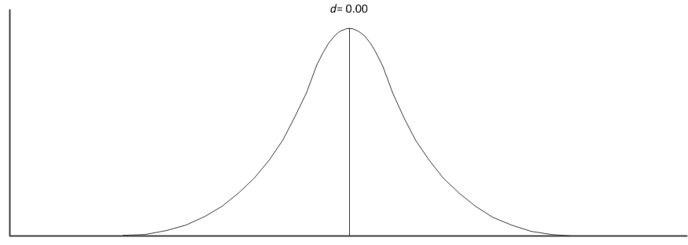
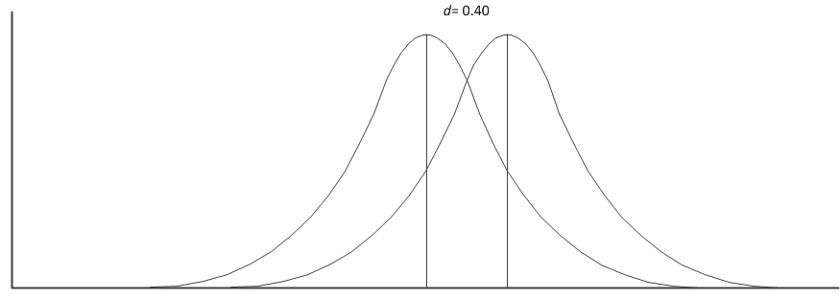
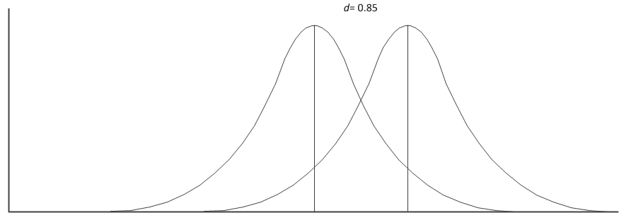
Effect Sizes

Slide 6
Raw Mean Difference, D
The raw (unstandardized) mean difference can be used on a meaningful outcome measure (e.g. blood pressure) and when all studies use the same measure
The population mean difference is defined as
$$∆ =μ_{1}−μ_{2}$$

Slide 7
D from Independent Groups
The mean difference $∆$ from studies using two independent groups (e.g., treatment and control) can be estimated from the sample group means ${\overline{X}}_{1}$and ${\overline{X}}_{2}$ as
$$D={\overline{X}}_{1}−{\overline{X}}_{2}$$

Slide 8
D from Independent Groups
Assuming $σ_{1}=σ_{2}=σ$ (as is assumed for most parametric statistics) the variance of D is
where
$$V_{D}=\frac{n_{1}+n_{2}}{n_{1}n_{2}}S_{pooled}^{2}$$
$$S_{pooled}=\sqrt{\frac{\left(n_{1}−1\right)S_{1}^{2}+\left(n_{2}−1\right)S_{2}^{2}}{n_{1}+n_{2}−2}}$$

Slide 9
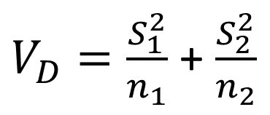
D from Independent Groups
Assuming $σ_{1}≠σ_{2}$ the variance of D is
For both $σ_{1}=σ_{2}$ and $σ_{1}≠σ_{2}$ the standard error of D is
$V_{D}=\frac{S_{1}^{2}}{n_{1}}$ + $\frac{S_{2}^{2}}{n_{2}}$
$${SE}_{D}=\sqrt{V_{D}}$$

Slide 10
D from Dependent Groups
When groups are dependent (e.g., matched pairs designs or pretest-posttest designs) then D is the difference score for each pair
$$D={\overline{X}}_{diff} or D={\overline{X}}_{1}−{\overline{X}}_{2}$$

Slide 11

D from Dependent Groups
Where the variance is
Where n is the number of pairs, and
$$V_{D}=\frac{S_{diff}^{2} }{n}$$
$${SE}_{D}=\sqrt{V_{D}}$$

Slide 12
D from Dependent Groups
If $S_{diff}$ must be computed
Where r is the correlation between pairs
If $S_{1}=S_{2}$ then
$$S_{diff}=\sqrt{S_{1}^{2}+S_{2}^{2}−2×r×S_{1}×S_{2}}$$
$$S_{diff}=\sqrt{{2×S}_{pooled}^{2}(1−r)}$$

Slide 13

Standardized Mean Difference, d and g
Assuming $σ_{1}=σ_{2}=σ$ (as is the case for most parametric statistics) the standardized mean difference population parameter is defined as
$$δ=\frac{μ_{1}−μ_{2}}{σ}$$

Slide 14

d and g from Independent Groups
The standardized mean difference ($δ$) from independent groups (e.g., treatment and control) can be estimated from the sample group means ${\overline{X}}_{1}$and ${\overline{X}}_{2}$ as
$$d=\frac{{\overline{X}}_{1}−{\overline{X}}_{2}}{S_{within}}$$

Slide 15
d and g from Independent Groups
Where $S_{within}$ is the within-groups standard deviation, pooled across groups
$$S_{within}=\sqrt{\frac{\left(n_{1}−1\right)S_{1}^{2}+(n_{2}−1)S_{2}^{2}}{n_{1}+n_{2}−2}}$$

Slide 16
d and g from Independent Groups
Where the variance is
And the standard error is
$$V_{d}=\frac{n_{1}+n_{2}}{n_{1}n_{2}}+\frac{d^{2}}{2(n_{1}+n_{2})}$$
$${SE}_{d}=\sqrt{V_{d}}$$

Slide 17

d and g from Independent Groups
In small samples (N < 20), d overestimates $δ$ and this bias can be reduced by converting d to Hedges’ g using the correction factor J, where
For two independent groups
$$J=1−\frac{3}{4df−1}$$
$$df=n_{1}+n_{2}−2$$

Slide 18

d and g from Independent Groups
Using the correction factor J, Hedges’ g is calculated as
With
And
$$g=J×d$$
$$V_{g}=J^{2}×V_{d}$$
$${SE}_{g}=\sqrt{V_{g}}$$

Slide 19
d and g from Dependent Groups
When groups are dependent (e.g., matched pairs designs or pretest-posttest designs) then d is the difference score for each pair
$$d=\frac{{\overline{Y}}_{diff}}{S_{within}}=\frac{{\overline{Y}}_{1}−{\overline{Y}}_{2}}{S_{within}}$$

Slide 20
d and g from Dependent Groups
Where $S_{within}$ is
$$S_{within}=\frac{S_{diff}}{\sqrt{2(1−r)}}$$

Slide 21
d and g from Dependent Groups
Where the variance is
Where n is the number of pairs, and
$$V_{d}=\left(\frac{1}{n}+\frac{d^{2}}{2n}\right)2(1−r)$$
$${SE}_{D}=\sqrt{V_{d}}$$

Slide 22
d and g from Dependent Groups
If $S_{diff}$ must be computed
Where r is the correlation between pairs
If $S_{1}=S_{2}$ then
$$S_{diff}=\sqrt{S_{1}^{2}+S_{2}^{2}−2×r×S_{1}×S_{2}}$$
$$S_{diff}=\sqrt{{2×S}_{pooled}^{2}(1−r)}$$

Slide 23
d and g from Dependent Groups
In small samples (N < 20), d overestimates $δ$ and this bias can be reduced by converting d to Hedges’ g using the correction factor J, where
Where, in dependent groups
$$J=1−\frac{3}{4df−1}$$
$$df=n−1$$

Slide 24

d and g from Dependent Groups
Using the correction factor J, Hedges’ g is calculated as
With
And
$$g=J×d$$
$$V_{g}=J^{2}×V_{d}$$
$${SE}_{g}=\sqrt{V_{g}}$$

Slide 25
Effect Direction
For all designs the direction of the effect (${\overline{X}}_{1}−{\overline{X}}_{2}$ or ${\overline{X}}_{2}−{\overline{X}}_{1}$) is arbitrary, except that the same convention must be applied to all studies in a meta-analysis (e.g., a positive difference indicates that the treated group did better than the control group)

Slide 26
Review Questions
When is it appropriate to use D?
When is it appropriate to use d?
When is it appropriate to use g?

Slide 27
Today’s In-Class Activity
Individually, or in your working groups, download “Data Sets 1-6 XLSX” from the course Website
Calculate the appropriate effects sizes, standard deviations, variances, and standard errors for Data Sets 1, 2, 3, and 4
Be certain to save your work as we will use these data again

