Slide 1
EVAL 6970: Meta-Analysis
Subgroup Analysis
Dr. Chris L. S. Coryn
Kristin A. Hobson
Fall 2013

Slide 2
Agenda
Subgroup analyses
  In-class activity

Slide 3
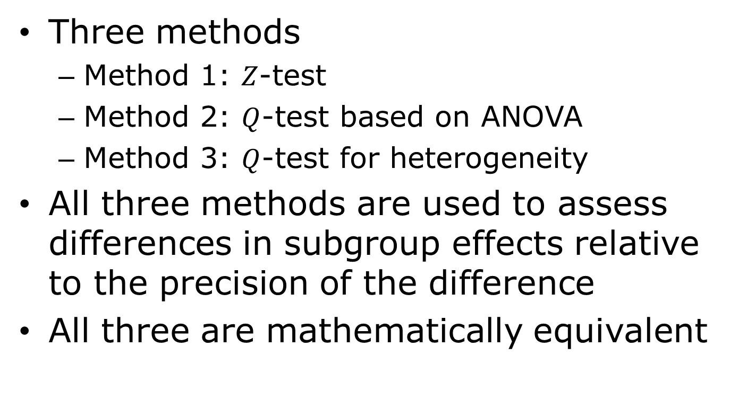
Subgroup Analyses
Three methods
  Method 1: $Z$-test
  Method 2: $Q$-test based on ANOVA
  Method 3: $Q$-test for heterogeneity
All three methods are used to assess differences in subgroup effects relative to the precision of the difference
All three are mathematically equivalent

Slide 4
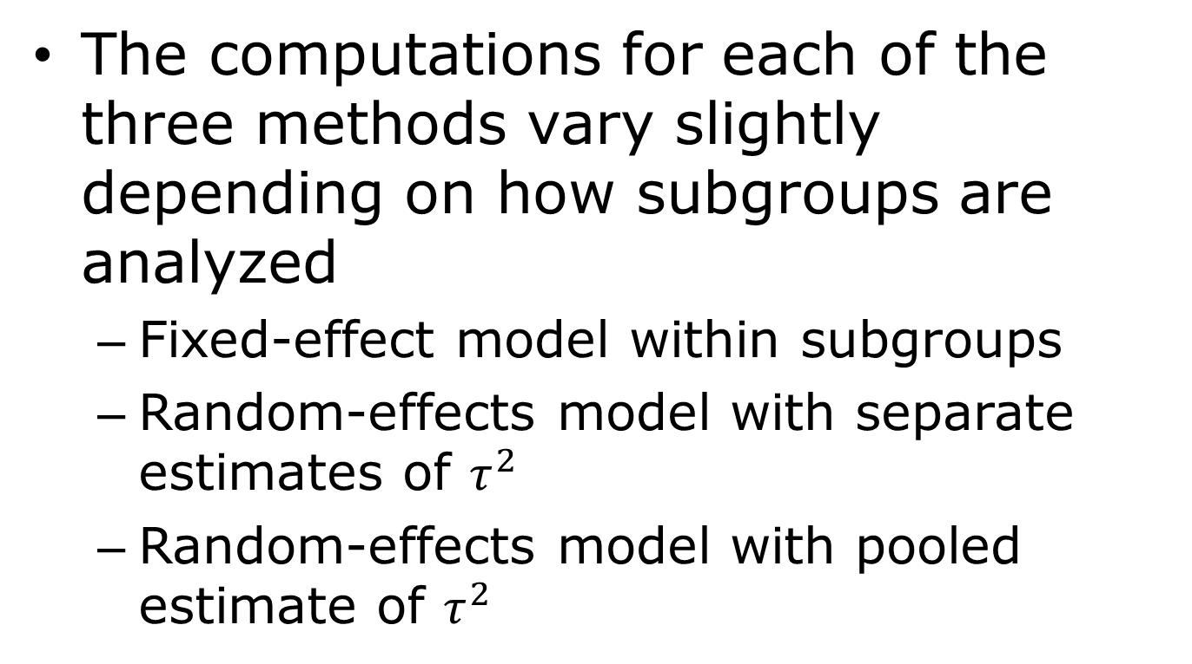
Subgroup Analyses
The computations for each of the three methods vary slightly depending on how subgroups are analyzed
  Fixed-effect model within subgroups
  Random-effects model with separate estimates of $τ^{2}$
  Random-effects model with pooled estimate of $τ^{2}$

Slide 5
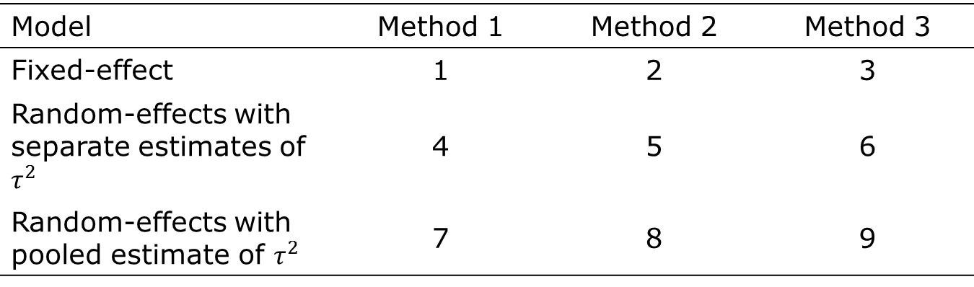
Subgroup Analyses
Model | Method 1 | Method 2 | Method 3
Fixed-effect | 1 | 2 | 3
Random-effects with separate estimates of $τ^{2}$ | 4 | 5 | 6
Random-effects with pooled estimate of $τ^{2}$ | 7 | 8 | 9

Slide 6
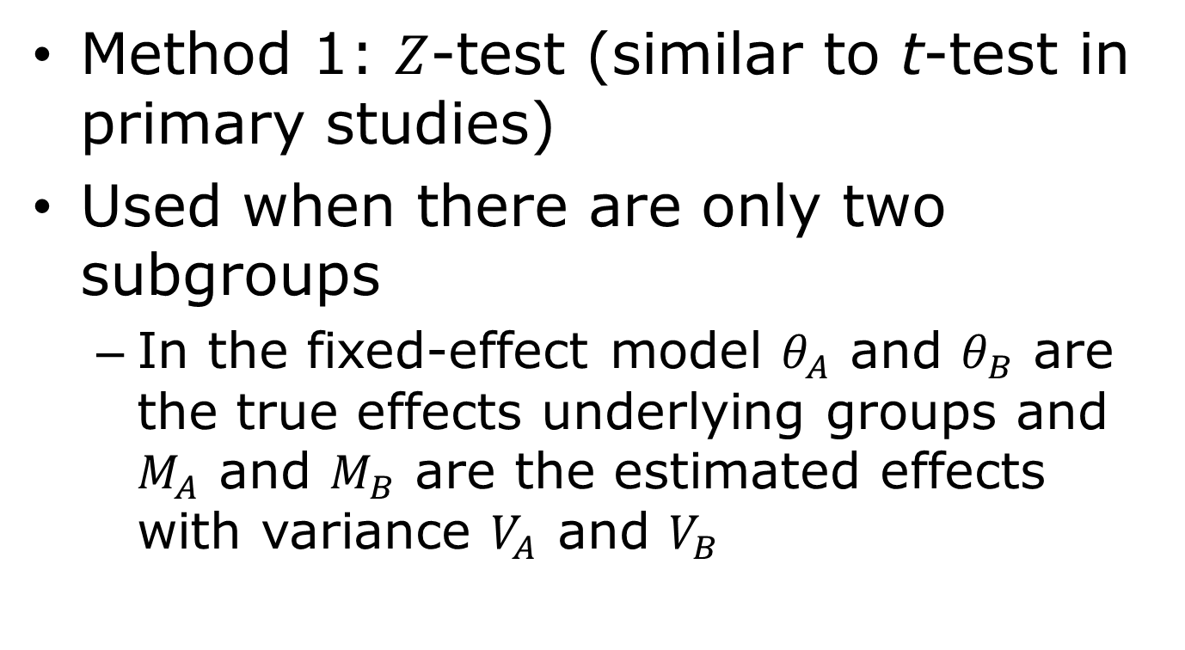
Fixed-Effect Model within Subgroups: Method 1
Method 1: $Z$-test (similar to t-test in primary studies)
Used when there are only two subgroups
  In the fixed-effect model $θ_{A}$ and $θ_{B}$ are the true effects underlying groups and $M_{A}$ and $M_{B}$ are the estimated effects with variance $V_{A}$ and $V_{B}$

Slide 7


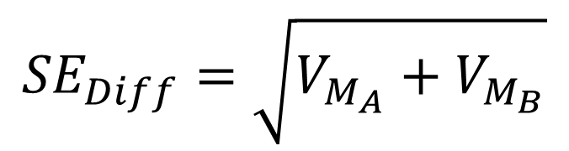
Fixed-Effect Model within Subgroups: Method 1
The difference between the two effects is
Which is tested as
Where
$$Diff=M_{B}−M_{A}$$
$$Z_{Diff}=\frac{Diff}{{SE}_{Diff}}$$
$${SE}_{Diff}=\sqrt{V_{M_{A}}+V_{M_{B}}}$$

Slide 8

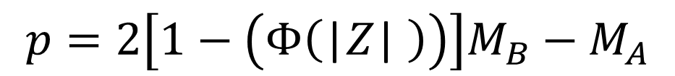
Fixed-Effect Model within Subgroups: Method 1
Where
For a two-tailed test
=(1-(NORMDIST(ABS(Z))))*2
$H_{0} : θ_{A}=$ $θ_{B}$
$$p=2\left[1−\left(Φ\left(\text{|}Z\text{| }\right)\right)\right]M_{B}−M_{A}$$

Slide 9
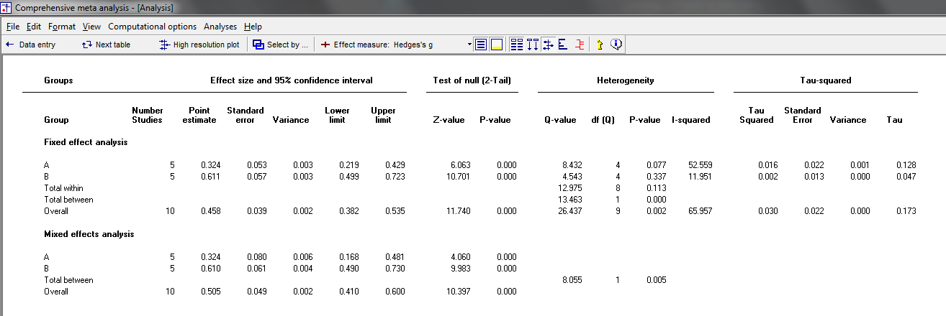


Fixed-Effect Model within Subgroups: Method 1
$$M_{A} \text{and} M_{B}$$
$$V_{A} \text{and} V_{B}$$

Slide 10
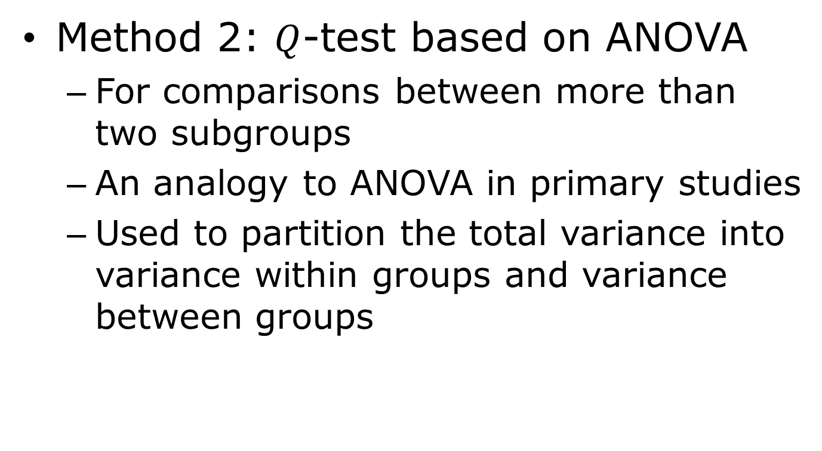
Fixed-Effect Model within Subgroups: Method 2
Method 2: $Q$-test based on ANOVA
  For comparisons between more than two subgroups
  An analogy to ANOVA in primary studies
  Used to partition the total variance into variance within groups and variance between groups

Slide 11
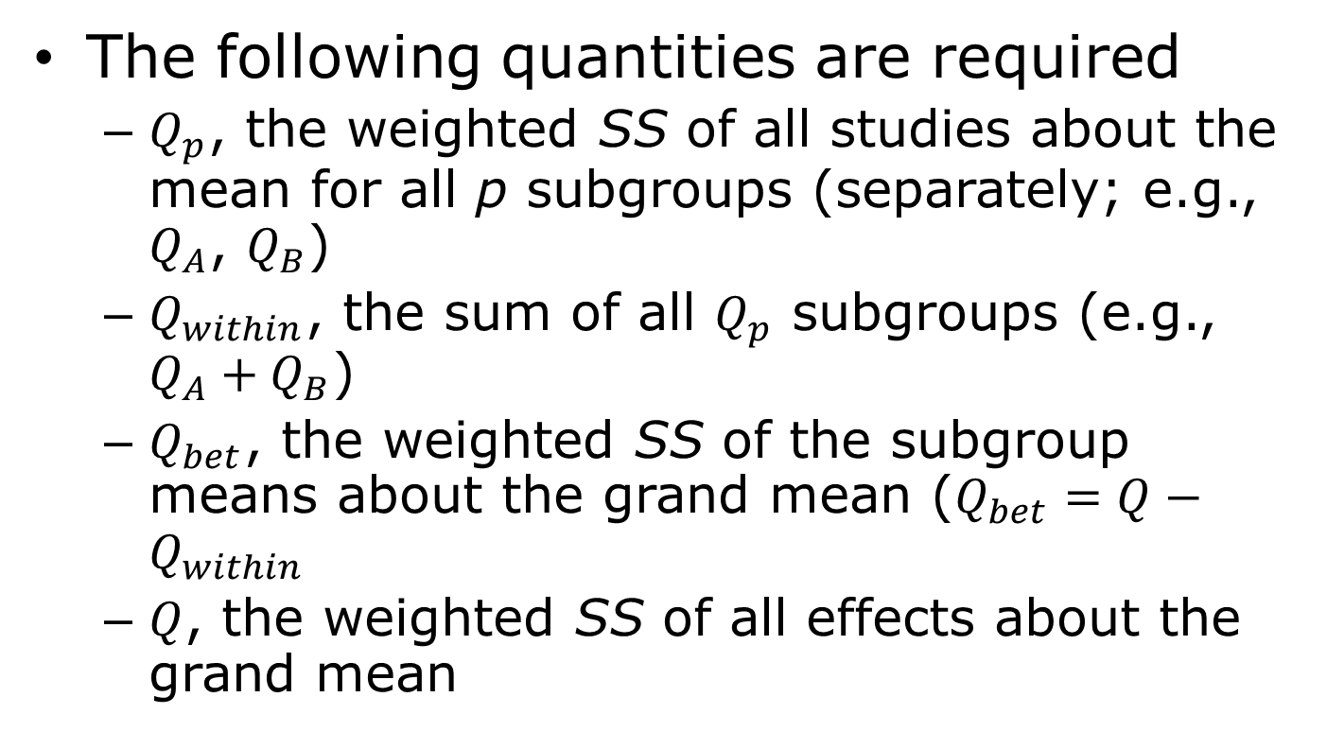
Fixed-Effect Model within Subgroups: Method 2
The following quantities are required
  $Q_{p}$, the weighted SS of all studies about the mean for all p subgroups (separately; e.g., $Q_{A}$, $Q_{B}$)
  $Q_{within}$, the sum of all $Q_{p}$ subgroups (e.g., $Q_{A}+Q_{B}$)
  $Q_{bet}$, the weighted SS of the subgroup means about the grand mean ($Q_{bet}=Q−Q_{within}$
  $Q$, the weighted SS of all effects about the grand mean

Slide 12
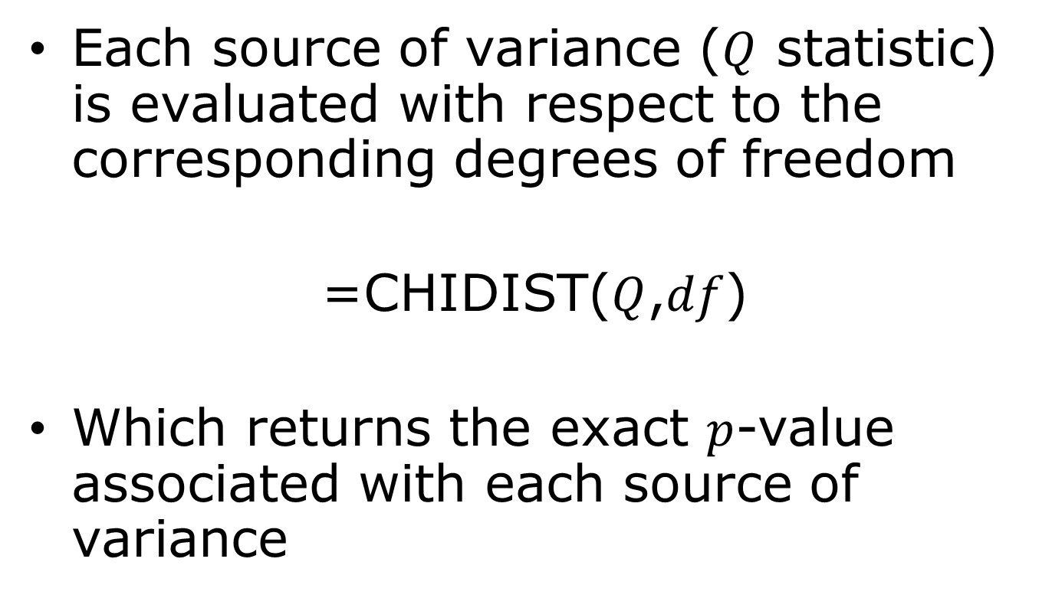
Fixed-Effect Model within Subgroups: Method 2
Each source of variance ($Q$ statistic) is evaluated with respect to the corresponding degrees of freedom
=CHIDIST($Q$,$df$)
Which returns the exact $p$-value associated with each source of variance

Slide 13

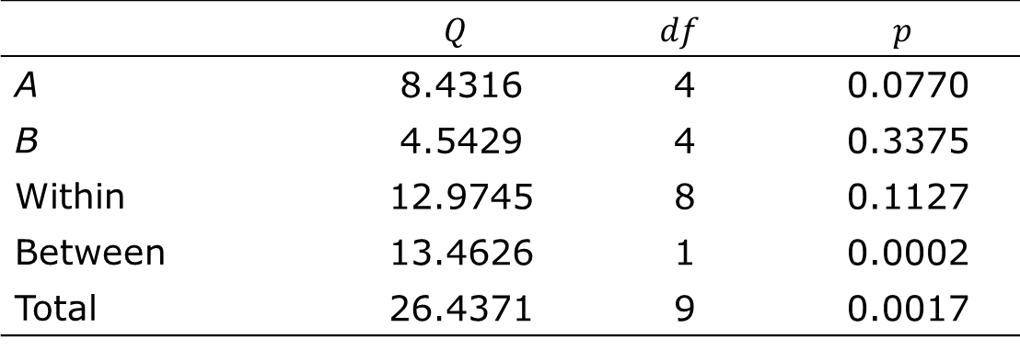
Fixed-Effect Model within Subgroups: Method 2
 | $$Q$$ | $$df$$ | $$p$$
A | 8.4316 | 4 | 0.0770
B | 4.5429 | 4 | 0.3375
Within | 12.9745 | 8 | 0.1127
Between | 13.4626 | 1 | 0.0002
Total | 26.4371 | 9 | 0.0017
$Q$-test ANOVA table

Slide 14
Fixed-Effect Model within Subgroups: Method 2
Variance components

Slide 15
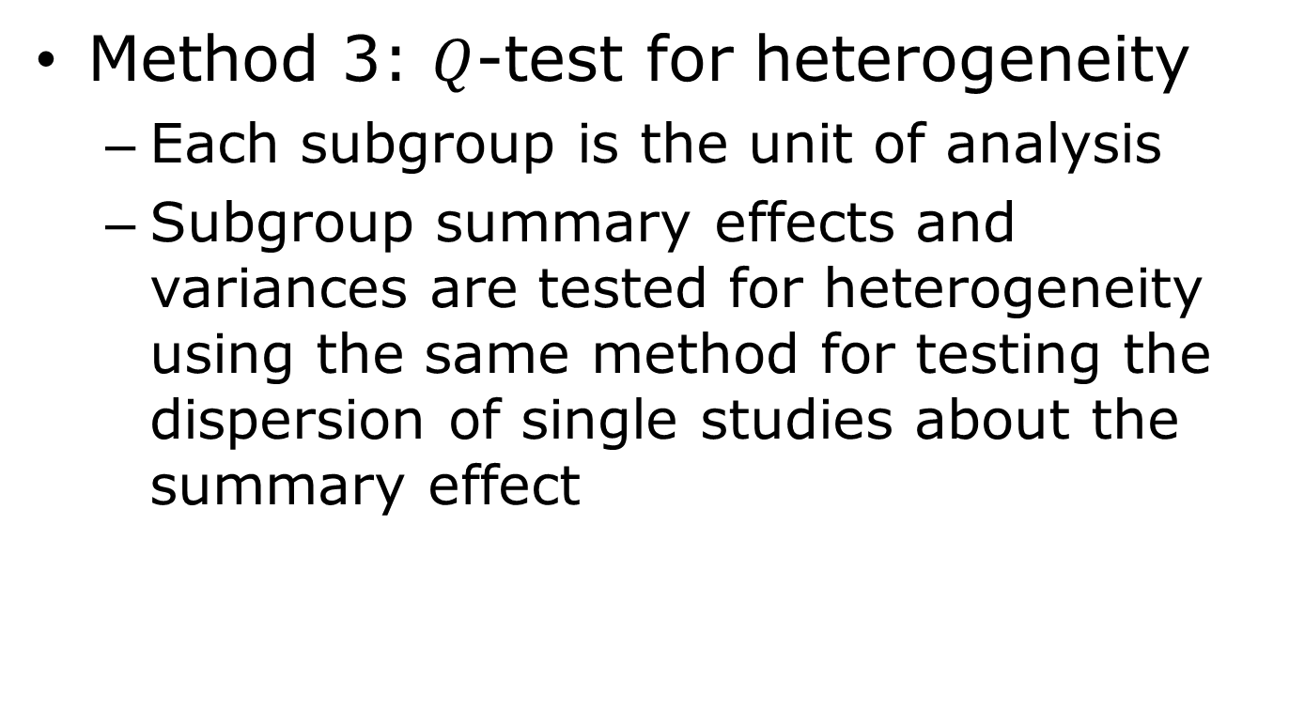
Fixed-Effect Model within Subgroups: Method 3
Method 3: $Q$-test for heterogeneity
  Each subgroup is the unit of analysis
  Subgroup summary effects and variances are tested for heterogeneity using the same method for testing the dispersion of single studies about the summary effect

Slide 16
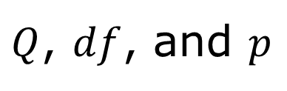
Fixed-Effect Model within Subgroups: Method 3
$Q$, $df$, and $p$
Use Total between

Slide 17
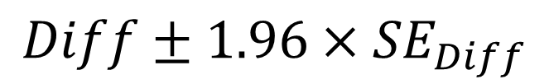

Magnitude of Subgroup Differences
With
The 95% confidence interval is
Where
$$Diff=M_{B}−M_{A}$$
$$Diff±1.96×{SE}_{Diff}$$
$${SE}_{Diff}=\sqrt{V_{M_{A}}+V_{M_{B}}}$$

Slide 18
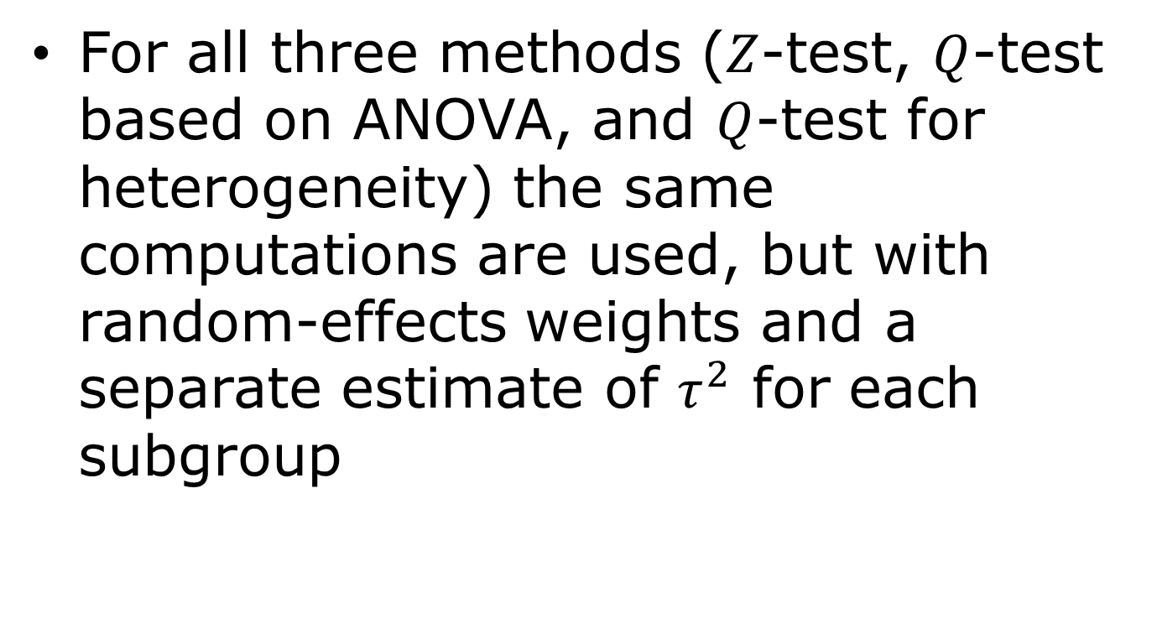
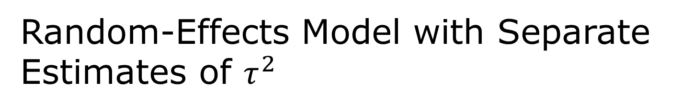
Random-Effects Model with Separate Estimates of $τ^{2}$
For all three methods ($Z$-test, $Q$-test based on ANOVA, and $Q$-test for heterogeneity) the same computations are used, but with random-effects weights and a separate estimate of $τ^{2}$ for each subgroup

Slide 19
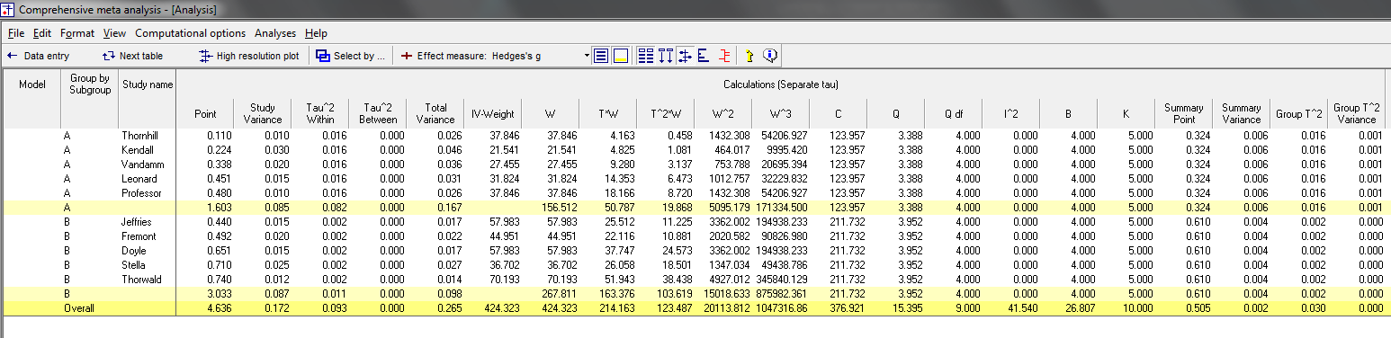
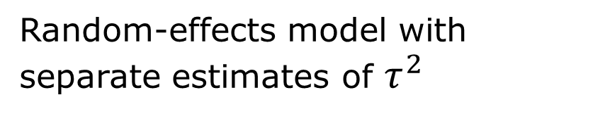
Random-Effects Model with Separate Estimates of $τ^{2}$
Random-effects model with
separate estimates of $τ^{2}$

Slide 20
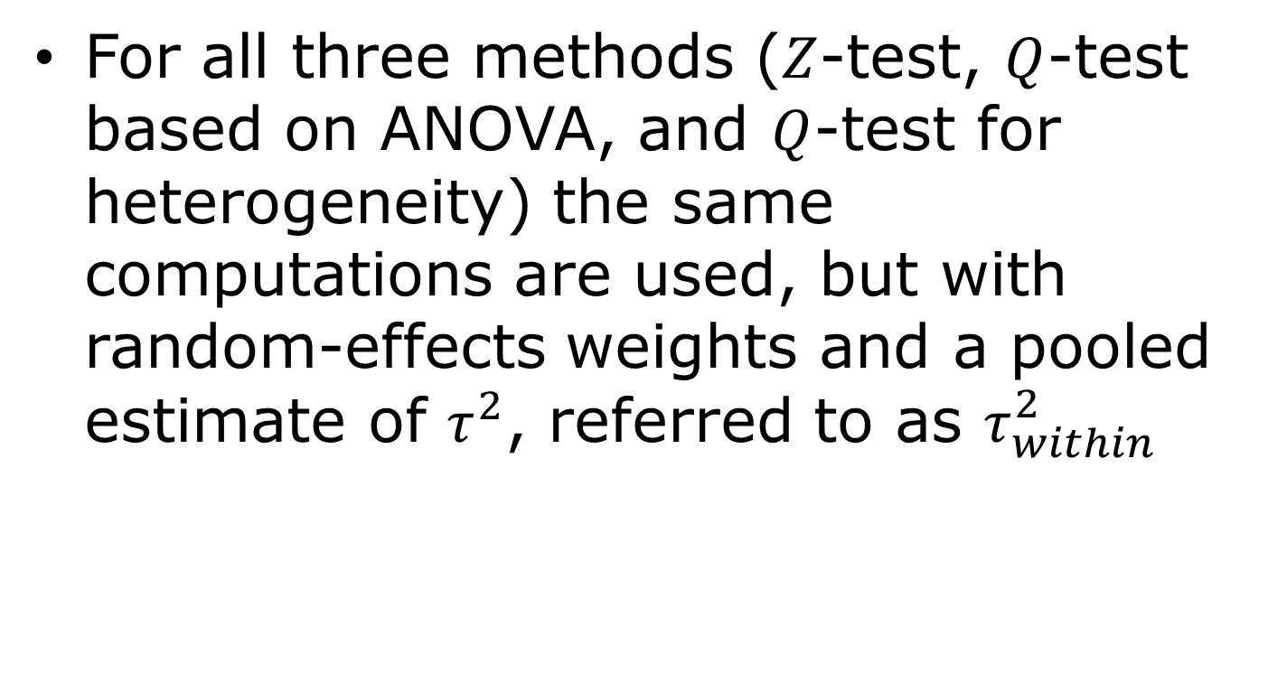
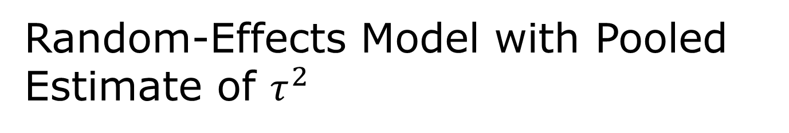
Random-Effects Model with Pooled Estimate of $τ^{2}$
For all three methods ($Z$-test, $Q$-test based on ANOVA, and $Q$-test for heterogeneity) the same computations are used, but with random-effects weights and a pooled estimate of $τ^{2}$, referred to as $τ_{within}^{2}$

Slide 21


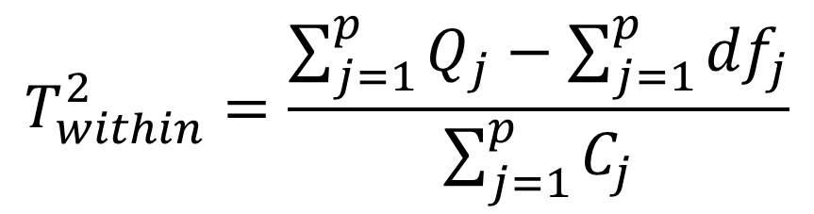
Random-Effects Model with Pooled Estimate of $τ^{2}$
The pooled estimate of $τ^{2}$, $τ_{within}^{2}$, is
Where
$$T_{within}^{2}=\frac{\sum_{j=1}^{p}{Q_{j}−\sum_{j=1}^{p}{{df}_{j}}}}{\sum_{j=1}^{p}{C_{j}}}$$
$$C=\sum{W_{i}}−\frac{\sum{W_{i}^{2}}}{\sum{W_{i}}}$$

Slide 22
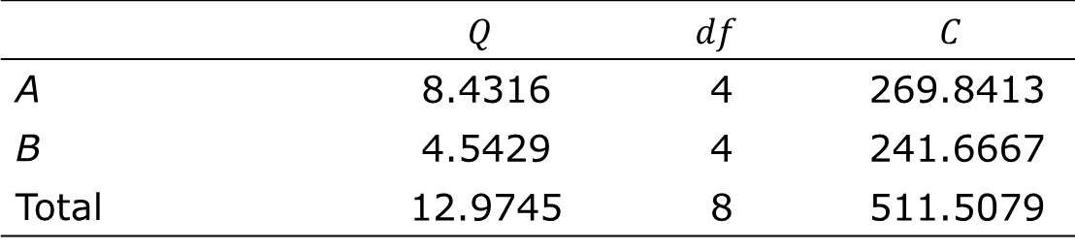
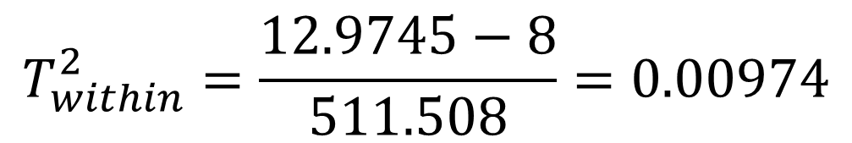
Random-Effects Model with Pooled Estimate of $τ^{2}$
 | $$Q$$ | $$df$$ | $$C$$
A | 8.4316 | 4 | 269.8413
B | 4.5429 | 4 | 241.6667
Total | 12.9745 | 8 | 511.5079
$$T_{within}^{2}=\frac{12.9745−8}{511.508}=0.00974$$

Slide 23
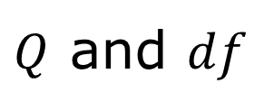
Random-Effects Model with Pooled Estimate of $τ^{2}$
$Q$ and $df$
Use A and B
and Total within

Slide 24
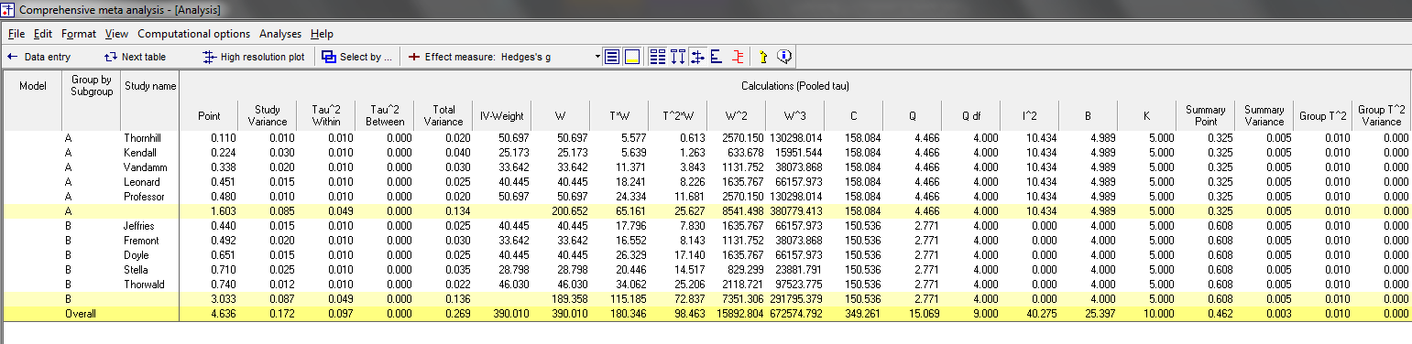
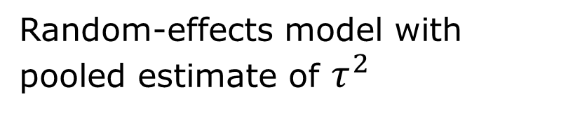
Random-Effects Model with Pooled Estimate of $τ^{2}$
Random-effects model with
pooled estimate of $τ^{2}$

Slide 25
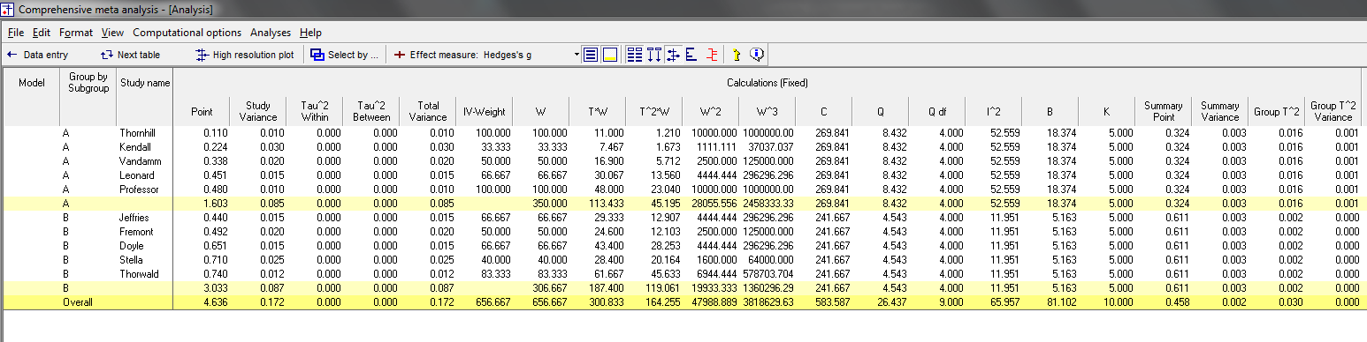
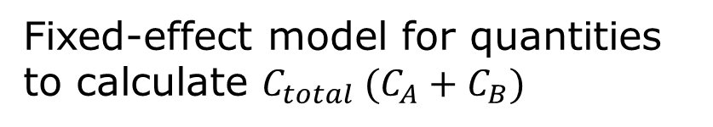

Random-Effects Model with Pooled Estimate of $τ^{2}$
Fixed-effect model for quantities to calculate $C_{total} (C_{A}+C_{B})$
$C_{A}$ and $C_{B}$

Slide 26
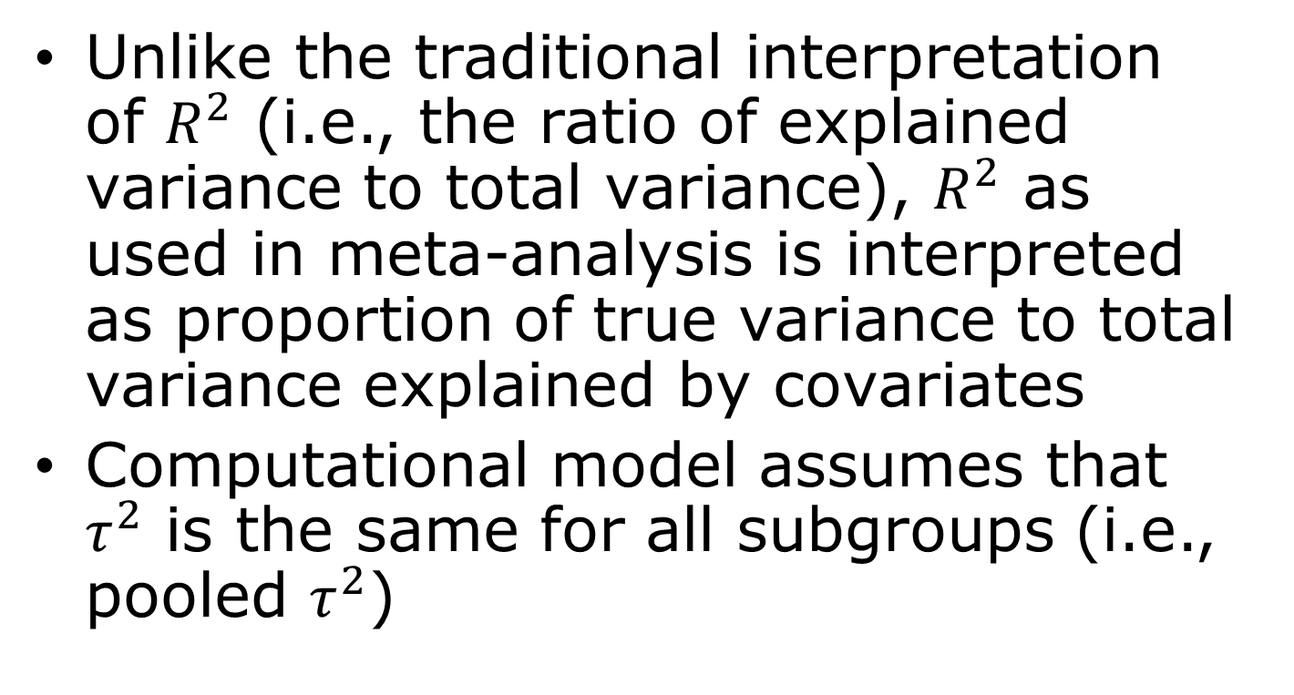
Proportion of Explained Variance
Unlike the traditional interpretation of $R^{2}$ (i.e., the ratio of explained variance to total variance), $R^{2}$ as used in meta-analysis is interpreted as proportion of true variance to total variance explained by covariates
Computational model assumes that $τ^{2}$ is the same for all subgroups (i.e., pooled $τ^{2}$)

Slide 27
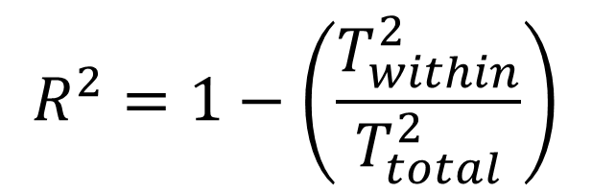
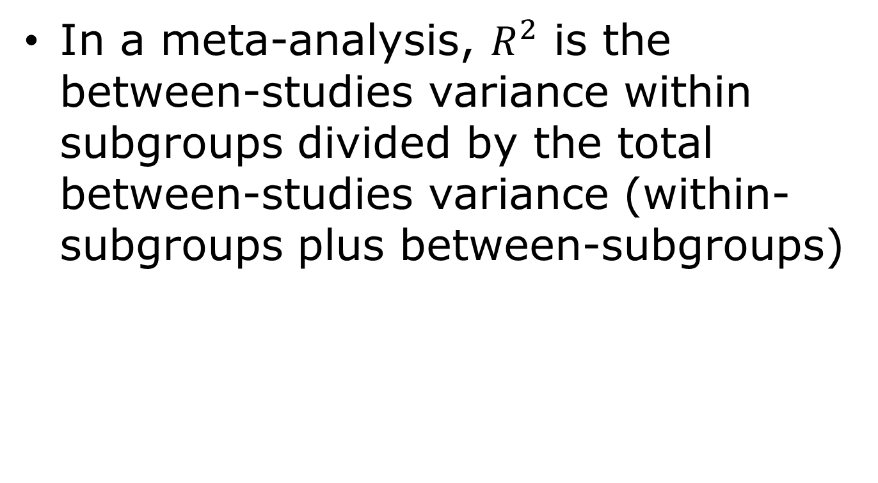
Proportion of Explained Variance
In a meta-analysis, $R^{2}$ is the between-studies variance within subgroups divided by the total between-studies variance (within-subgroups plus between-subgroups)
$$R^{2}=1−\left(\frac{T_{within}^{2}}{T_{total}^{2}}\right)$$

Slide 28
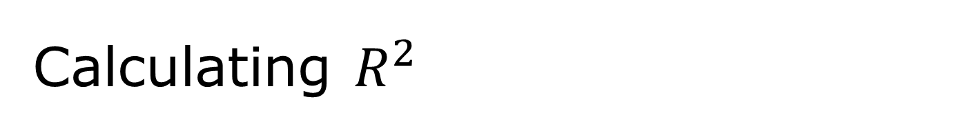
Calculating $R^{2}$
Random-effects model with
pooled estimate of $τ^{2}$

Slide 29
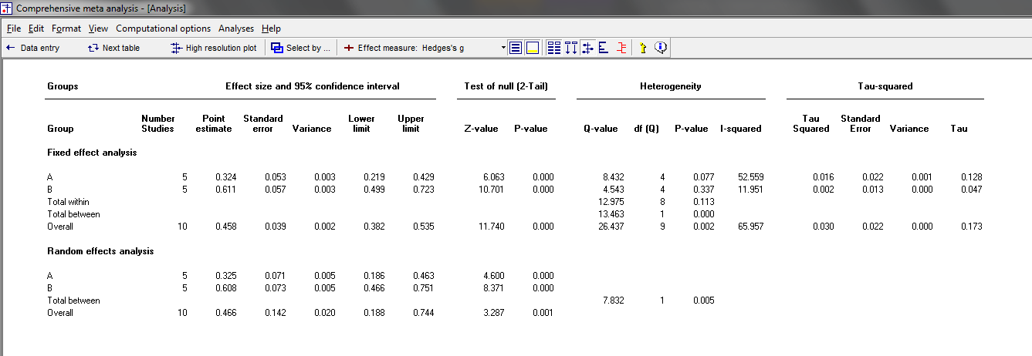

Calculating $R^{2}$
$$T_{total}^{2}$$

Slide 30
Variance Explained by Subgroup Membership

Slide 31
Summary Effects in Subgroup Analyses
Depends on questions and the nature of data
If question is one of superiority, best not to report a summary effect across subgroups
If question is one of equivalence, a summary effect across subgroups may or may not be warranted
Most important are substantive implications and what summary effect represents

Slide 32
Models for Subgroup Analyses
Three models
  Fixed-effect analysis: Fixed-effect model within and across subgroups
  Mixed-effect analysis: Random-effects model within subgroups and fixed-effect model across subgroups (generally recommended model)
  Fully random-effects analysis: Random-effects model within and across subgroups

Slide 33
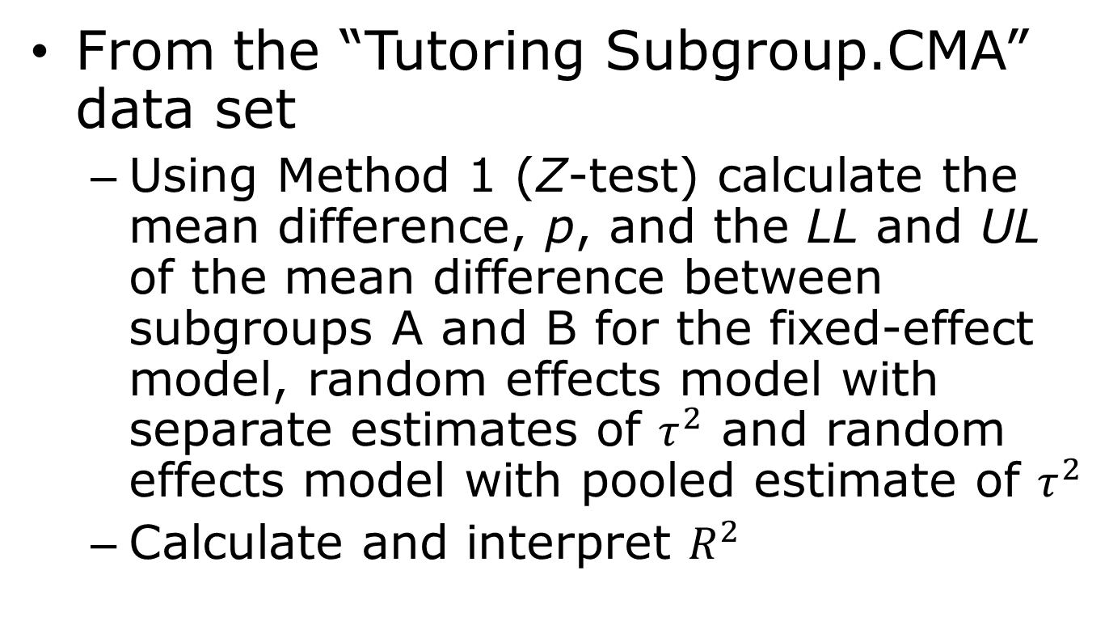
Today’s In-Class Activity
From the “Tutoring Subgroup.CMA” data set
  Using Method 1 (Z-test) calculate the mean difference, p, and the LL and UL of the mean difference between subgroups A and B for the fixed-effect model, random effects model with separate estimates of $τ^{2}$ and random effects model with pooled estimate of $τ^{2}$
  Calculate and interpret $R^{2}$

