Slide 1
EVAL 6970: Meta-Analysis
Meta-Regression and Complex Data Structures
Dr. Chris L. S. Coryn
Spring 2011

Slide 2
Agenda
Meta-regression
  In-class activity
Complex data structures
  In-class activity

Slide 3
Meta-Regression
Used to estimate the impact/influence of categorical and/or continuous covariates (moderators) on effect sizes or to predict effect sizes in studies with specific characteristics
A ratio of 10:1 (studies to covariates) is recommended

Slide 4
Fixed-Effect Model

Slide 5
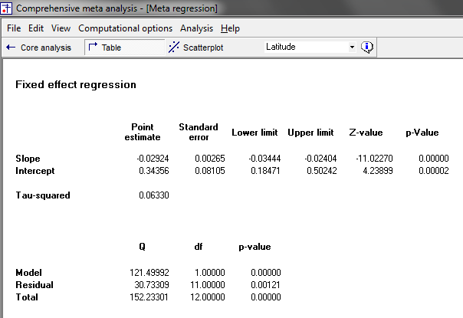
Fixed-Effect Model
ANOVA information

Slide 6
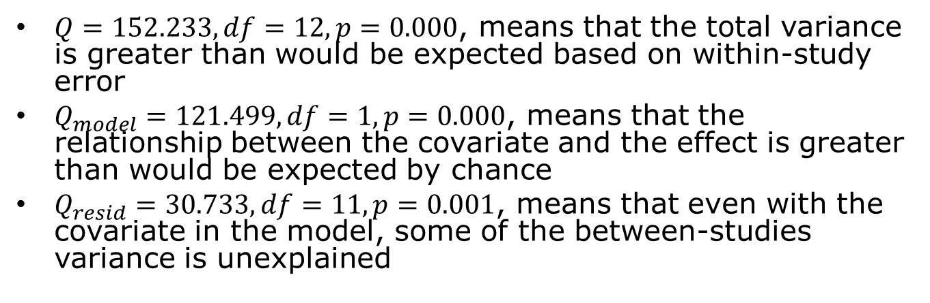
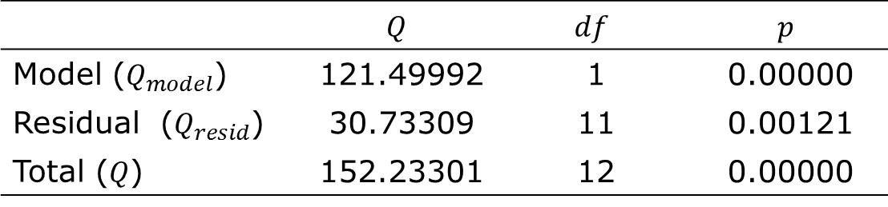
Fixed-Effect Model ANOVA Table
 | $$Q$$ | $$df$$ | $$p$$
Model ($Q_{model}$) | 121.49992 | 1 | 0.00000
Residual ($Q_{resid}$) | 30.73309 | 11 | 0.00121
Total ($Q$) | 152.23301 | 12 | 0.00000
$Q=152.233, df=12, p=0.000$, means that the total variance is greater than would be expected based on within-study error
$Q_{model}=121.499, df=1,p=0.000$, means that the relationship between the covariate and the effect is greater than would be expected by chance
$Q_{resid}=30.733,df=11,p=0.001$, means that even with the covariate in the model, some of the between-studies variance is unexplained

Slide 7
Random-Effects Model

Slide 8
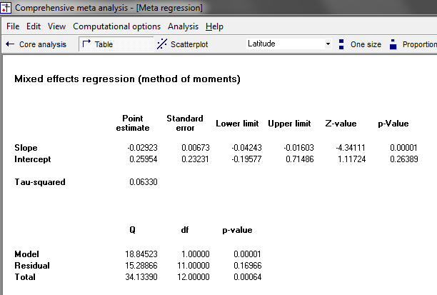
Random-Effects Model

Slide 9
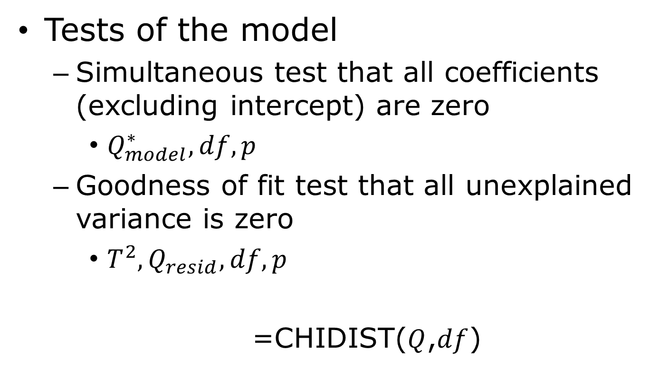
Random-Effects Model Fit
Tests of the model
  Simultaneous test that all coefficients (excluding intercept) are zero
    $Q_{model}^{∗}, df, p$
  Goodness of fit test that all unexplained variance is zero
    $T^{2},Q_{resid},df,p$
    =CHIDIST($Q$,$df$)

Slide 10
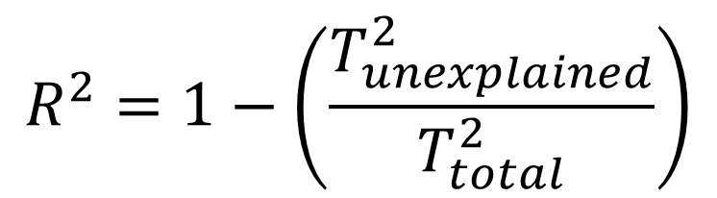
Proportion of Covariate Explained Variance
In meta-analysis, the total variance includes both variance within studies and between studies
Study-level covariates explain only the between-studies portion of the variance
$$R^{2}=1−\left(\frac{T_{unexplained}^{2}}{T_{total}^{2}}\right)$$

Slide 11
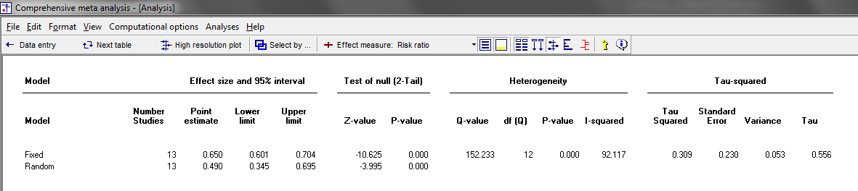
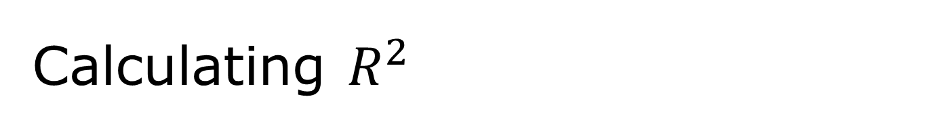

Calculating $R^{2}$
$$T_{total}^{2}$$
Use the fixed-effect meta-analysis results
(not meta-regression results)

Slide 12
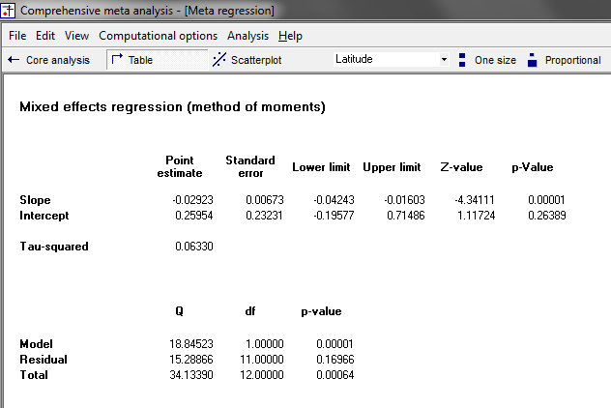

Calculating $R^{2}$
Results from random-effects
meta-regression using
method of moments
$$T_{unexplained}^{2}$$

Slide 13
Variance Explained by Covariate

Slide 14
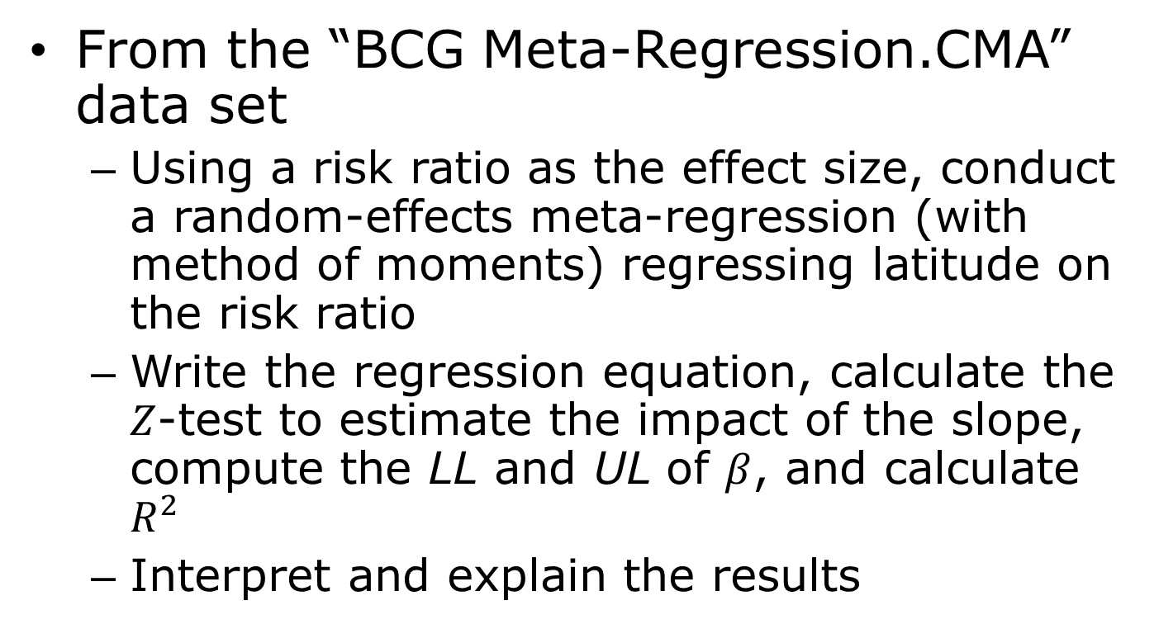
Today’s First In-Class Activity
From the “BCG Meta-Regression.CMA” data set
  Using a risk ratio as the effect size, conduct a random-effects meta-regression (with method of moments) regressing latitude on the risk ratio
  Write the regression equation, calculate the $Z$-test to estimate the impact of the slope, compute the LL and UL of $β$, and calculate $R^{2}$
  Interpret and explain the results

Slide 15
Complex Data Structures
Main categories of complex data structures
  Independent subgroups within a study
  Multiple outcomes or time-points within a study
  Multiple comparisons within a study
The first two are (relatively) easily handled in Comprehensive Meta-Analysis 2.0

Slide 16
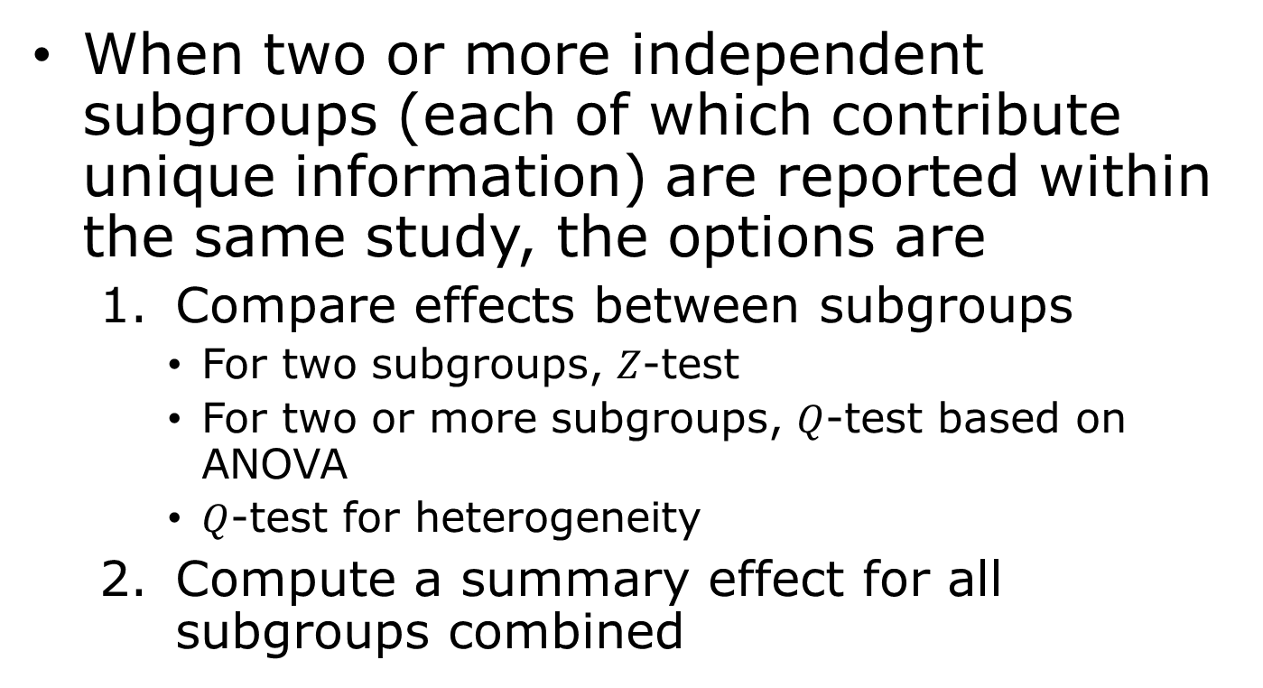
Independent Subgroups within a Study
When two or more independent subgroups (each of which contribute unique information) are reported within the same study, the options are
  Compare effects between subgroups
    For two subgroups, $Z$-test
    For two or more subgroups, $Q$-test based on ANOVA
    $Q$-test for heterogeneity
  Compute a summary effect for all subgroups combined

Slide 17
Combining Across Subgroups
Option 1a (effect size is computed within subgroups)
  Treat each subgroup as a separate study
    Interest is in between-subgroup variation
Option 1b (effect size is computed within studies)
  Compute a composite score and use the composite score for each study as the unit of analysis
    Interest is in between-study variation

Slide 18
Combining Across Subgroups
Option 2 (ignore subgroup membership)
  Collapse across subgroups to compute a summary effect size and variance
  Subgroup membership is considered unimportant and is ignored (and its variance is not part of the summary effect size or standard error)
  Essentially a main effect meta-analysis

Slide 19
Multiple Outcomes or Time-Points within a Study
When a study reports data on more than one outcome, or over more than one time-point, where outcomes or time-points are based on the same participants (i.e., dependent), the options are
  Compute a composite effect size accounting for the correlation between outcomes or time-points
  Compute a difference between outcomes or time-points accounting for the correlation between outcomes or time-points

Slide 20
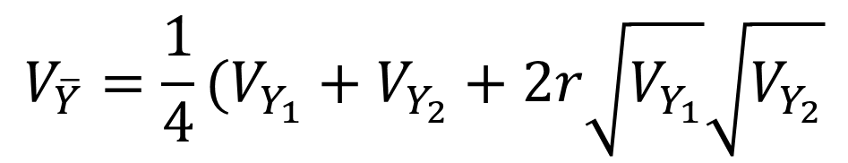

Combining Outcomes or Time-Points
The effect size for two outcomes or time-points is computed as
With variance of the combined mean
$$\overline{Y}=\frac{1}{2}(Y_{1}=Y_{2})$$
$$V_{\overline{Y}}=\frac{1}{4}(V_{Y_{1}}+V_{Y_{2}}+2r\sqrt{V_{Y_{1}}}\sqrt{V_{Y_{2}}}$$

Slide 21
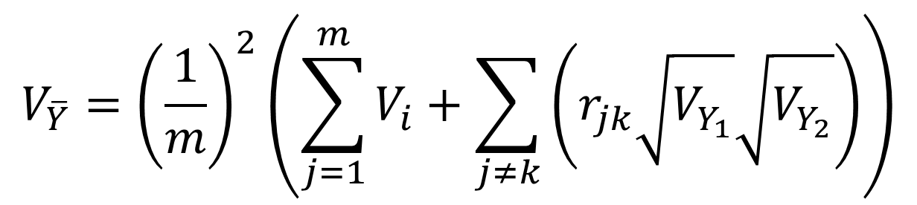

Combining Outcomes or Time-Points
For more than two outcomes or time-points
With variance of
$$\overline{Y}=\frac{1}{m}\left(\sum_{j}^{m}{Y_{j}}\right)$$
$$V_{\overline{Y}}={\left(\frac{1}{m}\right)}^{2}\left(\sum_{j=1}^{m}{V_{i}+\sum_{j≠k}{\left(r_{jk}\sqrt{V_{Y_{1}}}\sqrt{V_{Y_{2}}}\right)}}\right)$$

Slide 22
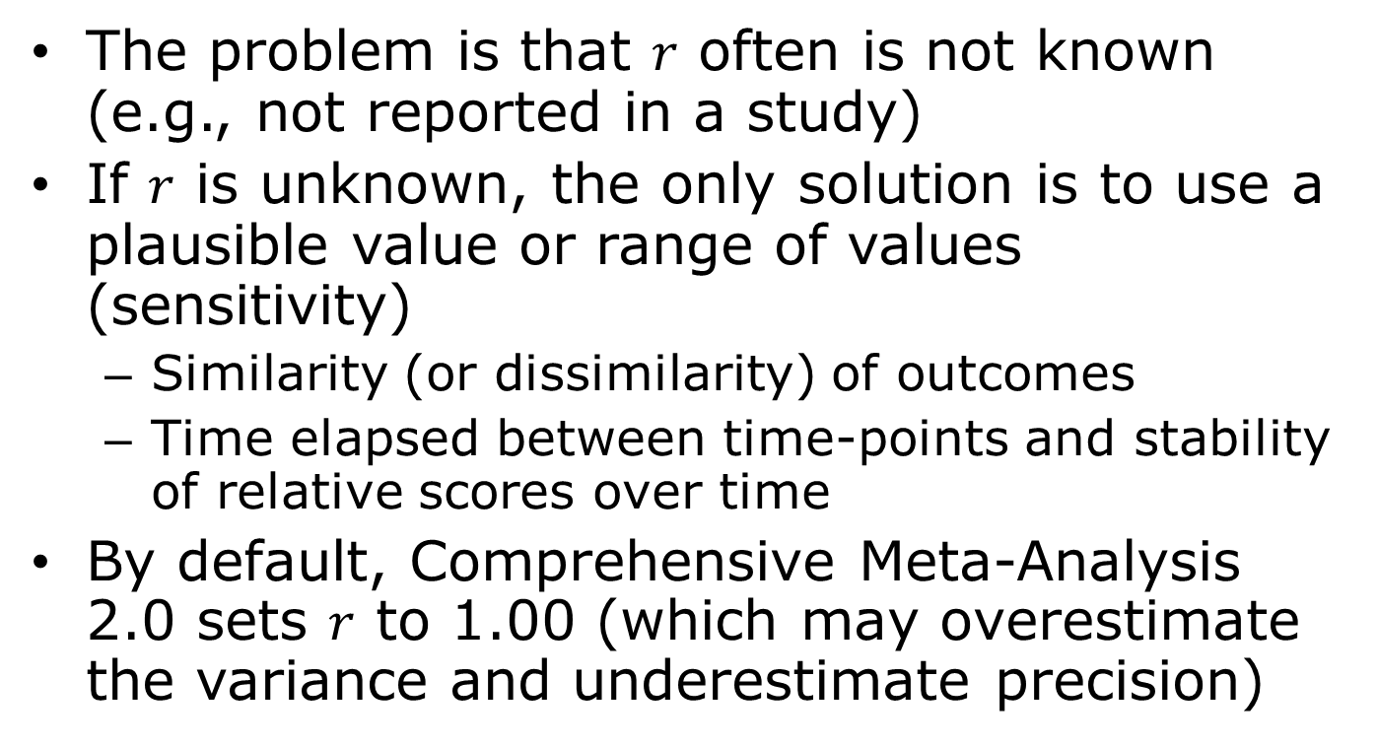
Combining Outcomes or Time-Points
The problem is that $r$ often is not known (e.g., not reported in a study)
If $r$ is unknown, the only solution is to use a plausible value or range of values (sensitivity)
  Similarity (or dissimilarity) of outcomes
  Time elapsed between time-points and stability of relative scores over time
By default, Comprehensive Meta-Analysis 2.0 sets $r$ to 1.00 (which may overestimate the variance and underestimate precision)

Slide 23
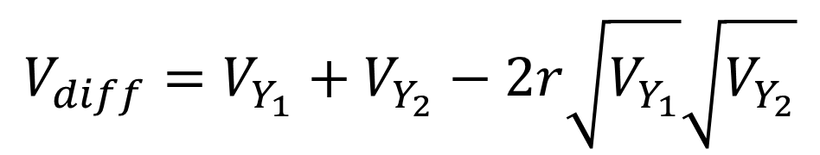
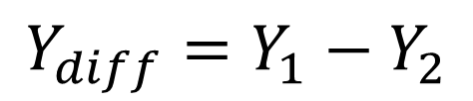
Comparing Outcomes or Time-Points within a Study
The effect size for the difference between two outcomes or time-points is computed as
With variance
$$Y_{diff}=Y_{1}−Y_{2}$$
$$V_{diff}=V_{Y_{1}}+V_{Y_{2}}−2r\sqrt{V_{Y_{1}}}\sqrt{V_{Y_{2}}}$$

Slide 24
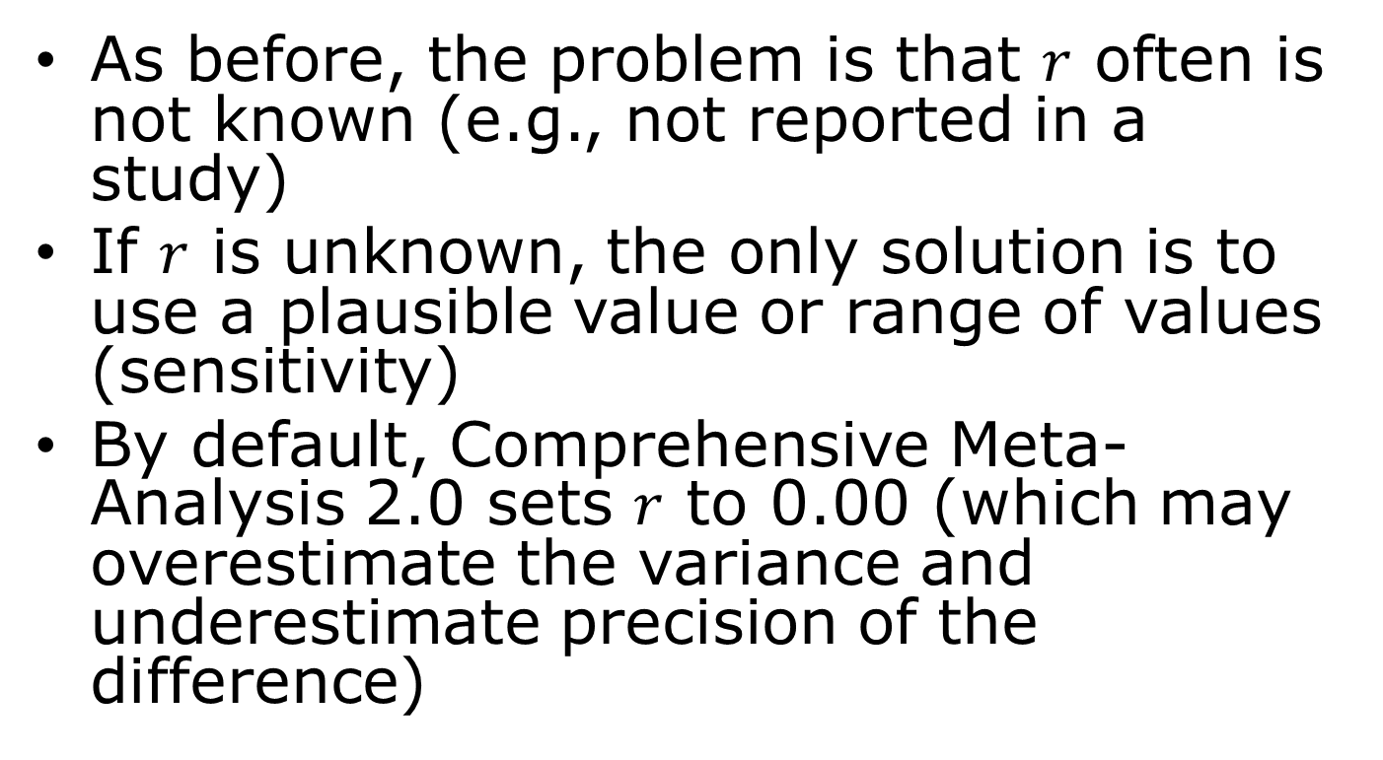
Comparing Outcomes or Time-Points
As before, the problem is that $r$ often is not known (e.g., not reported in a study)
If $r$ is unknown, the only solution is to use a plausible value or range of values (sensitivity)
By default, Comprehensive Meta-Analysis 2.0 sets $r$ to 0.00 (which may overestimate the variance and underestimate precision of the difference)

Slide 25
Multiple Comparisons within a Study
When a study reports multiple comparisons between more than two (dependent) groups (e.g., treatment variant A, treatment variant B, and control group C), the options are
  Compute a summary effect for the active intervention (combing A and B) versus control (C); the same as option 2 for independent subgroups
  Compute a difference for interventions A and B (ignoring C)

Slide 26
Today’s Second In-Class Activity
From the “Complex Data Structures Multiple Outcomes or Time-Points.CMA” data set
  Conduct fixed-effect analyses (1) using composite effect sizes within studies and (2) treating each outcome as the unit of analysis
  Interpret and explain both analyses (including all relevant statistical tests)

