Slide 1
EVAL 6970: Meta-Analysis
Vote Counting, The Sign Test, Power, Publication Bias, and Outliers
Dr. Chris L. S. Coryn
Spring 2011

Slide 2
Agenda
Vote counting and the sign test
  In-class activity
Statistical power
Publication bias
  In-class activity
Outlier analysis
  In-class activity

Slide 3
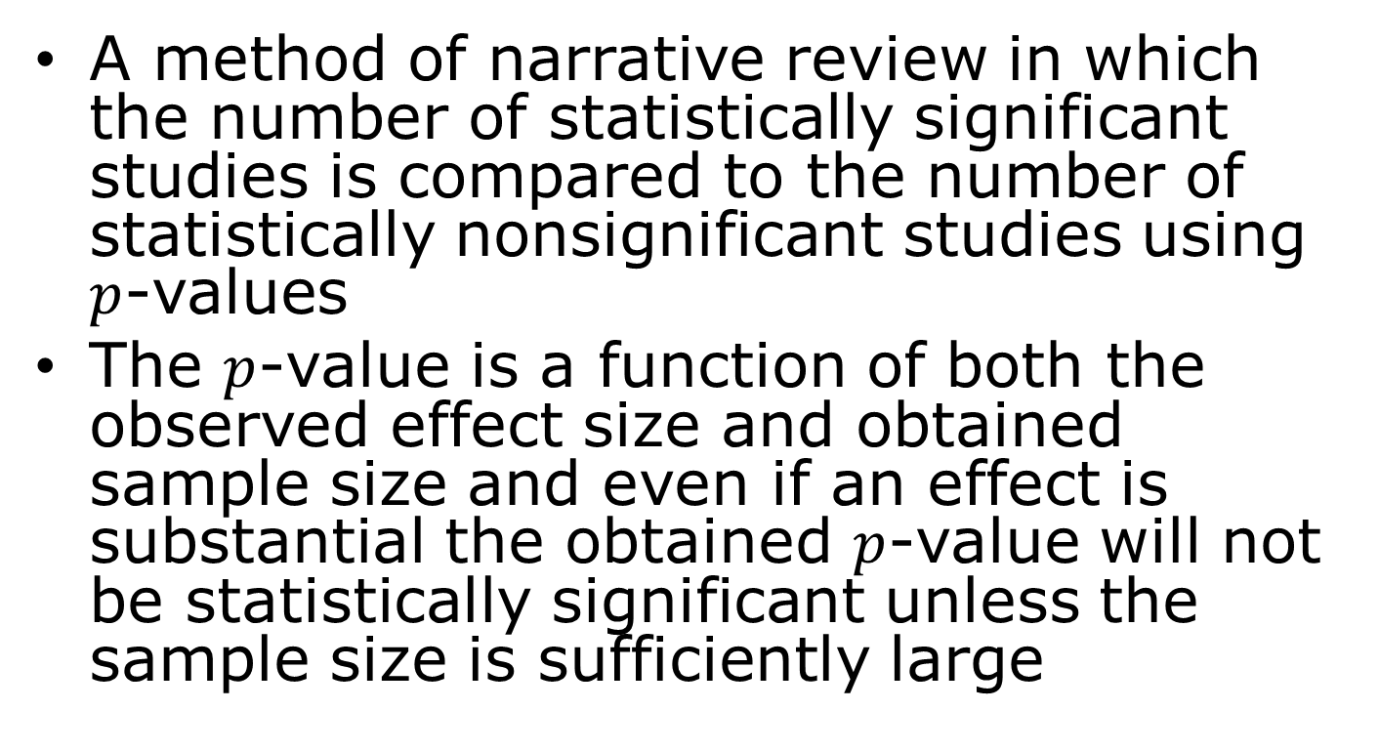
Vote Counting
A method of narrative review in which the number of statistically significant studies is compared to the number of statistically nonsignificant studies using $p$-values
The $p$-value is a function of both the observed effect size and obtained sample size and even if an effect is substantial the obtained $p$-value will not be statistically significant unless the sample size is sufficiently large

Slide 4
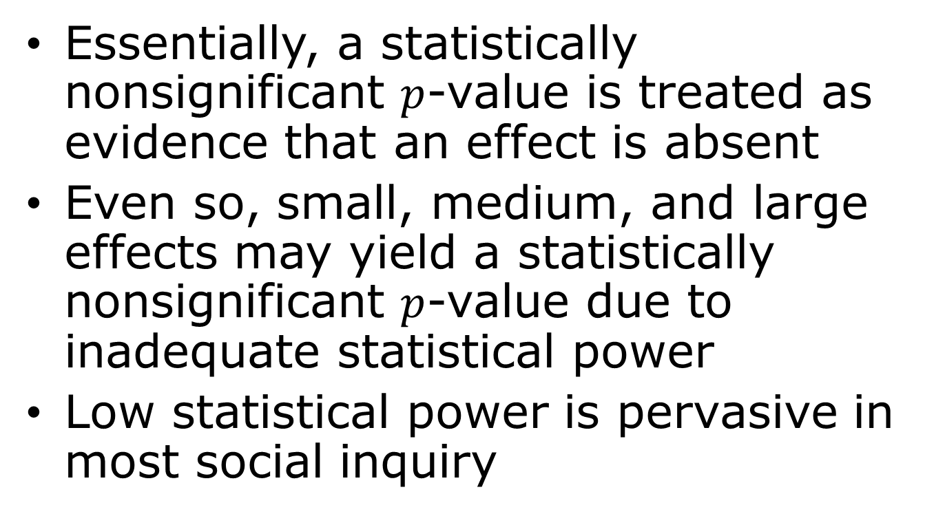
Vote Counting
Essentially, a statistically nonsignificant $p$-value is treated as evidence that an effect is absent
Even so, small, medium, and large effects may yield a statistically nonsignificant $p$-value due to inadequate statistical power
Low statistical power is pervasive in most social inquiry

Slide 5
The Sign Test
Similar to the vote counting method, the sign test is used to count the number of studies with findings in one direction compared to the number of findings in the other direction irrespective of whether the findings are statistically significant
If a treatment were truly ineffective, it would be expected that half of the studies would lie on each side of the no-effect line

Slide 6
The Sign Test
The sign test is considered a valid approach when
  No numeric data are provided from studies, but directions of effects are provided
  Numeric data are of such different types that they cannot be combined statistically
  Studies are so diverse in their populations or other characteristics that a pooled effect size is meaningless, but studies are addressing a questions sufficiently similar that the direction of effect is meaningful

Slide 7
The Sign Test
The sign test takes into account neither the actual effect’s magnitudes observed in studies nor the amount of evidence within studies (e.g., sample sizes and precision)
Can be tested for statistical significance
=2*BINOMDIST(n,N,0.5,TRUE)
With n of the smaller two numbers

Slide 8
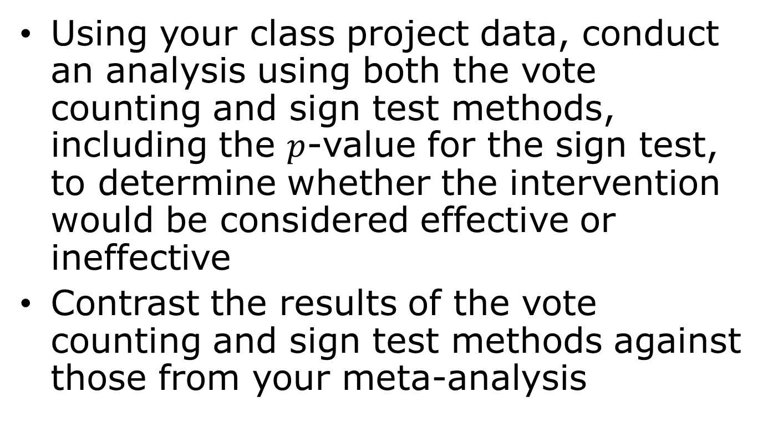
First In-Class Activity
Using your class project data, conduct an analysis using both the vote counting and sign test methods, including the $p$-value for the sign test, to determine whether the intervention would be considered effective or ineffective
Contrast the results of the vote counting and sign test methods against those from your meta-analysis

Slide 9


Type I and Type II Error
Type I Error
(false-positive)
Type II Error
(false-negative)
You’re not pregnant
You’re pregnant

Slide 10
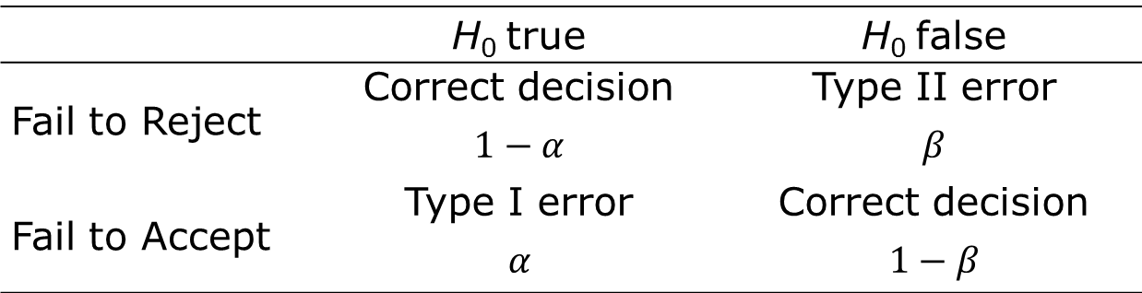
Type I and Type II Error
 | H₀ true | H₀ false
Fail to Reject | Correct decision $$1−α$$ | Type II error $$β$$
Fail to Accept | Type I error $$α$$ | Correct decision $$1−β$$

Slide 11

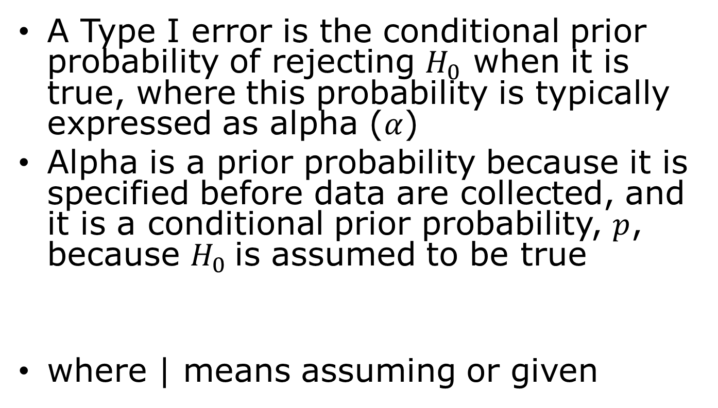
Statistical Power
A Type I error is the conditional prior probability of rejecting $H_{0}$ when it is true, where this probability is typically expressed as alpha ($α$)
Alpha is a prior probability because it is specified before data are collected, and it is a conditional prior probability, $p$, because $H_{0}$ is assumed to be true
where | means assuming or given
$$α=p\left(Reject H_{0}\text{|}H_{0} true\right)$$

Slide 12
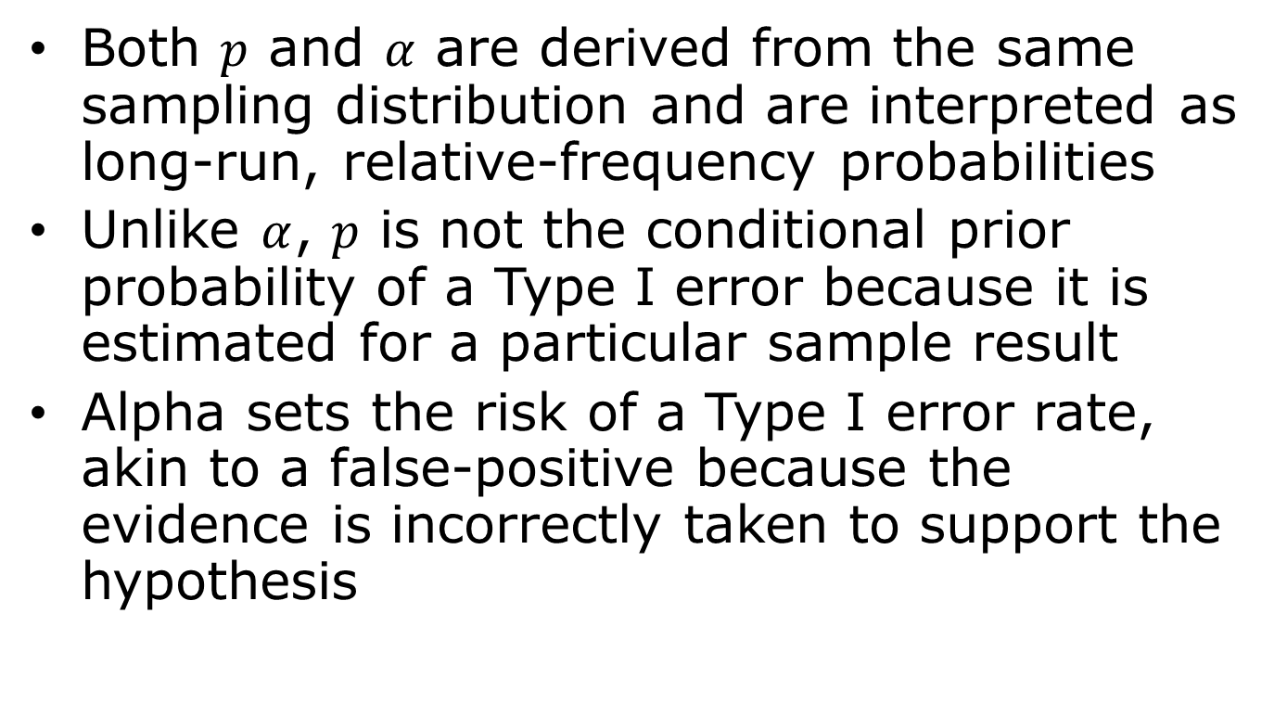
Statistical Power
Both $p$ and $α$ are derived from the same sampling distribution and are interpreted as long-run, relative-frequency probabilities
Unlike $α$, $p$ is not the conditional prior probability of a Type I error because it is estimated for a particular sample result
Alpha sets the risk of a Type I error rate, akin to a false-positive because the evidence is incorrectly taken to support the hypothesis

Slide 13

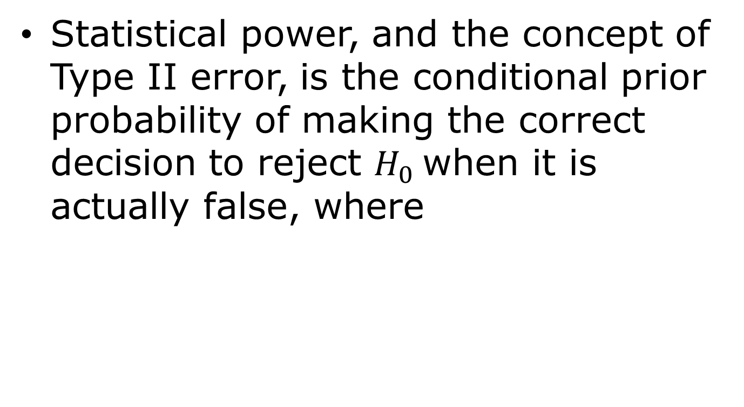
Statistical Power
Statistical power, and the concept of Type II error, is the conditional prior probability of making the correct decision to reject $H_{0}$ when it is actually false, where
$$Power=p\left(Reject H_{0}\text{|}H_{0} false\right)$$

Slide 14
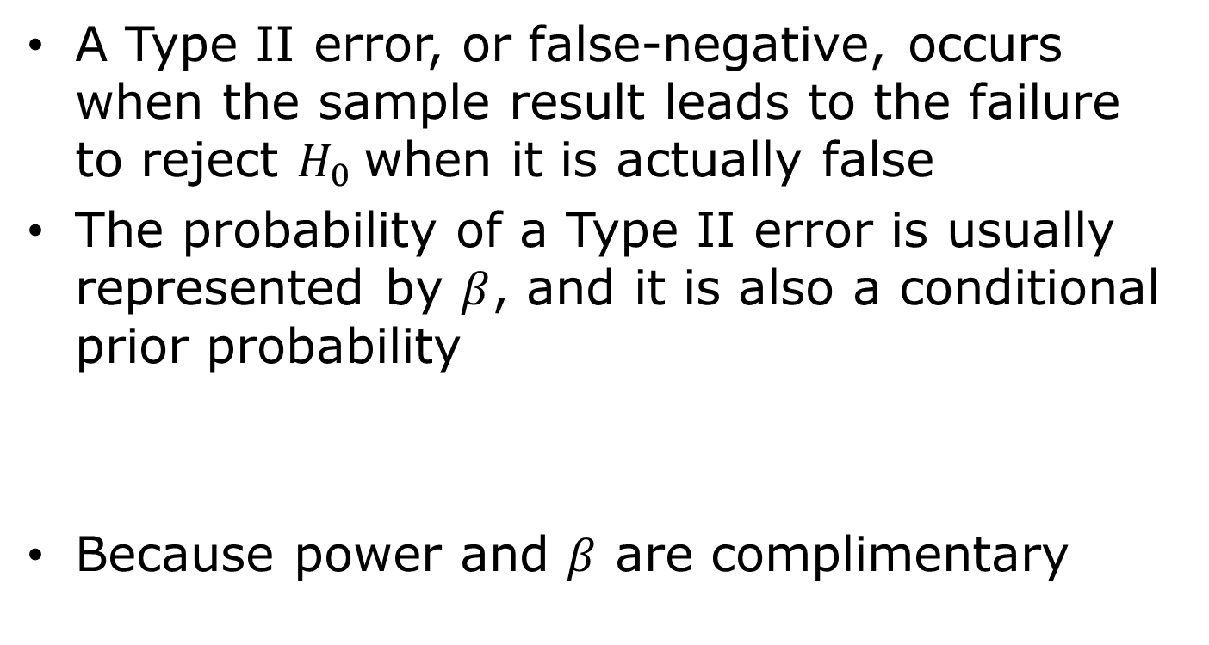

Statistical Power
A Type II error, or false-negative, occurs when the sample result leads to the failure to reject $H_{0}$ when it is actually false
The probability of a Type II error is usually represented by $β$, and it is also a conditional prior probability
Because power and $β$ are complimentary
$$β=p\left(Fail to reject H_{0}\text{|}H_{0} false\right)$$
$$Power+β=1.00$$
Notes:
Whatever increases power decreases the probability of a Type II error and vice versa

Slide 15


Power for Fixed-Effect Model
The test for significance for the main effect
For a two-tailed test where
$$Z=\frac{M}{\sqrt{V_{M}}}$$
$$p=2\left[1−\left(Φ\text{|}Z\text{|}\right)\right]$$

Slide 16

Power for Fixed-Effect Model
Which is based on
Where
See pages 268-269 for a worked example
$$λ=\frac{δ}{\sqrt{V_{δ}}}$$
$$Power=1−Φ\left(c_{α}−λ\right)+Φ\left(−c_{α}−λ\right)$$

Slide 17


Power for Random-Effects Model
The test for significance for the main effect
For a two-tailed test where
$$Z^{∗}=\frac{M^{∗}}{\sqrt{V_{M^{∗}}}}$$
$$p^{∗}=2\left[1−\left(Φ\text{|}Z^{∗}\text{|}\right)\right]$$

Slide 18


Power for Random-Effects Model
Which is based on
With
$$λ^{∗}=\frac{δ^{∗}}{\sqrt{V_{δ^{∗}}}}$$
$$V_{δ}^{∗}=\frac{V_{Y}+τ^{2}}{k}$$

Slide 19
Power for Random-Effects Model
Where
See pages 271-272 for a worked example
$$Power=1−Φ\left(c_{α}−λ^{∗}\right)+Φ\left(−c_{α}−λ^{∗}\right)$$

Slide 20
Publication Bias
Publication bias is concerned with biases that arise from missing studies in a meta-analysis
  If missing studies are a random subset of all relevant studies, failure to include these studies will result in less information, wider confidence intervals, and less powerful tests
  If missing studies are systematically different from located studies, then the sample of studies will be biased

Slide 21
Publication Bias
Publication bias methods are used to determine if bias is likely, the impact of bias, and to make adjustments
If these methods are used to estimate an adjusted effect to remove bias, one of three situations potentially arise
  The resulting effect is essentially unchanged
  The effect changes, but the basic conclusion remains unaffected
  The basic conclusion is called into question

Slide 22
Publication Bias
The models used to assess publication bias assume
  Large studies are likely to be published regardless of statistical significance
  Moderately-sized studies are at risk for being lost, but with moderate sample sizes even modest effects will be statistically significant, and so only some of these studies will be lost
  Small studies are at the greatest risk of being lost
    Because of small sample sizes only very large effects are likely to be significant and those with small and moderate effects are likely to be unpublished

Slide 23
Funnel Plot of Standard Error

Slide 24
Funnel Plot of Precision

Slide 25
Evidence of Bias
From the funnel plots
  In the absence of publication bias the studies will be distributed symmetrically about the combined effect size
  In the presence of bias, the bottom of the plot would tend to show a higher concentration of studies on one side of the mean than the other
  This would reflect the fact that smaller studies (which appear toward the bottom) are more likely to be published if they have larger than average effects, which makes them more likely to meet the criterion for statistical significance

Slide 26
Estimate of the Unbiased Effect Size: Trim and Fill
Duval and Tweedie’s Trim and Fill builds on the idea behind the funnel plot; that in the absence of bias the plot would be symmetric about the summary effect
If there are more small studies on the right than on the left, the concern is that studies may be missing from the left
The Trim and Fill procedure imputes these missing studies, adds them to the analysis, and then re-computes the summary effect size

Slide 27
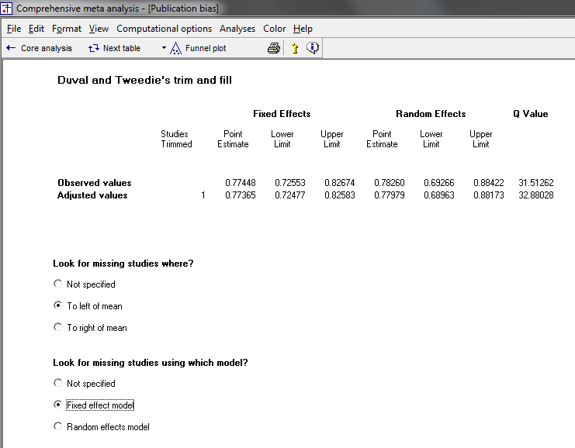
Estimate of the Unbiased Effect Size: Trim and Fill
Here, there is one imputed missing study

Slide 28
Estimate of the Unbiased Effect Size: Trim and Fill
Imputed summary effect
Imputed study

Slide 29
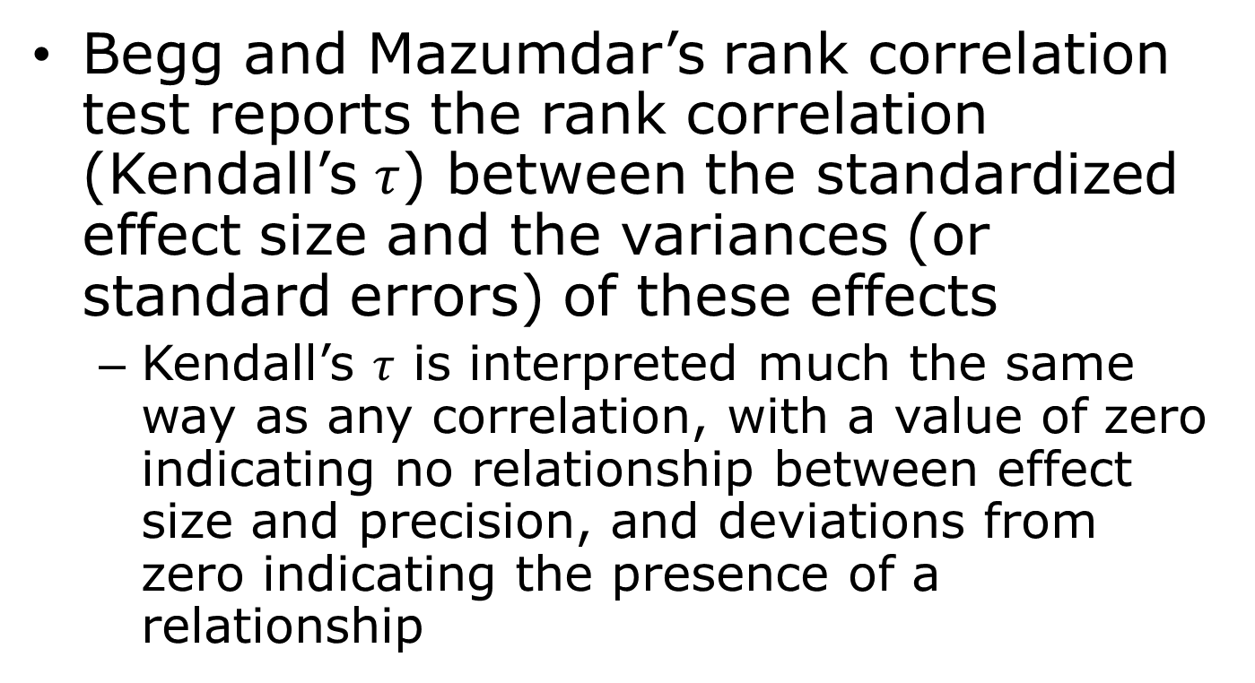
Correlation and Regression Methods
Begg and Mazumdar’s rank correlation test reports the rank correlation (Kendall’s $τ$) between the standardized effect size and the variances (or standard errors) of these effects
  Kendall’s $τ$ is interpreted much the same way as any correlation, with a value of zero indicating no relationship between effect size and precision, and deviations from zero indicating the presence of a relationship

Slide 30
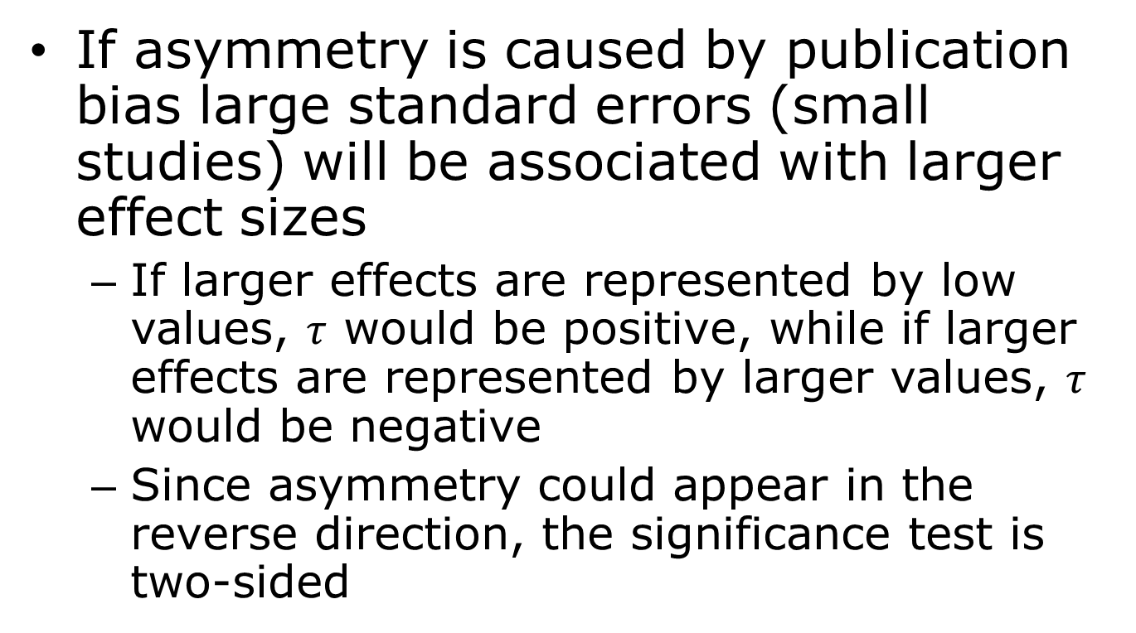
Correlation and Regression Methods
If asymmetry is caused by publication bias large standard errors (small studies) will be associated with larger effect sizes
  If larger effects are represented by low values, $τ$ would be positive, while if larger effects are represented by larger values, $τ$ would be negative
  Since asymmetry could appear in the reverse direction, the significance test is two-sided

Slide 31
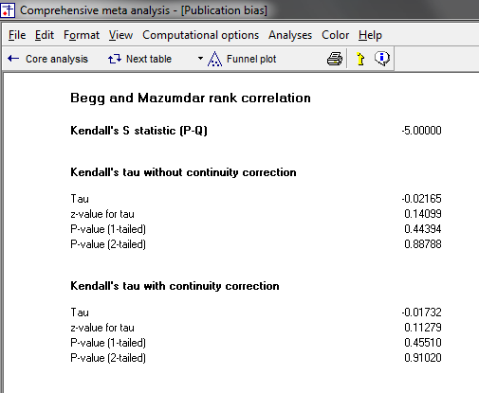
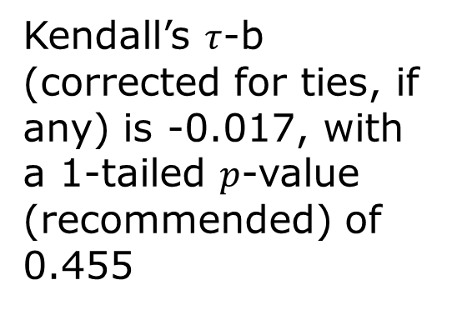
Correlation and Regression Methods
Kendall’s $τ$-b (corrected for ties, if any) is -0.017, with a 1-tailed $p$-value (recommended) of 0.455

Slide 32
Correlation and Regression Methods
Egger’s linear regression method, like the rank correlation test, quantifies the bias captured by the funnel plot using the actual values of the effect sizes and their precision
In the Egger test, the standardized effect (effect size divided by standard error) is regressed on precision (inverse of standard error)
Small studies generally have a precision close to zero, due to their large standard error

Slide 33
Correlation and Regression Methods
In the absence of bias such studies would be associated with small standardized effects and large studies associated with large standardized effects
  This would create a regression line whose intercept approaches the origin
  If the intercept deviates from this expectation, publication bias may be the cause
    This would occur when small studies are disproportionately associated with larger effect sizes

Slide 34
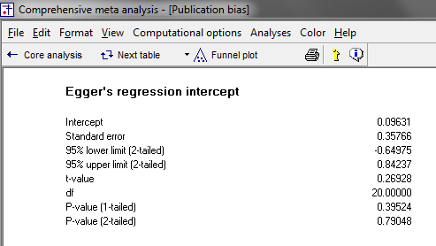
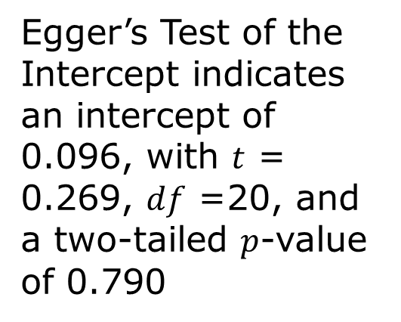
Correlation and Regression Methods
Egger’s Test of the Intercept indicates an intercept of 0.096, with $t$ = 0.269, $df$ =20, and a two-tailed $p$-value of 0.790

Slide 35
Fail-Safe N
Rosenthal’s Fail-Safe N test computes the number of missing studies (with mean effect of zero) that would need to be added to the analysis to yield a statistically nonsignificant overall effect
The Orwin variant of this test addresses two problems with Rosenthal’s method; that it focuses on statistical rather than clinical significance, and that it assumes a nil overall effect in the missing studies

Slide 36
Fail-Safe N
Orwin’s test allows for selecting both the smallest effect value deemed to be clinically important and a value other than nil for the mean effect in the missing studies
This method can be used to model a series of other distributions for missing studies
All Fail-Safe N methods lead to widely varying estimates

Slide 37
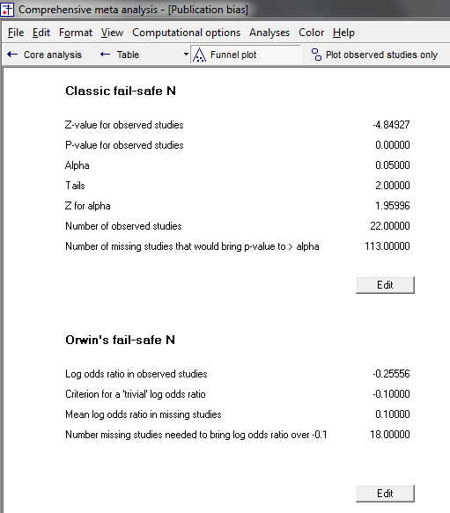
Fail-Safe N
Rosenthal’s Fail-Safe N
Orwin’s Fail-Safe N

Slide 38
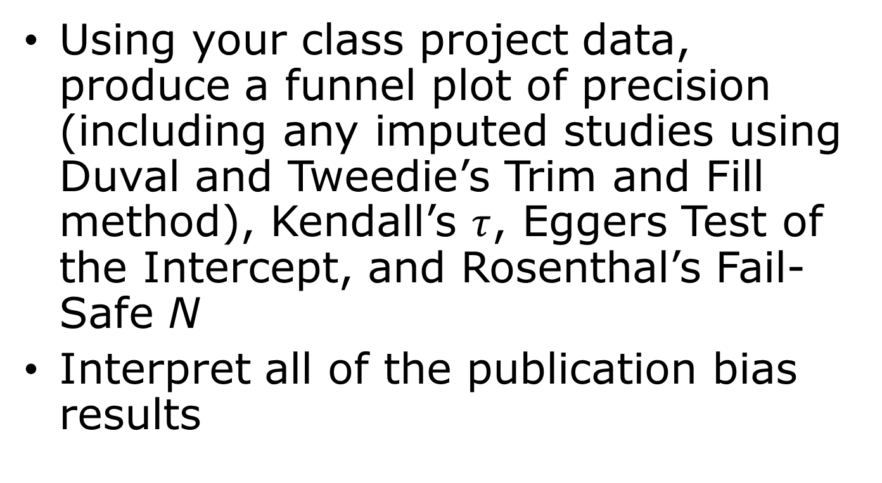
Second In-Class Activity
Using your class project data, produce a funnel plot of precision (including any imputed studies using Duval and Tweedie’s Trim and Fill method), Kendall’s $τ$, Eggers Test of the Intercept, and Rosenthal’s Fail-Safe N
Interpret all of the publication bias results

Slide 39
Outlier Analysis
An outlier is an observation that is numerically distant from the rest of the data; that is, a value that appears to deviate markedly from other members of the sample in which it occurs
Identification of outliers serves multiple purposes and in the context of meta-analysis can most usefully be used as part of a sensitivity analysis that includes meta-analyses with and without outliers (i.e., removed from the analysis)

Slide 40

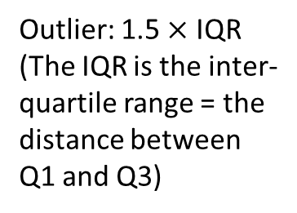
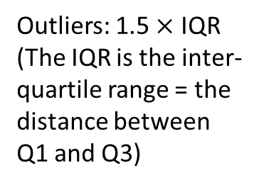
Outlier Analysis
Outlier: 1.5 $×$ IQR (The IQR is the inter-quartile range = the distance between Q1 and Q3)
Upper fence/whisker: Greatest value excluding outliers
Q3 (Upper quartile, 0.75): 25% of data greater than this value
Median (0.50)
Q1 (Lower quartile, 0.25): 25% of data less than this value
Lower fence/whisker: Least value excluding outliers
Outliers: 1.5 $×$ IQR (The IQR is the inter-quartile range = the distance between Q1 and Q3)

Slide 41
Third In-Class Activity
Using your class project data, conduct a statistical outlier analysis on the study effect sizes
If there are outliers, estimate the summary effect including all studies as well as excluding statistical outliers
  How similar or dissimilar are the summary effects?

